Slide 1
Status and Outlook
Evaluating CFSR Air-Sea Heat, Freshwater, and Momentum Fluxes in the context of the Global Energy and Freshwater Budgets
PI: Lisan Yu, Woods Hole Oceanographic Institution
Co-I: Yan Xue, Climate Prediction Center, NOAA
Five themes:
Global ocean water cycle and budget in atmospheric reanalysis
Ocean-surface energy budget in atmospheric reanalysis
Tropical ocean-surface winds in atmospheric reanalysis
Impact of uncertainties in reanalysis surface fluxes on tropical ocean simulations
High-latitude Fluxes – A broadened scope
MAPP Climate Reanalysis Task Force (CRTF)
Telecon, June 29th, 2016

Slide 2
Theme 1. Ocean-surface Freshwater Budget in Reanalysis
Yu, L. X. Jin, S. A. Josey, T. Lee, A. Kumar, C. Wen, and Y. Xue, 2016: The global ocean water cycle in atmospheric reanalysis, satellite, and ocean salinity. J. Climate, Submitted.
Global ocean-surface E-P = 11 ± 4 (36%) cm/yr
(not including ERA40)
The large uncertainty is due to the large uncertainty in tropical precipitation
The E-P budget is proportional to the E/P ratio

Slide 3
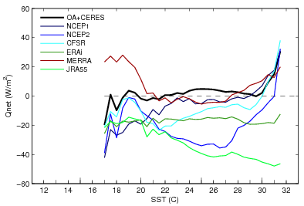
Theme 2. Ocean-surface Energy Budget in Reanalysis
The work on “The ocean-surface energy budget in atmospheric reanalysis, satellite, and at air-sea flux buoy sites” is currently underway.
The large uncertainty is due to the large uncertainty in tropical Qnet
Global ocean-surface Qnet = 10 ± 7 (70%) W/m²
(not including JRA55)
29°C
Distribution of DIFF (product – buoy) with SST
Buoy evaluation indicates the Qnet estimates have a SST dependence

Slide 4
Theme 3. Tropical Ocean-surface Winds in Reanalysis
Wind Stress Curl
Mean average 11/2007-10/2009
Although most reanalyses assimilate scatterometer observations, they do not look like satellite winds.
Uncertainty in tropical winds is influenced by model physics

Slide 5
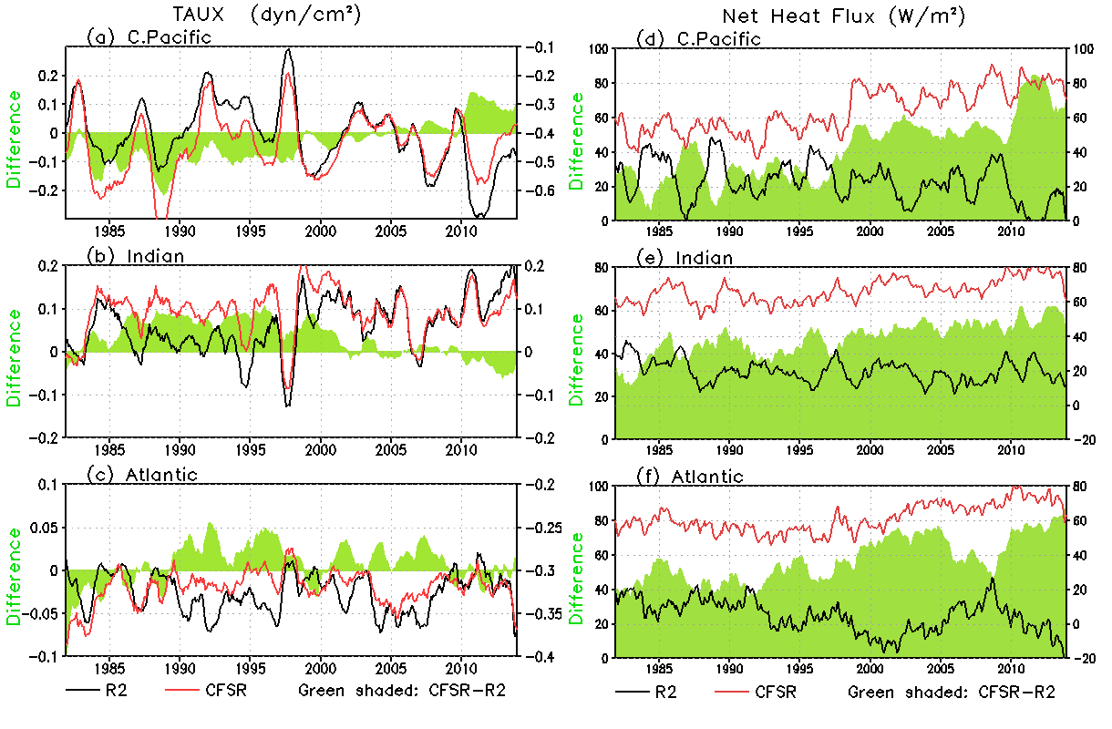
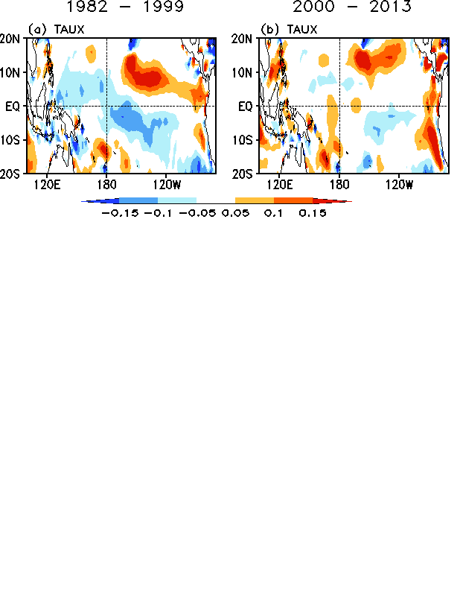
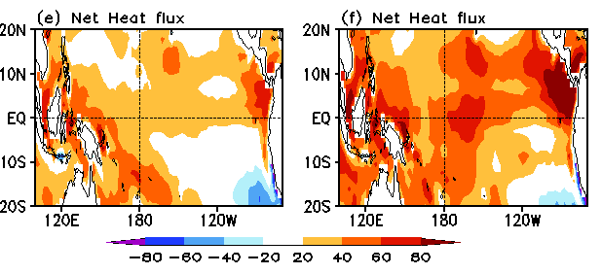
Theme 4. Impact of uncertainties in NCEP R2 and CFSR surface fluxes on tropical ocean simulations
Wen, C., Y. Xue, A. Kumar, D. Behringer, and L. Yu, 2016: How do uncertainties in NCEP R2 and CFSR surface fluxes impact tropical ocean simulations? Climate Dynamics. Submitted.
CFSR – R2 (shade)
CFSR – R2
CFSR – R2
Trade winds in CFSR were too strong before 2000; Net heat fluxes into ocean were much larger in CFSR than in R2 after 2000
CFSR wind stress are generally superior to R2 wind stress after 2000 in forcing a control simulation that provides background fields for ocean data assimilation

Slide 6
Theme 5. High-latitude Fluxes – A broadened scope
Yu, L., X. Jin, E. Schultz, and S. Josey, 2016: Surface heat budget in the Southern open ocean and the Antarctic marginal ice zone: Ship observations versus satellite and atmospheric reanalysis products. To be submitted.
Qnet seasonal STD
All products show strong Qnet variances in the seasonal marginal ice zone
However, air-sea measurements obtained from the Australian icebreaker suggest that reanalysis has wrong thermodynamics in the marginal ice zone: enhanced LW loss is used in a place where sensible heat loss (due to strong air-sea temperature contrast) should be large.

Slide 7
Current Status and Future Perspectives
Current status:
- During the past three years, our team has worked on five broad topics.
- We have produced detailed assessments of the uncertainty issues in atmospheric reanalysis in general and with particular focus on CFSR.
- We found that
Main source of the uncertainties in the global ocean-surface energy and freshwater budgets in atmospheric reanalysis resides in the tropics (precipitation, clouds, surface LW)
Reanalysis converges to a pattern that is influenced more by model physics and less by data assimilation.
(3) The state-of-the-art reanalyses (CFSR, ERA-interim, JRA55, and MERRA-2) do not necessarily represent an improvement of the ocean energy and water budgets.
Future perspectives:
Climate reanalysis progresses toward higher resolution, fully engaged land, ocean, atmosphere, and cryosphere system. Key dynamical regimes that need to be fully investigated and understood including
(1) land-atmosphere-ocean interactions
(2) Ice-atmosphere-ocean interactions

