Slide 1
Stratosphere Issues in the CFSR
All Reanalyses have issues:
Capturing the QBO zonal wind transitions from Westerly > Easterly and Easterly > Westerly as they occur in nature.
There are delays in these transitions in the various reanalyses.
Transition from TOVS(SSU+MSU) to ATOVS(AMSU) in 1998.
Depending upon several factors (RTM, forecast model bias, model top and number of model levels in stratosphere, immediate or gradual transition) the transition can result as a jump in upper stratosphere temperatures or a subtle transition of temperatures.
Specific to the CFSR:
Bias correction of SSU channel 3 resulted in jumps at beginning of each stream.
Poor representation of QBO in 1980’s
Poor representation of SAO throughout the entire reanalysis
Warm bias in upper stratosphere compared to other reanalyses
CFSR did not assimilate AMSU-A channel 14
Polar temperature annual amplitude inconsistent with other reanalyses
Repeating seasonal cycle in ozone mixing ratios above 5 hPa
Poor specific humidity above the tropopause

Slide 2
Year 1 & 2 Results
In Year 1
Focused our attention to the tropical zonal wind quasi-biennial oscillation (QBO) in the early 1980’s.
We learned that using an 80 member Ensemble Kalman Filter (EnKF) with the Gridpoint Statistical Interpolation (GSI) improves the analysis of the QBO versus a one member 3Dvar analysis.
Ideally, the EnKF will produce better background errors than that used in the 3Dvar such that the GSI will use the observation data where it is best needed to address the ensemble uncertainty.
In addition we learned that assimilating rocketsondes observations also improved the analysis of the QBO, especially at 20 and 10 hPa.
However, as long as the forecasts from the model want to persist the zonal winds, there will always be some delay in the wind transition.
Having a forecast model generated QBO would greatly improve the reanalysis of the actual QBO.
In Year 2
Focused our attention towards the transition from the TOVS to ATOVS instruments at the end of 1998.
We found that not bias correcting the SSU channel 3 resulted in cooler global temperatures than CFSR in upper stratosphere at end of the stream prior to the switch from TOVS to ATOVS.
We found that an immediate switch from SSU to AMSU produces an increase in global temperatures at 1 hPa by 2°C and a decrease in temperatures of 2°C between 3 and 5 hPa.
However, assimilating both SSU and AMSU radiances moderates, by half, the warming at 1 hPa and the cooling between 3-7 hPa.
We learned that assimilation of ozone impacts ozone amounts in polar latitudes (especially SH during ozone hole months) and that this impacts the polar temperatures during that time.
We learned that the repeating ozone mixing ratio pattern in the upper stratosphere is not a result of observation error table issues, but that it is caused by the ozone Production+Loss terms driving seasonal cycle and dominating changes made by the observed ozone amounts.

Slide 3
Year 3 Work
Work to be address in Year 3:
Further evaluation of the temperature increments and how the observation minus analysis (O-A) temperature differences and analysis minus forecast (A-F) temperature differences vary with pressure level, latitude, and with season.
To determine whether assimilating AMSU Ch 14 improves the analyzed temperatures between 10 and 1 hPa.
To determine if not bias correcting the AMSU Ch 13 decreases the bias correction of channels 9-12.
Run the multi-member EnKF during the TOVS to ATOVS transition.
Test runs continued in Year 3 on the research computer:
3Dvar and hybrid EnKF runs using SSU ch 3 (not bias corrected) and AMSU ch 14 (not bias corrected) to compare with the CFSR which did bias correct SSU ch 3 and did not assimilate AMSU ch 14 post October, 1998.
3Dvar and hybrid EnKF runs to determine the impacts of not bias correcting AMSU ch 13 (and 14)

Slide 4
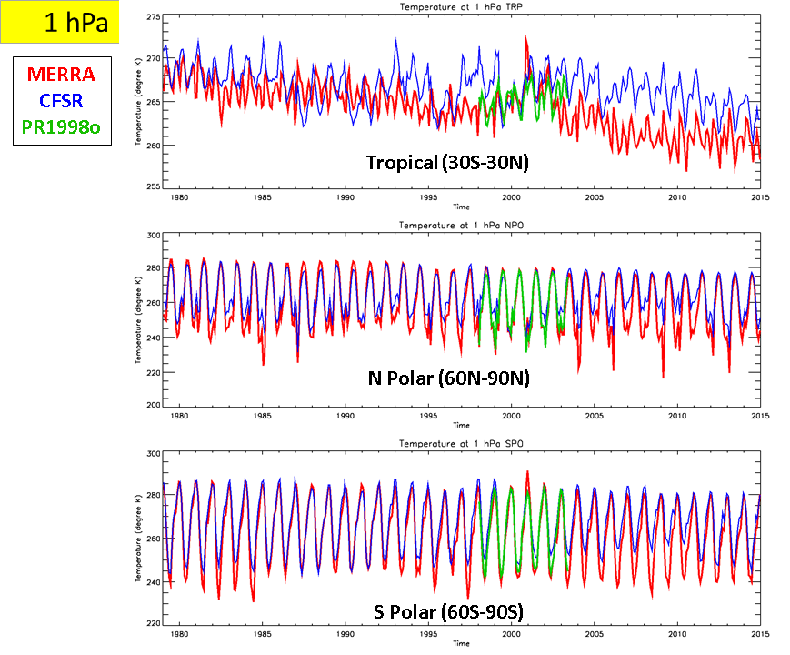
Better Annual Temp Range in Upper Strat
1hPa temperature time series from the CFSR (blue), MERRA (red), and the 3Dvar run (green) for the tropical(30S-30N), NH polar (60N-90N), and SH polar (60S-90S) latitude regions. The 3Dvar job ran from 1998 through 2003.

Slide 5
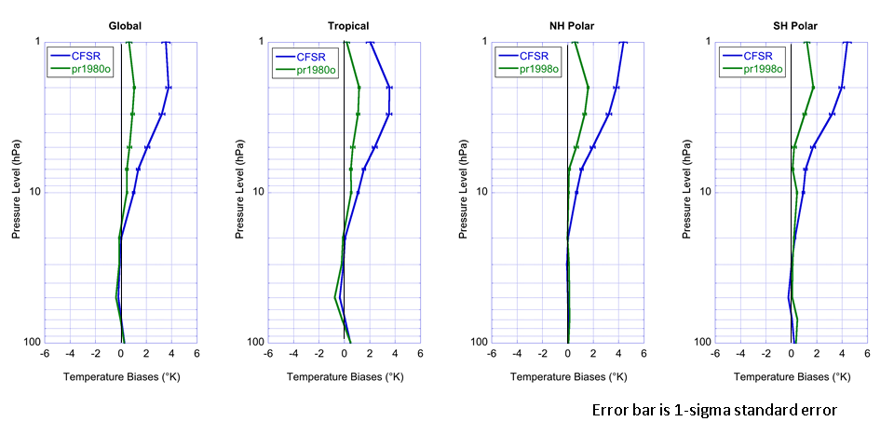
Smaller Differences from MERRA
1998-2003 time mean temperature differences of the CFSR (blue) and 3Dvar (green) from MERRA for the global (90N-90S), tropics (30N-30S), NH polar (60N-90N), and SH polar (60S-90S) latitude regions. The vertical axis is pressure from 100 to 1 hPa.

Slide 6
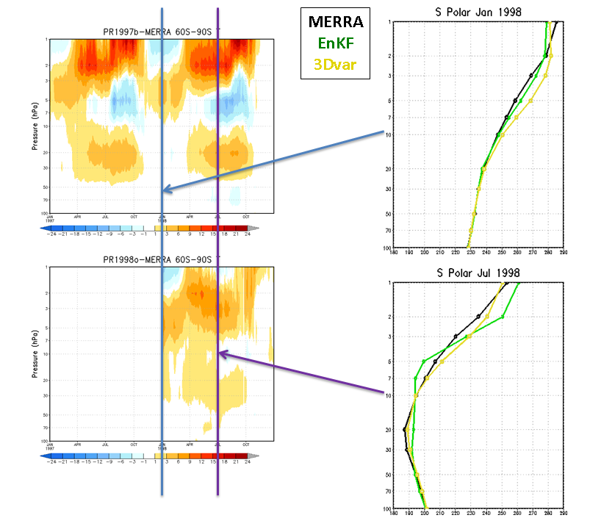
Ringing Pattern in Temp Profile in SH Polar
Time-pressure plot of SH polar temperature differences of the EnKF (top left) and 3Dvar (bottom left) from MERRA. Monthly mean temperature profiles for January 1998 (top right) and July 1998 (bottom right) of MERRA (black), EnKF (green) and 3Dvar (yellow).

Slide 7
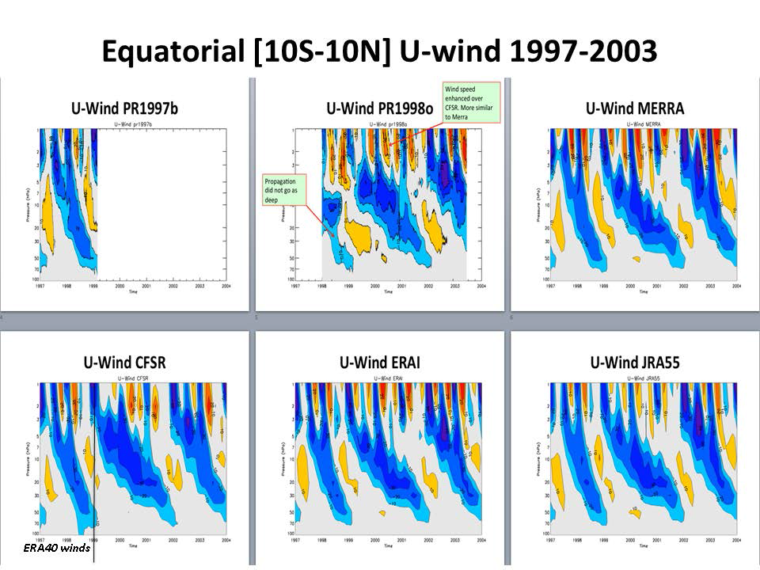
QBO and SAO Winds
Time-pressure plots of the equatorial zonal mean zonal winds from 1997=2004. Shown are the EnKF (upper left),, the 3Dvar (upper middle), the MERRA (upper right), CFSR (lower left), ERA-I (lower middle) and JRA55 (lower right).

