Slide 1
Strongly Coupled EnKF Data Assimilation in Coupled Ocean-Atmosphere Models
Travis Sluka Acknowledgements: Eugenia Kalnay, Steve Penny, Takemasa Miyoshi
Climate Reanalysis Task Force March 30, 2016
Notes:
Intro, PhD Student, Eugenia Kalnay
Ties in with tom’s talk,
1 method of how to unify the solvers amongst all domains

Slide 2
Outline
Overview of strongly coupled DA (vs weakly and uncoupled DA)
Past results with intermediate complexity model SPEEDY-NEMO LETKF (Sluka, et al. 2016)
Recent results with full scale CGCM CFSv2-LETKF

Slide 3
Uncoupled Data Assimilation
ATM obs
Operational data assimilation (DA) is usually performed separately for the ocean and atmosphere, reasons include:
Different DA schemes, atmosphere more advanced
Different grids tri-polar vs rectilinear
Different time and spatial scales
Difficulty in calculating cross-domain covariance
Data Assimilation
forecast
analysis
ATM model
OCN model
forecast
analysis
Data Assimilation
OCN obs
Notes:
As Tom, spoke of in previous talk
DA is done separately for each domain, atmosphere, ocean, ice, land…
Uncoupled and Weakly coupled…,

Slide 4
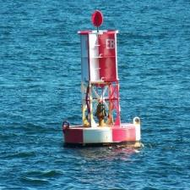
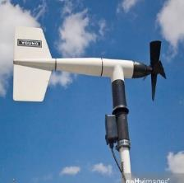
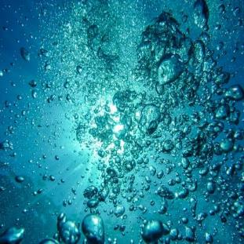
Uncoupled DA why do we need better?
Can observations be used across domains to:
create a better analysis by using information in the cross domain error covariance
Create better forecasts by reducing initialization shock (Mulholland et al., 2015)
Ocean
Atmosphere
Notes:
Could be especially beneficial for historical reanalysis in pre-argo era
Use cross-domain obs for sparsely sampled areas.

Slide 5
Weakly Coupled DA
ATM obs
A single coupled model generates background for separate DA systems
EnKF GFDL CDA (Zhang et al. 2007)
3D/4DVAR CDAS (Saha, 2010) Met Office, ECMWF (Laloyaux et al., 2015; Lea et al. 2015)
Data Assimilation
forecast
analysis
Coupled
OCN/ATM model
forecast
analysis
Data Assimilation
OCN obs

Slide 6
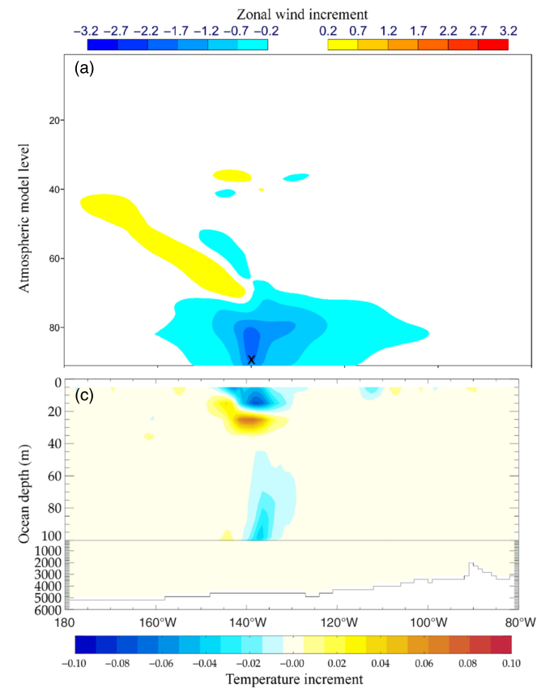
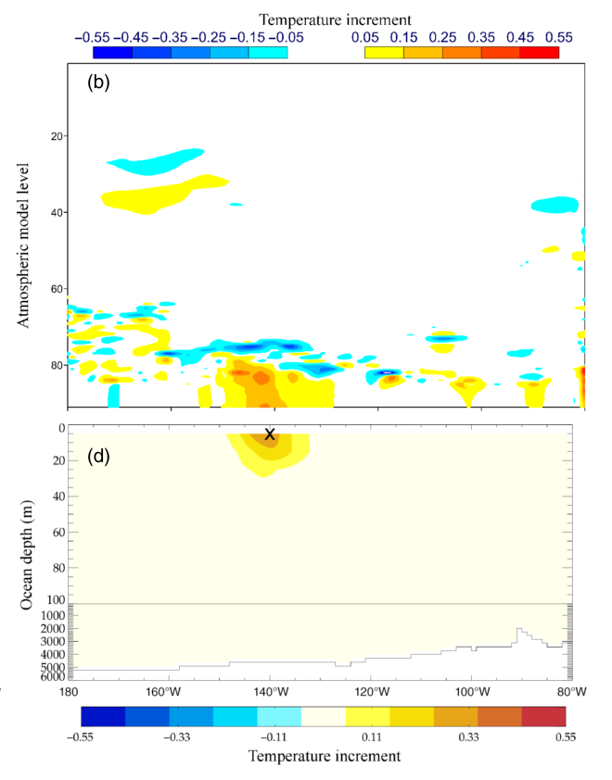
Weakly Coupled DA
“slightly more than”
- CERA single obs tests
(Laloyaux et al., 2015)
Coupled ECMWF ReAnalysis System (CERA)
Separate 3D/4DVAR for ocean /atmosphere
Coupled model in outer loops enable cross domain obs impacts
A step towards strongly coupled DA
Laloyaux, P., M. Balmaseda, D. Dee, K. Mogensen, and P. Janssen, 2015: A coupled data assimilation system for climate reanalysis. Q. J. R. Meteorol. Soc.,
Single ATM wind
Observation
Single OCN temp
Observation

Slide 7
Strongly Coupled DA
Studied w/ simple models:
EnKF (Lu et al., 2015; Liu et al., 2013; Han et al., 2013; Luo & Hoteit, 2014; Tardif et al., 2013)
4DVAR (Smith et al., 2015)
Studied w/ realistic models:
EnKF (Lu et al., 2015)
4DVar (Sugiura et al., 2008)
OCN obs
ATM obs
Data Assimilation
forecast
analysis
Coupled
OCN/ATM model
Notes:
Systems for realistic models, may be useful for reanalysis,
but haven’t explored systems appropriate for operational 6 hour DA

Slide 8
Goal of our research
Create a strongly coupled data assimilation system for a realistic ocean-atmosphere model, capable of assimilating all observations at 6 hour intervals
Will form the basis for a prototype CFSv2-LETKF system being developed for the Indian Monsoon Mission Directorate
Design should allow for easy future integration of all aspects of the Earth system (ocean, atmosphere, land, ice, etc.)

Slide 9
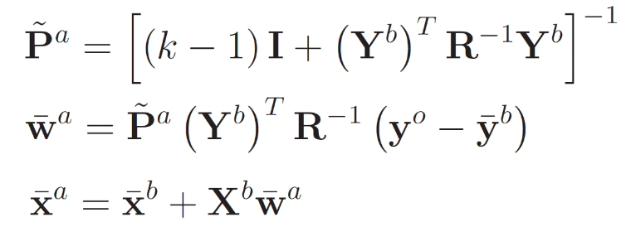
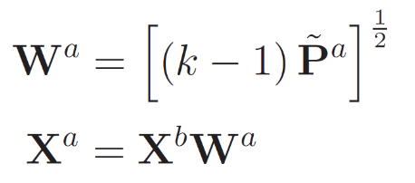
Local Ensemble Transform Kalman Filter
Observation operator
analysis mean
analysis ensemble perturbations
LETKF calculates analysis for each grid point in parallel using subset of obs around it. For weakly coupled DA, y contains only obs from its own domain. For strongly coupled DA, y contains obs from all domains.
Notes:
IGNORE

Slide 10
Local Ensemble Transform Kalman Filter
Observation operator
analysis mean
analysis ensemble perturbations
Cross-domain observation impacts analysis mean
W varies smoothly across domain interface, allows individual ensemble members to stay “matched” together, allowing for better balance of ensemble members

Slide 11
SPEEDY-NEMO OSSE
Using the fast SPEEDY-NEMO (one year run takes only 12 hours on 1 core)
Perfect model OSSE conducted using only atmospheric observations
SPEEDY-NEMO
T30 atmosphere
2 degree ocean
Coupling every 6 hours
6 hr observations
Experiment parameters
40 ensemble members
Localization: 1000km Hz
Relaxation to prior spread: 90% for ocn 60% for atm
Notes:
OSSE with SPEEDYNEMO, T30 atm, 2 degree ocean,
Fast, 1 year of DA in 1 day
Somewhat realistic, with decent ENSO pattern

Slide 12
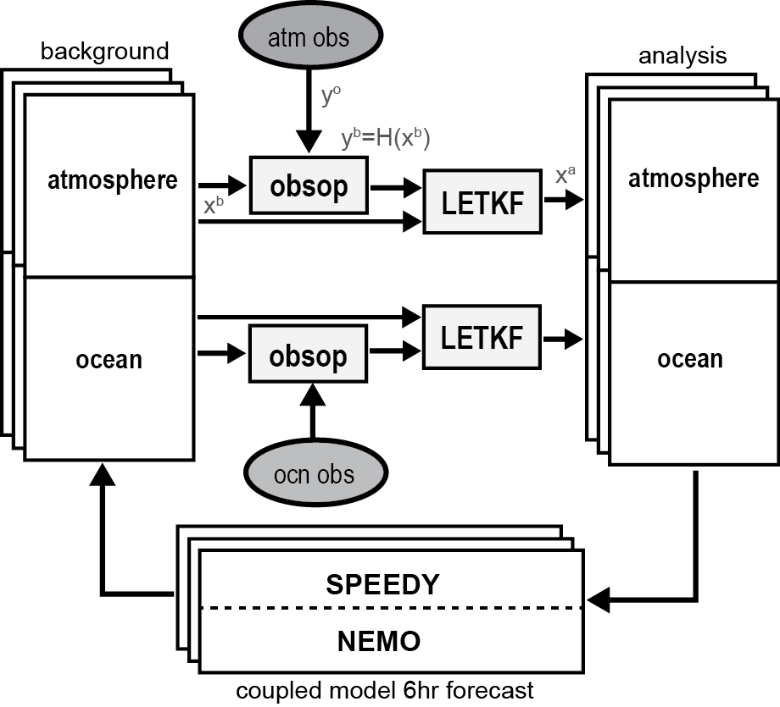
SPEEDY-NEMO LETKF
Sharing of observational departures allows system to act as single strongly coupled system.
Separate LETKF for each domain helps keep implementation simpler. Ocean LETKF and Atmosphere LETKF can be developed independently.
Sluka, T. C., S. G. Penny, E. Kalnay, and T. Miyoshi (2016), Assimilating atmospheric observations into the ocean using strongly coupled ensemble data assimilation, Geophys. Res. Lett., 43(2), 752–759, doi:10.1002/2015GL067238.
Data assimilation systems, normally separate “weakly coupled DA”
Addition of cross-domain observational departures “strongly coupled DA”
Notes:
As tom talked about, desire for interoperability and abstraction
Can read about details in GRL paper

Slide 13
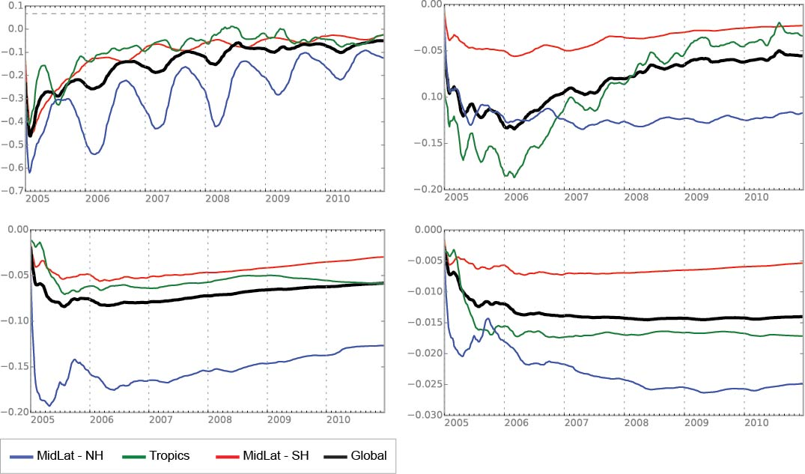
SPEEDY-NEMO Strongly Coupled DA STRONG-WEAK analysis RMSE
Temperature [C]
Salinity [PSU]
Improvement
Improvement
Surface
Northern Hemisphere
Southern Hemisphere
Deeper Ocean (500m-2km)
Improvement
Improvement
Global
Tropics
Analysis RMSE improvement of ocean, from strongly coupled DA of simulated atmospheric observations

Slide 14
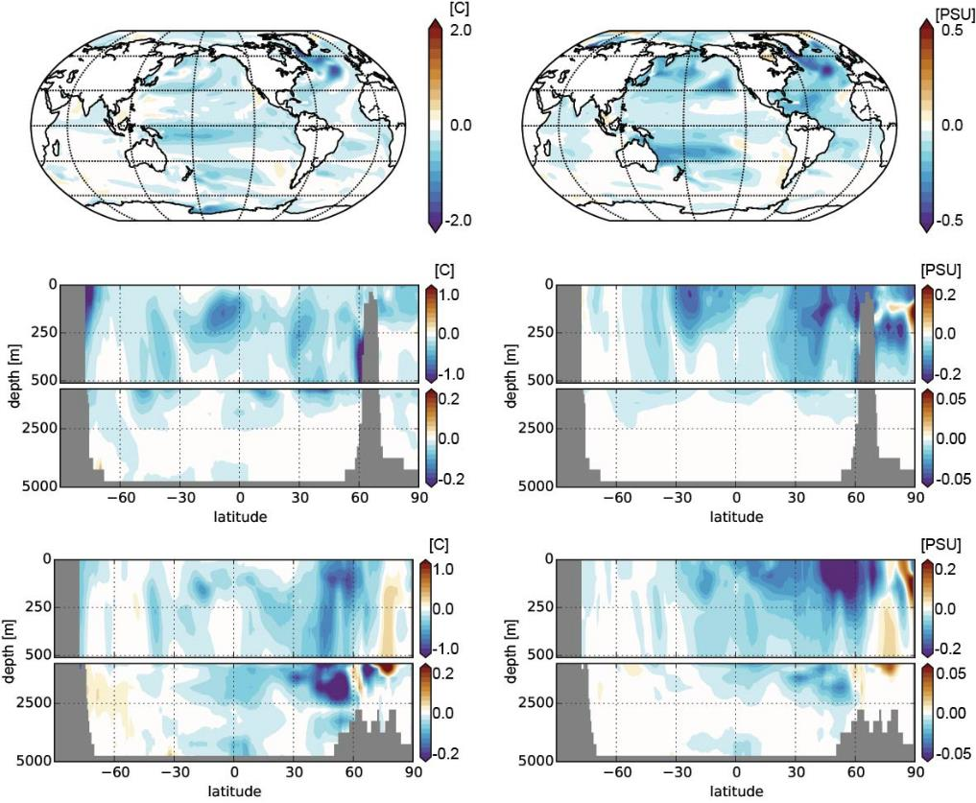
SPEEDY-NEMO Strongly Coupled DA STRONG-WEAK analysis RMSE
OCN Temperature
OCN Salinity
Upper 500m
Pacific
Atlantic

Slide 15
SPEEDY-NEMO Strongly Coupled DA STRONG-WEAK analysis RMSE
ATM T
ATM q
ATM U
Improvements in SST with strong reflect back on atmosphere

Slide 16
SPEEDY-NEMO LETKF
Assimilating ATM obs into the ocean reduces analysis RMSE for both domains
The opposite experiment (assimilating OCN obs into the atmosphere) shows improvement as well
Problems with SPEEDYNEMO prevent further work with 6 hour DA cycles. System might still be useful for climate length runs.
Improvement strongest in NH extratropics during spring/winter months (over 50% RMSE reduction)
Notes:
Problems with SPEEDYNEMO
Flux exchange not frequent enough, weak cross domain covariance information
Difficulty with ocean spread due to low resolution

Slide 17
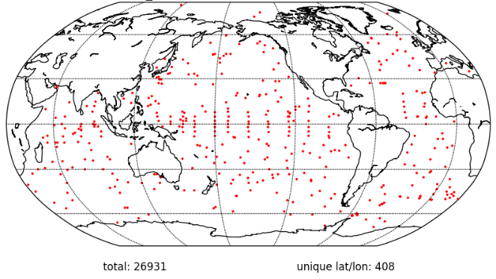
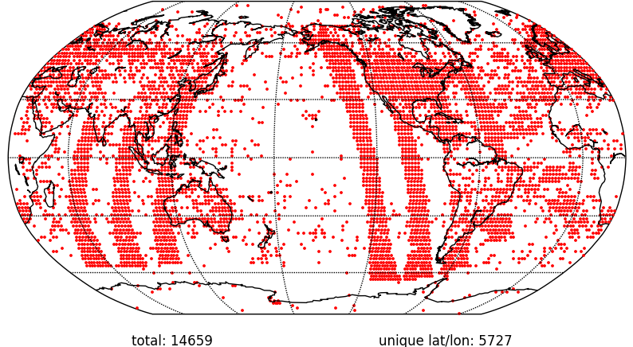
CFSv2-LETKF OSSE
Combined GFS-LETKF (Lien, 2013) and MOM-LETKF (Penny, 2013)
Weakly coupled DA with conventional observations performed for 1 month to spin-up
T62/L64 atm 0.5deg ocn
50 member ensemble
Synthetic observations of PREPBUFR and ocean profiles
24 hr OCN profiles
Jan 1, 2010 00Z
6hr ATM obs
Jan 1, 2010 00Z
Notes:
Switch to CFS, lower resolution atm, otherwise same
Plan to use actual observations as soon as current CFSv2-LETKF is verified and tuned slightly
These experiments are very short duration (2 months), plan to do several years

Slide 18
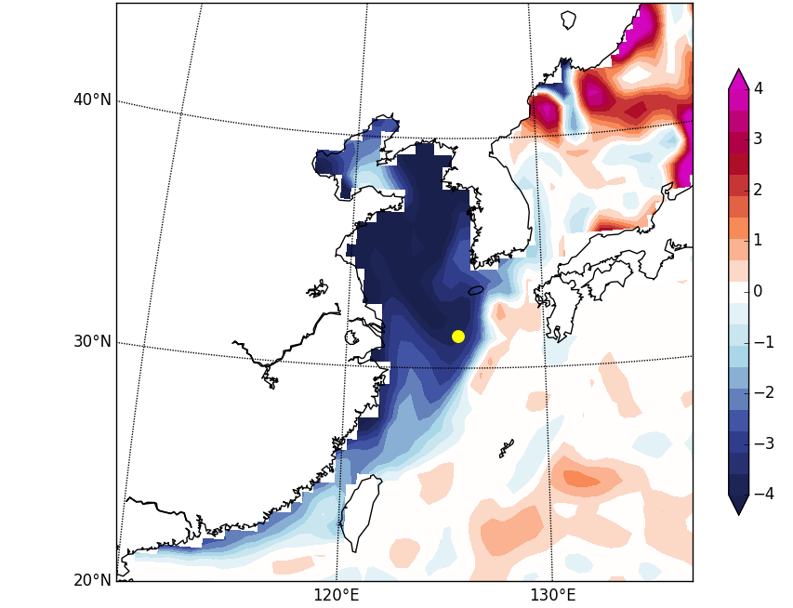
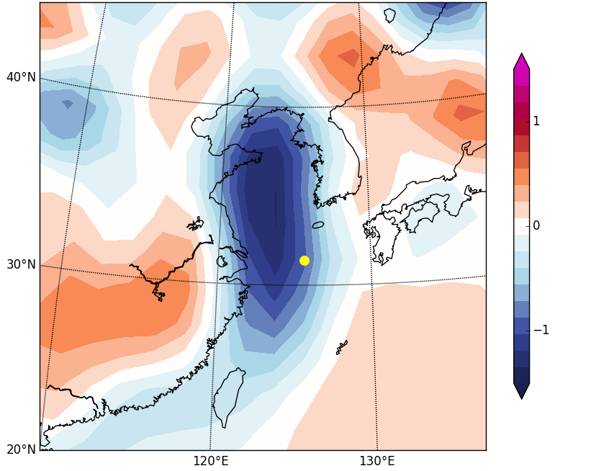
CFSv2-LETKF OSSE
After 1 month of weakly coupled DA, several locations, especially near coasts, exhibit large SST errors.
Yellow Sea is chosen for strongly coupled single observation test
SST background error
Surface atmosphere T error
Feb 1, 2010 00Z
Feb 1, 2010 00Z
obs location
Notes:
Several year free running nature run generated
Spun-up with conventional weakly coupled DA
First test performed as a single obs

Slide 19
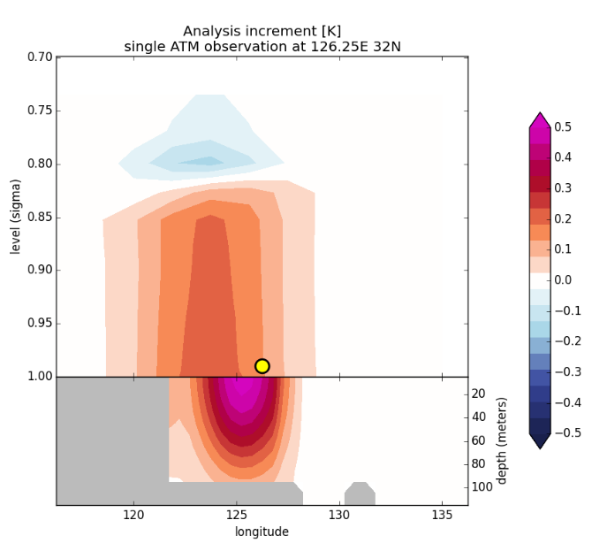
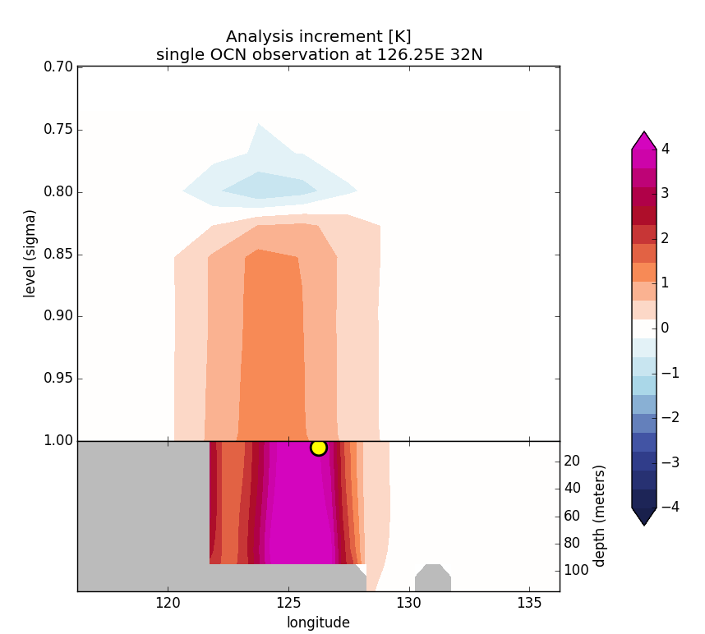
CFSv2-LETKF single obs test
2 strongly coupled DA experiments
In this case, OCN observation improves atmosphere MORE than ATM observation
Single ATM ob
Single OCN ob

Slide 20
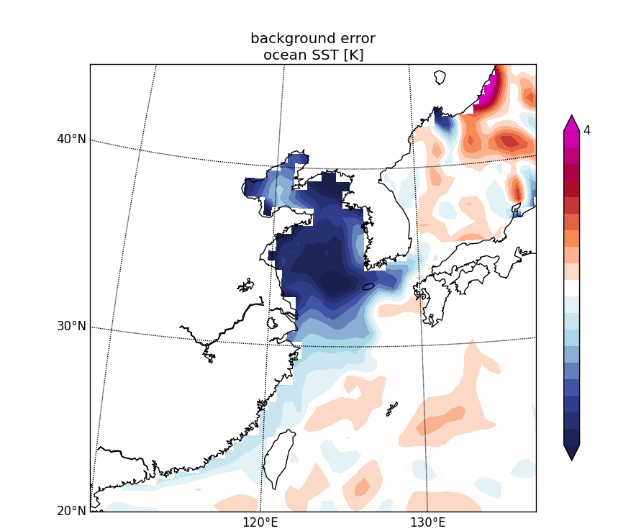
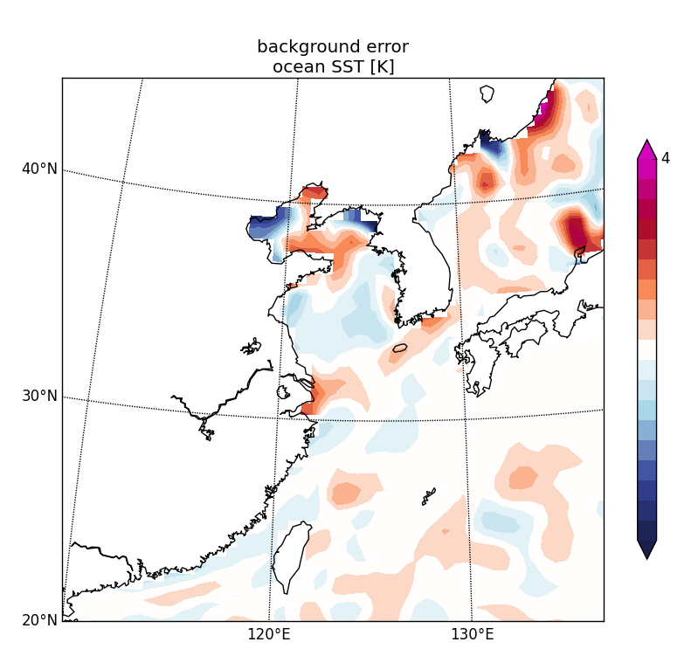
CFSv2-LETKF OSSE
After 1 month of strongly coupled DA with all observations, SST bias in Yellow Sea largely removed with strongly coupled DA
Weakly Coupled
Strongly Coupled
Mar 1, 2010 00Z
Mar 1, 2010 00Z
0
-4
Notes:
A bit of a made up case, as no SST forcing for ocean, only profile data
No tuning though!
DA of along track level 2 SST data, can SST improve atmosphere?

Slide 21
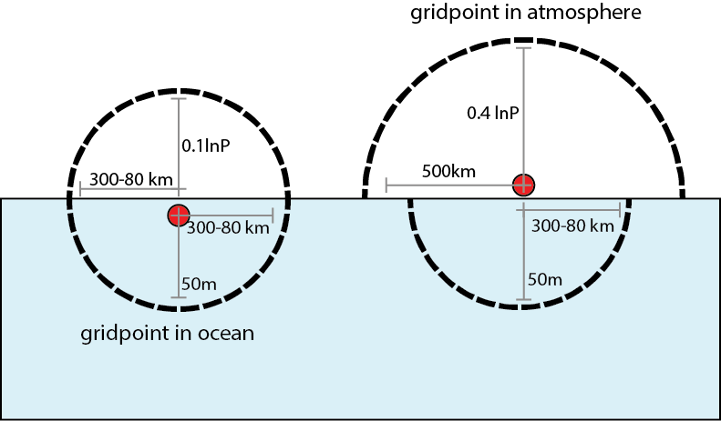
CFSv2-LETKF Spatial Localization
Strongly coupled DA greatly increases the number of localization parameters that must be tuned.
How should localization into opposite domain best be done?
Could be automatically tuned by various methods (Anderson, 2013; Lei, 2014)
For now, though, the following guesses are used:

Slide 22
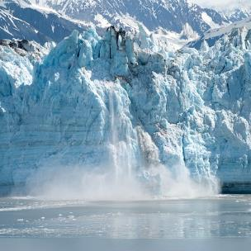
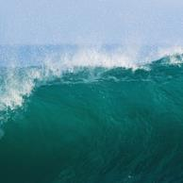
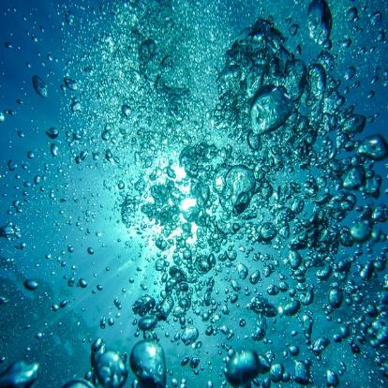
Ultimate Goal…
NCEP transitioning to hybrid-GODAS, based on LETKF for the ocean.
Increased potential after that for an operational strongly coupled hybrid-LETKF global DA system
Aerosol
Land
Atmosphere
Sea Ice
Waves
Ocean

Slide 23
Strongly Coupled EnKF Data Assimilation in Coupled Ocean-Atmosphere Models
Travis Sluka, and S. Penny, E. Kalnay, T. Miyoshi
Travis Sluka
University of Maryland
tsluka@umd.edu
Notes:
Outline
1 what is SCDA and how can it improve DA
2 overview of latest advancements In SCDA
3 Outline of our method and or future plans

Slide 25
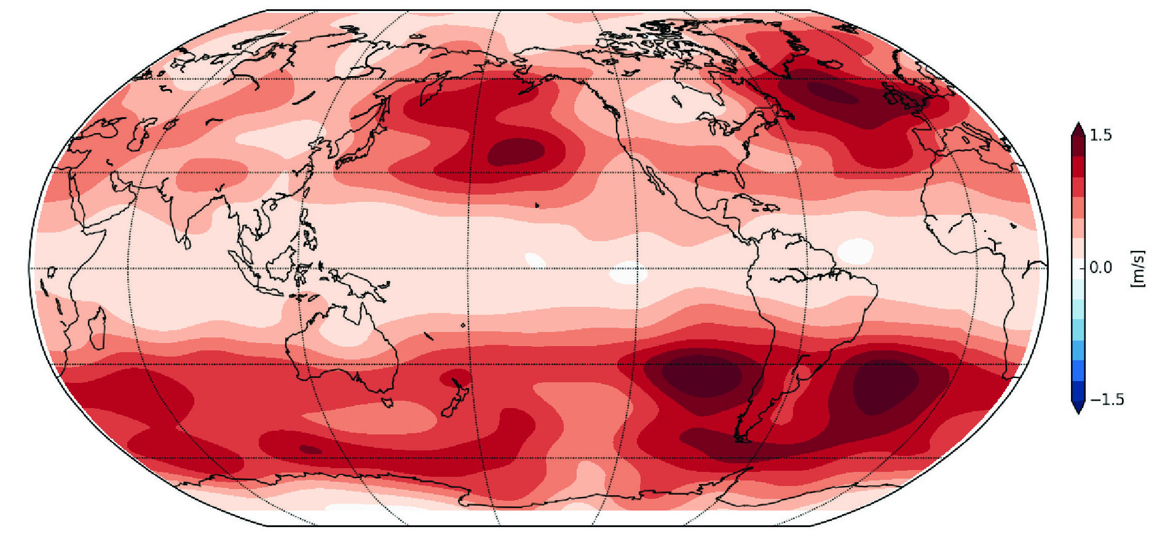
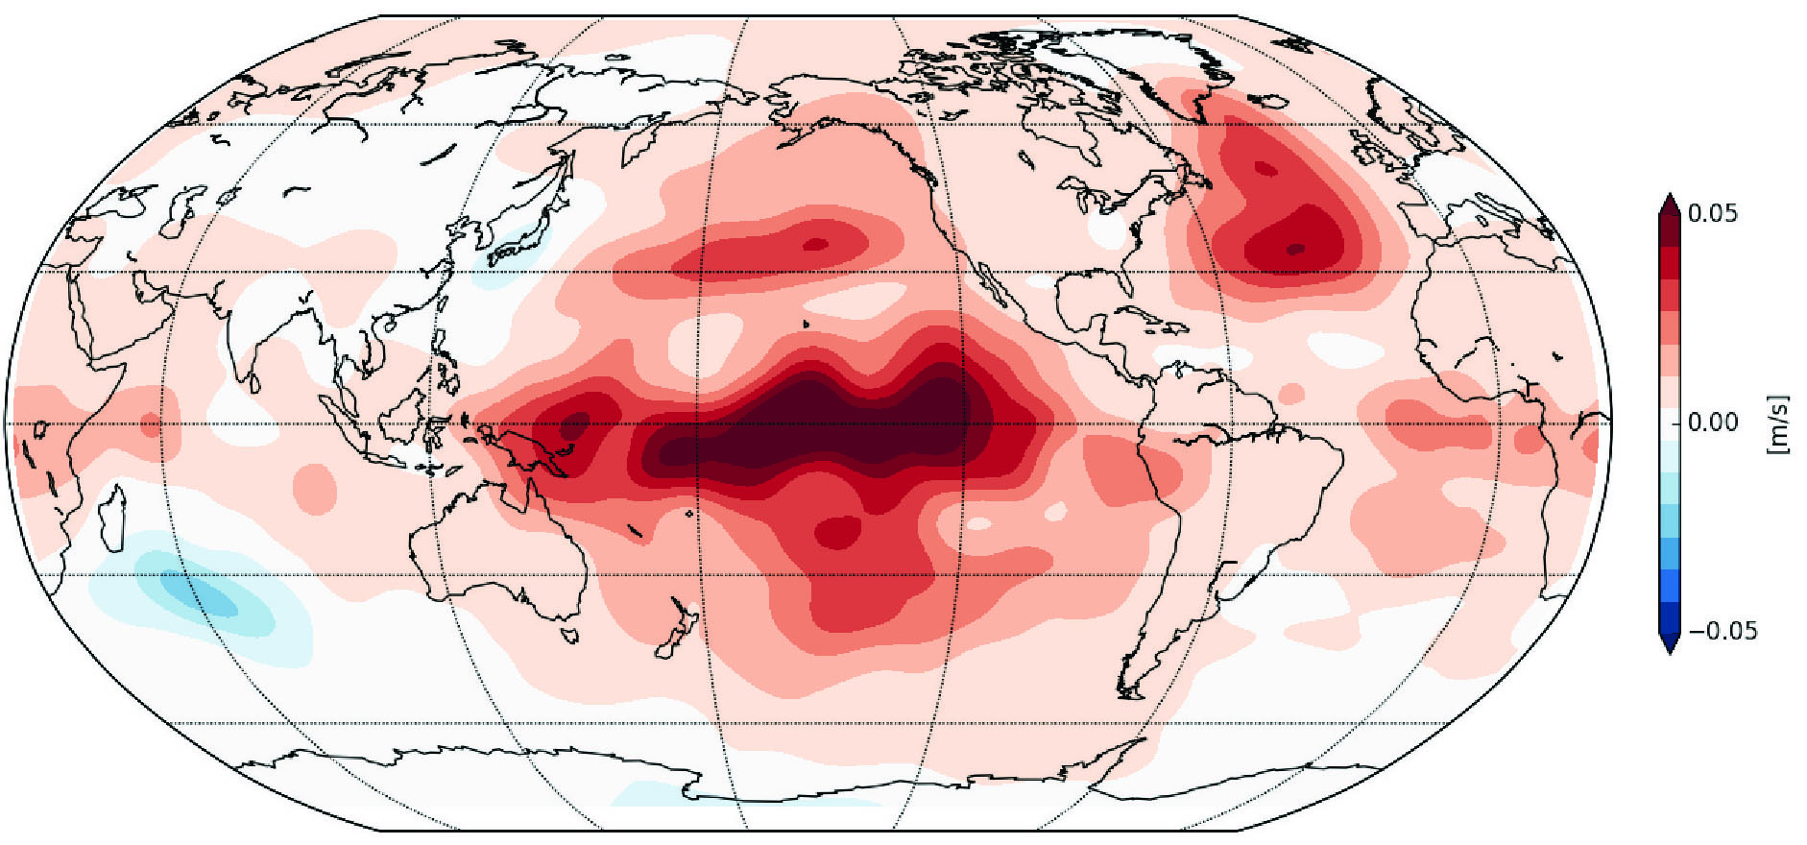
SPEEDY-NEMO Strongly Coupled DA STRONG-WEAK analysis RMSE
The opposite experiment (assimilating OCN obs into the atmosphere) shows improvement as well
A possible latitudinal dependence on cross domain impact?
WEAK-STRONG, RED is good
atm U
Ocean Observations
Atmosphere Observations

Slide 26
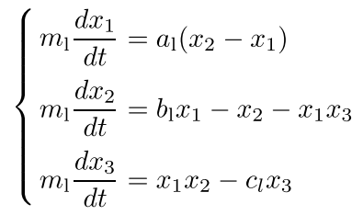
Strongly Coupled DA
Liu, et al, 2013
EAKF used to test strongly coupled DA with Lorenz63 model
Largest impact was in assimilating atmospheric obs into extratropical ocean
atmosphere (wind)
atmosphere (surface temp)
ocean (SST, thermocline
depth)

Slide 27
Strongly Coupled DA
Liu, et al, 2013
EAKF used to test strongly coupled DA with Lorenz63 model
Largest impact was in assimilating atmospheric obs into extratropical ocean

Slide 28
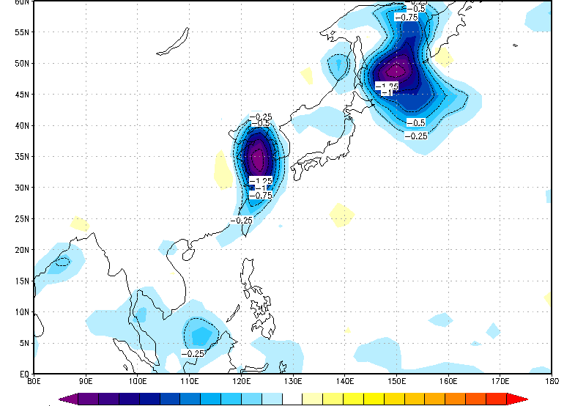
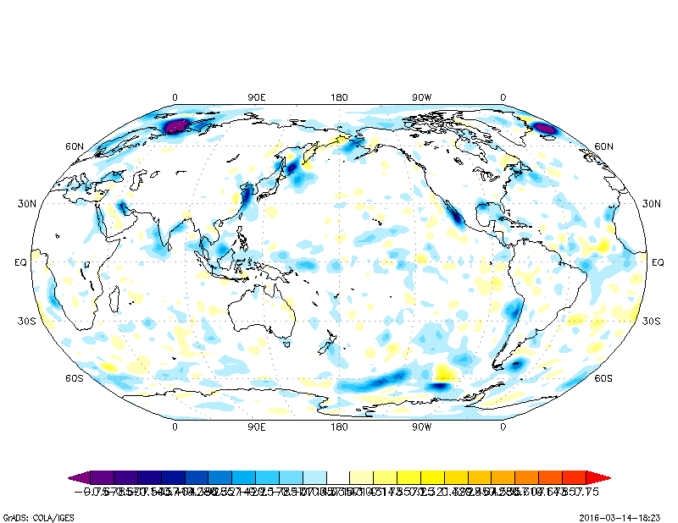
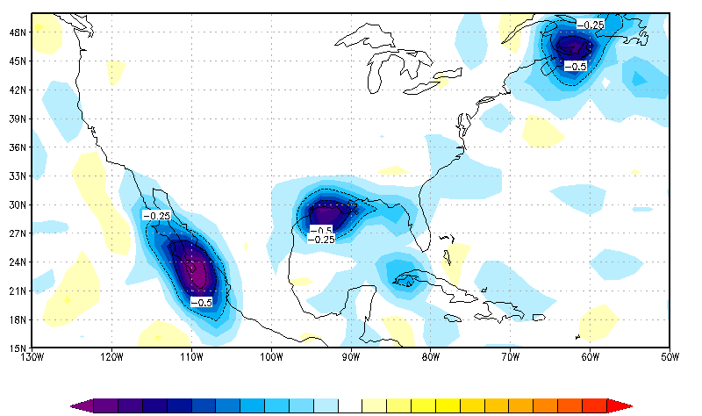
CFSv2-LETKF OSSE
Background RMSE difference, BLUE is better
Global reduction in atmosphere RMSE, especially near coastlines where higher ocean biases were

