Slide 1
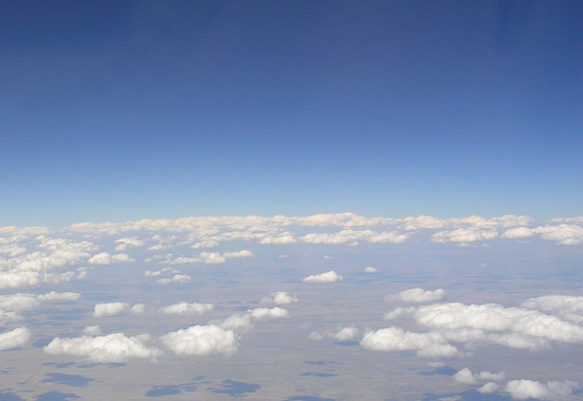
Improving the Land Surface Component of the CFS Reanalysis
Michael Ek¹, Jesse Meng², Jiarui Dong², Roshan Shresha², Rongqian Yang², Youlong Xia²
¹NOAA/NWS National Centers for Environmental Prediction (NCEP)
Environmental Modelling Center (EMC)
College Park, Maryland, USA
²NCEP/EMC and I.M. Systems Group (IMSG)
College Park, Maryland, USA
…and a large number of collaborators!

Slide 2
Outline
Global Land Data Assimilation System (GLDAS) of CFSR
Role of Land Models and Requirements
Land Information System
Land data upgrades
Precipitation data upgrades
Snow Data Assimilation
River-Routing
Drought Monitor
Summary

Slide 3
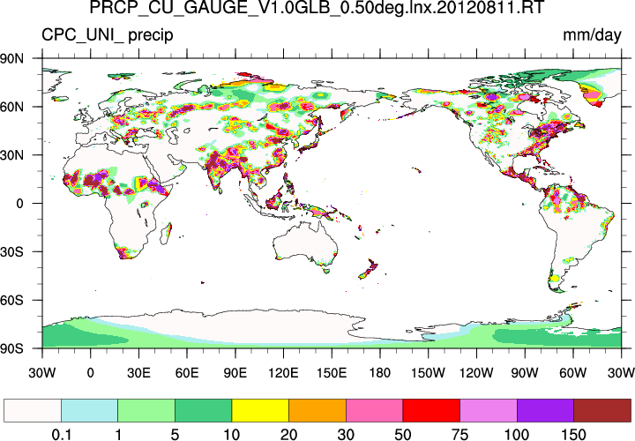
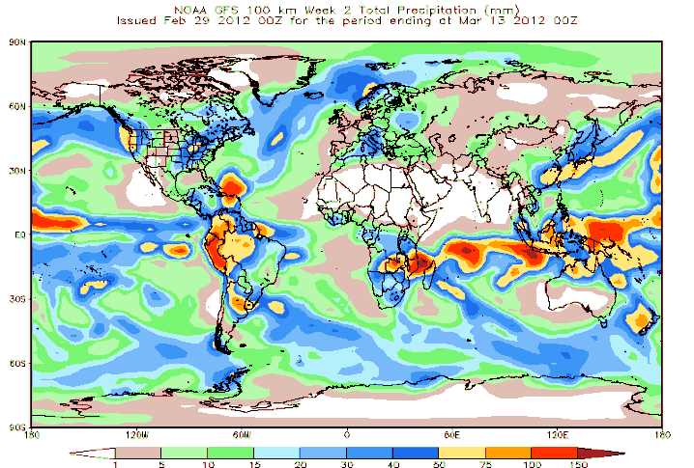
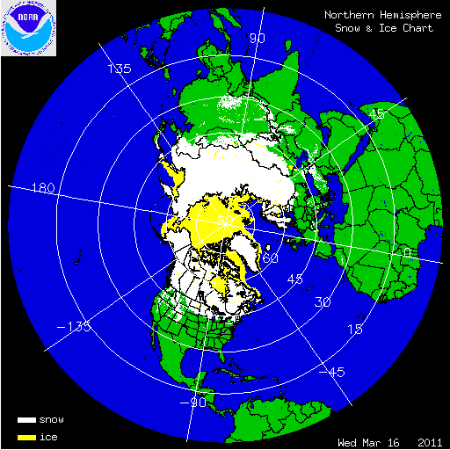
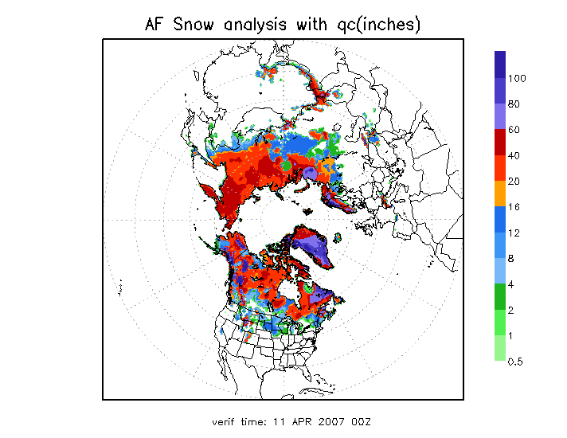
Current Global Land Data Assimilation System (GLDAS) at NCEP Operational in CFSv2 at NCEP 01 April 2011
Noah surface model runs in semi-coupled mode with Climate Data Assimilation System version (CDASv2); daily update provides initial land states to operational Climate Forecast System version 2 (CFSv2).
Forcing: CDASv2 atmospheric output, & “blended” precipitation, snow.
Blended Precipitation: CPC satellite (heaviest weight in tropics); CPC gauge (heaviest mid-latitudes); model CDASv2 (high latitude).
Snow: IMS cover & AFWA depth, cycled if within 0.5-2.0x “envelope”.
30+ year global land-surface climatology.
Research/partners supported by the NOAA Climate Program Office, Modeling, Analysis, Predictions, and Projections (MAPP) program.
Precipitation
Snow
CMAP
Surface gauge
GDAS
IMS cover
AFWA depth
Jesse Meng, NCEP/EMC

Slide 4
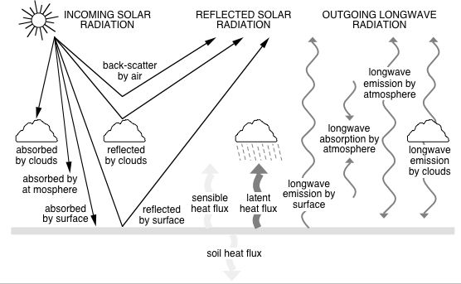
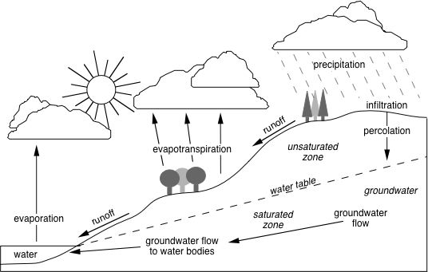
Role of Land-Surface Models & Requirements
Land Surface Models (LSMs) provide surface flux boundary conditions for heat, moisture and momentum to the atmosphere for NCEP weather and seasonal climate models.
Land models close surface energy and water budgets.
Land Model Requirements:
Physics: appropriate to represent land-surface processes (for relevant time/spatial scales) and assoc. LSM model parameters.
Atmospheric forcing to drive LSM.
Land data sets, e.g. land use/land cover (vegetation type), soil type, surface albedo, snow cover, surface roughness, etc.
Initial land states: Compared to atmosphere, land states carry more memory (especially deep soil moisture), similar to the role of SSTs and ocean temperatures.
seasonal storage
Land Data Assimilation: some of these quantities may be assimilated, e.g. snow depth and cover.
Land Data Assimilation Systems (LDAS): provide initial land states for NCEP modeling systems.

Slide 5
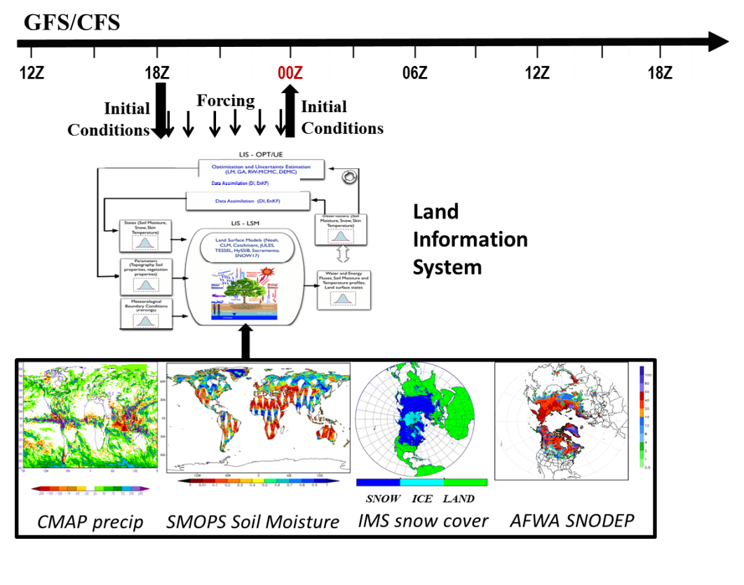
Satellite-based Land Data Assimilation in NCEP Modeling Systems
Use NASA Land Information System (LIS) to serve as a global Land Data Assimilation System (LDAS) for testing both GLDAS, NLDAS.
LIS EnKF-based Land Data Assimilation tool used to assimilate:
Snow cover area (SCA) from operational NESDIS Interactive Multisensor Snow and Ice Mapping System (IMS), and AFWA snow depth (SNODEP) products.
CFSR GLDAS
Michael Ek, Jiarui Dong, Jesse Meng (NCEP/EMC)
Christa Peters-Lidard, Grey Nearing (NASA/GSFC)
NASA
Build NCEP’s CFS-GLDAS by incorporating the NASA Land Information System (LIS) into NCEP’s GFS/CFS (left figure)
Offline tests of the existing EnKF-based land data assimilation capabilities in LIS driven by the operational CFS.
Coupled land data assimilation tests and evaluation against the operational system.
(LIS)
Jiarui Dong, NCEP/EMC

Slide 6
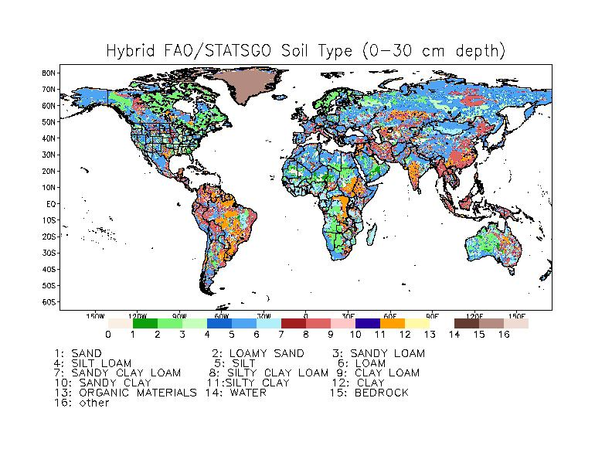
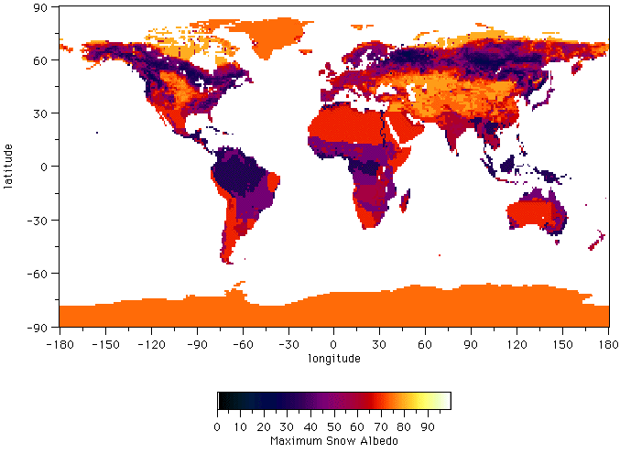
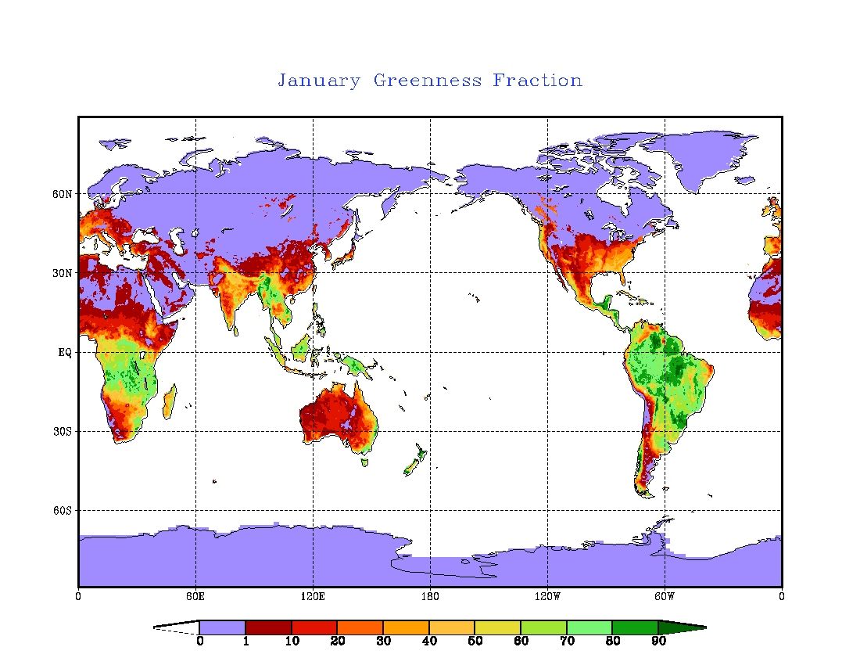
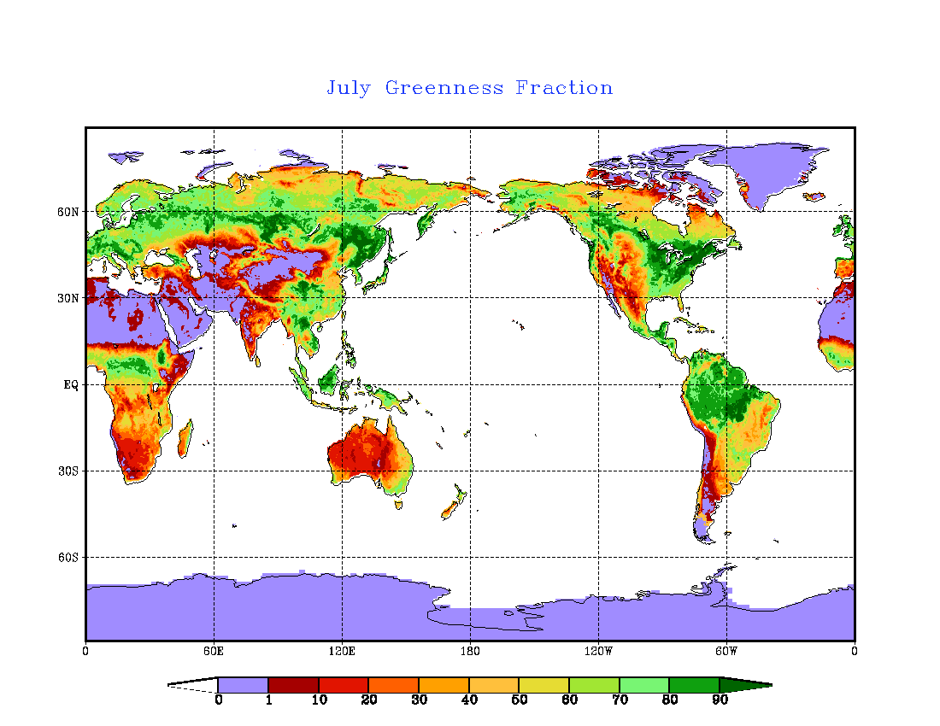
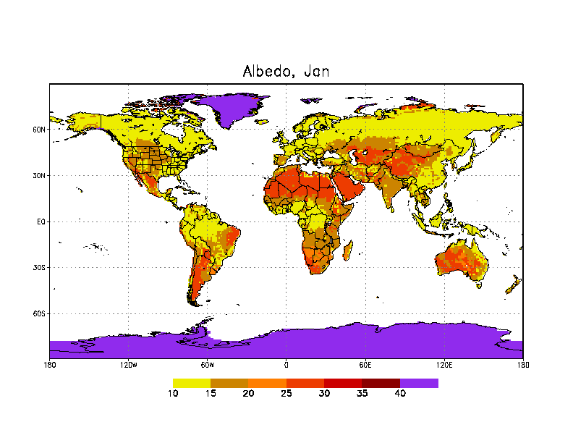
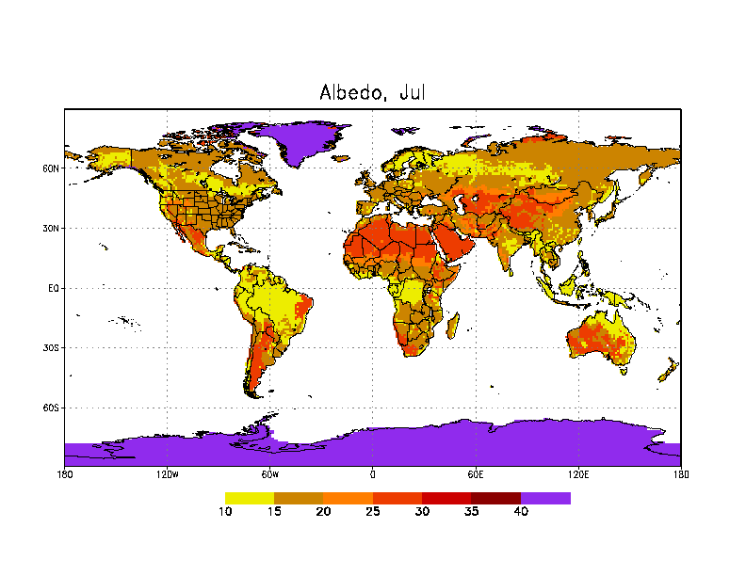
Land Data Sets Used in NCEP Modeling Systems
Vegetation Type
(1-km, IGBP-MODIS)
Soil Type
(1-km, STATSGO-FAO)
Max.-Snow Albedo
(1-deg, Robinson)
Jan
July
winter
summer
Green Vegetation Fraction (GVF) (monthly, 1/8-deg, NESDIS/AVHRR)
Snow-Free Albedo
(seasonal, 1-deg, Matthews)
Climatologies: fixed/annual, monthly, weekly.
Near real-time observations, e.g. GVF “becoming” a land state.

Slide 7
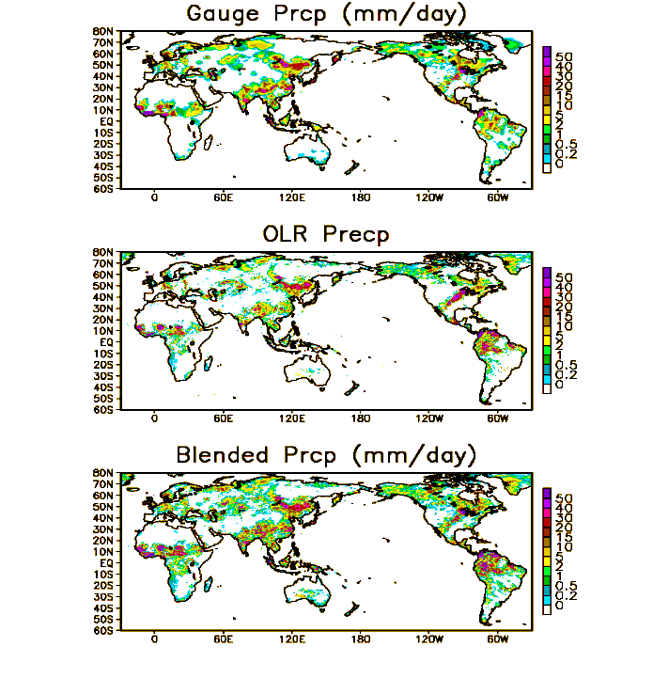
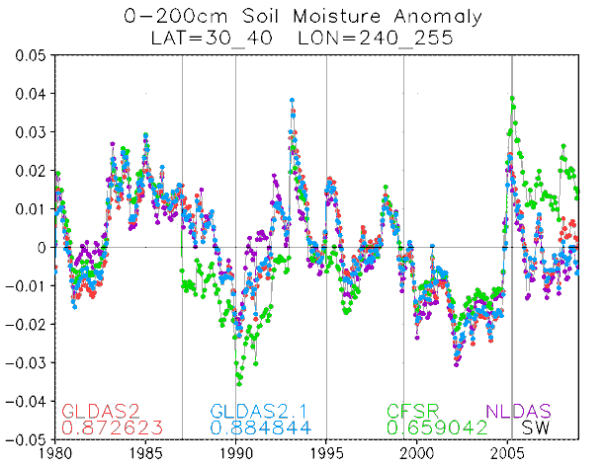
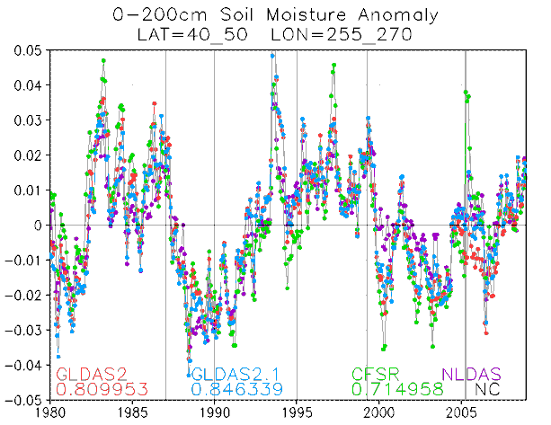
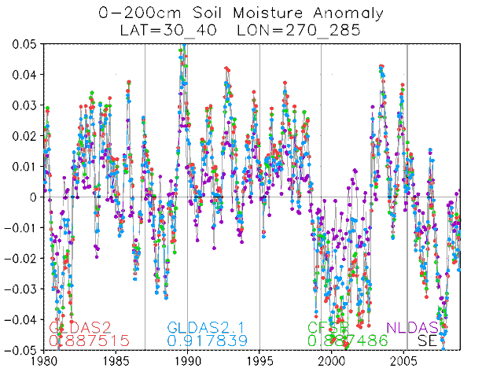
LDAS Upgrade: GLDASv2.2 with New Precipitation Forcing
Precipitation Data in current operation:
CMAP, 5-day data latency.
Unified global gauge analysis, 1-day data latency.
New Precipitation Data:
CPC Gauge-satellite blended analysis of daily global precipitation.
0.25º lat/lon over the global land.
1979-present.
Blending information from different sources:
CPC daily gauge analysis.
GPCC monthly gauge data.
OLR-based precipitation estimates.
CMORPH-based precipitation estimates.
1-day data latency.
Preliminary Results:
Improved soil moisture spin-up & anomalies.
Courtesy of Pingping Xie, NCEP/CPC
Southwest US
Northern Plains
Southeast US
Jesse Meng, NCEP/EMC

Slide 8
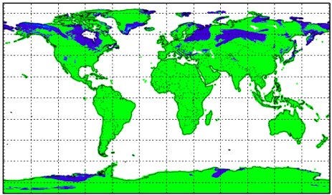
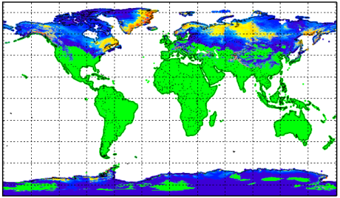
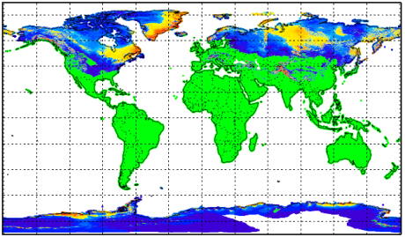
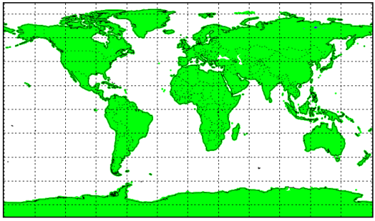
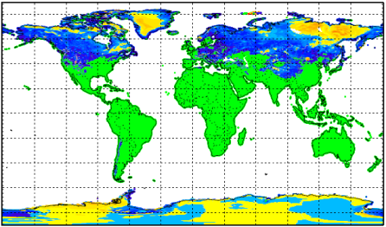
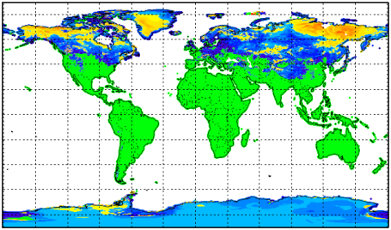
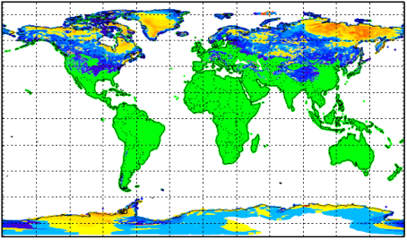
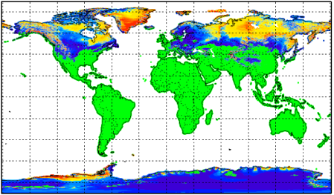
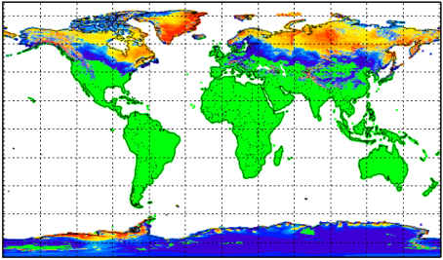
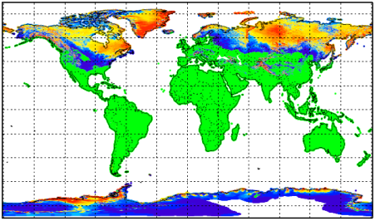
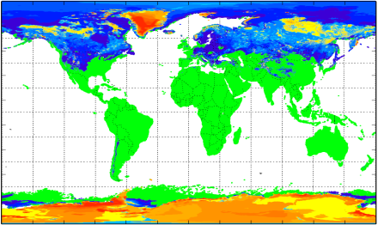
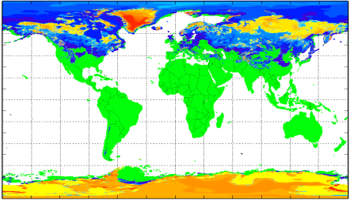
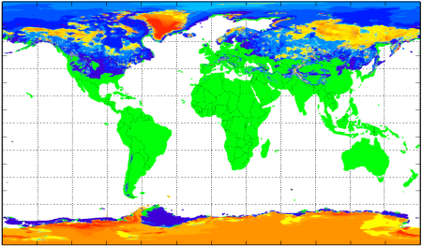
Demonstration of land data assimilation
of AFWA Snow Depth (initially under LIS)
Open Loop
12/31/2014 00Z
01/01/2015 00Z
02/01/2015 00Z
03/01/2015 00Z
Direct Insertion
07/01/2014 00Z
Control Run
GFS/GDAS (0.5x-2.0x)
Working on using LIS EnKF to assimilate AFWA snow depth. The successful EnKF applications require accurate error estimates both from satellite observations and from the land model.
Jiarui Dong, NCEP/EMC

Slide 9
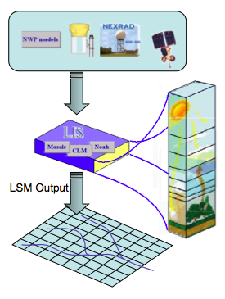
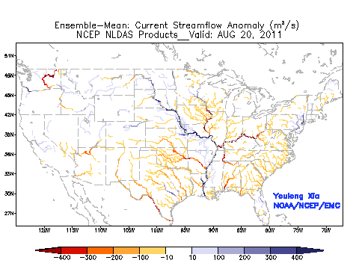
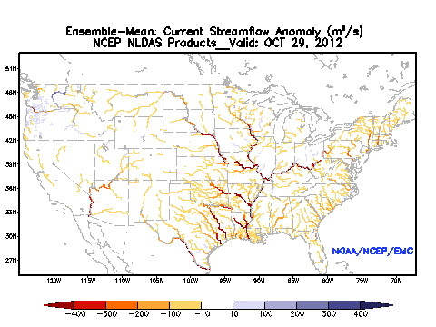
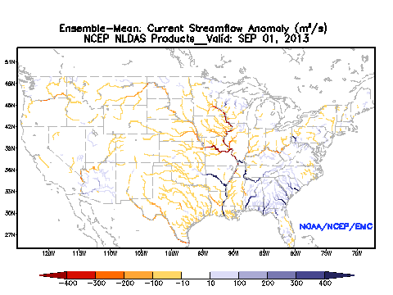
Model Improvement: Hydrology, River-Routing
Atmospheric
Forcing
Ensemble mean daily streamflow anomaly (NLDAS)
Hurricane Irene and Tropical Storm Lee, 20 August – 17 September 2011
Surface flow
Superstorm Sandy, 29 October – 04 November 2012
Saturated
subsurface flow
Colorado Front Range Flooding, September 2013
Close Coordination with National Water Center
Groundwater
Youlong Xia and Roshan Shresha, NCEP/EMC

Slide 10
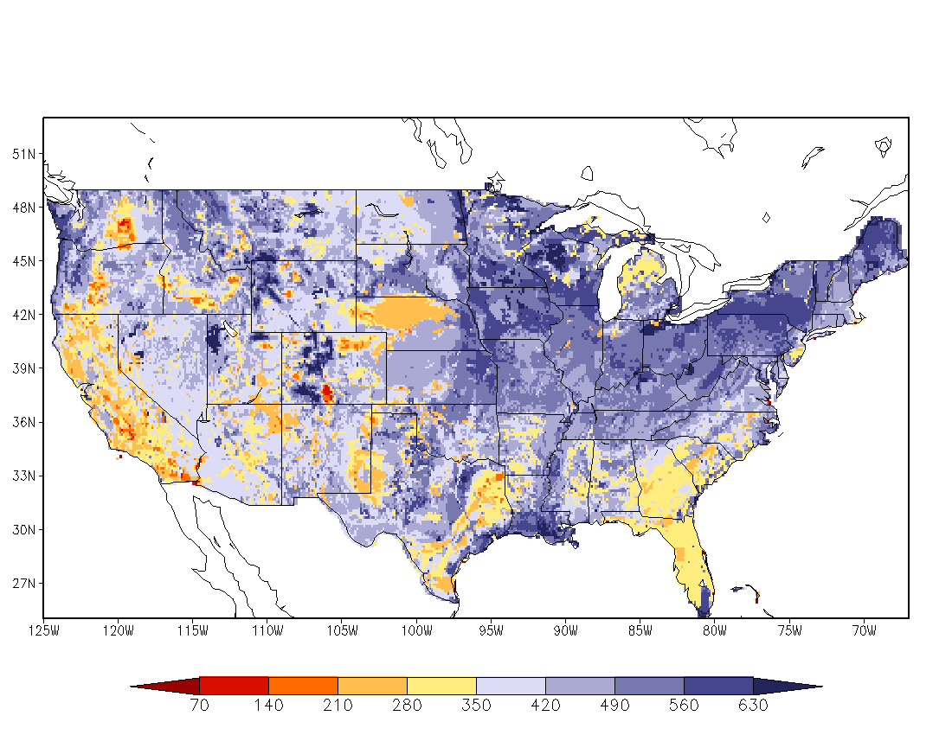
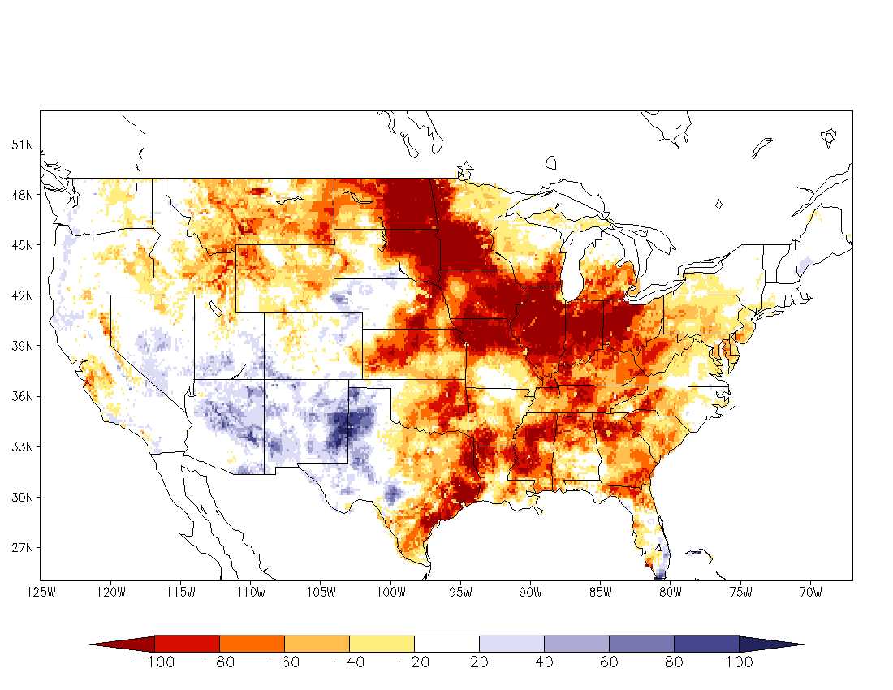
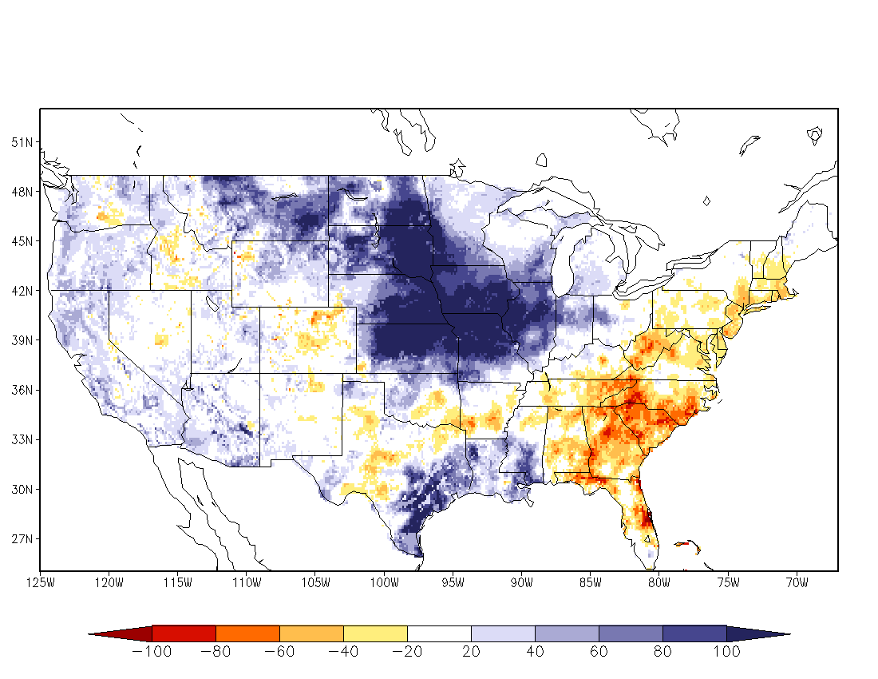
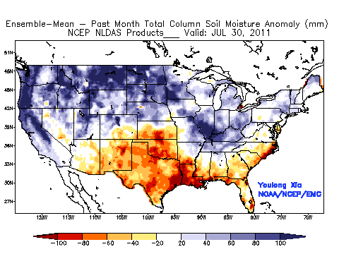
NLDAS Drought Monitor
Land models: Noah, SAC, VIC, Mosaic run in “uncoupled” mode.
Forcing: NCEP Climate Prediction Center obs precip (gauge-based, radar/satellite disaggregatred), and atmospheric forcing from NCEP North American Regional Climate Data Assimilation System.
Output: 1/8-deg. land & soil states, surface fluxes, runoff/streamflow.
Climatology from land model assimilation runs for 30+ years provide anomalies used for drought monitoring; supports USDM, NIDIS etc.
Comprehensive evaluation of energy fluxes, water budget and state variables using in situ and remotely-sensed data sets.
(ldas.gsfc.nasa.gov/nldas/NLDAS2valid.php)
www.emc.ncep.noaa.gov/mmb/nldas
July 30-yr climate
July 1988 (drought)
July 1993 (flood)
July 2011 (TX drought)
Youlong Xia, NCEP/EMC
Youlong Xia, NCEP/EMC

Slide 11
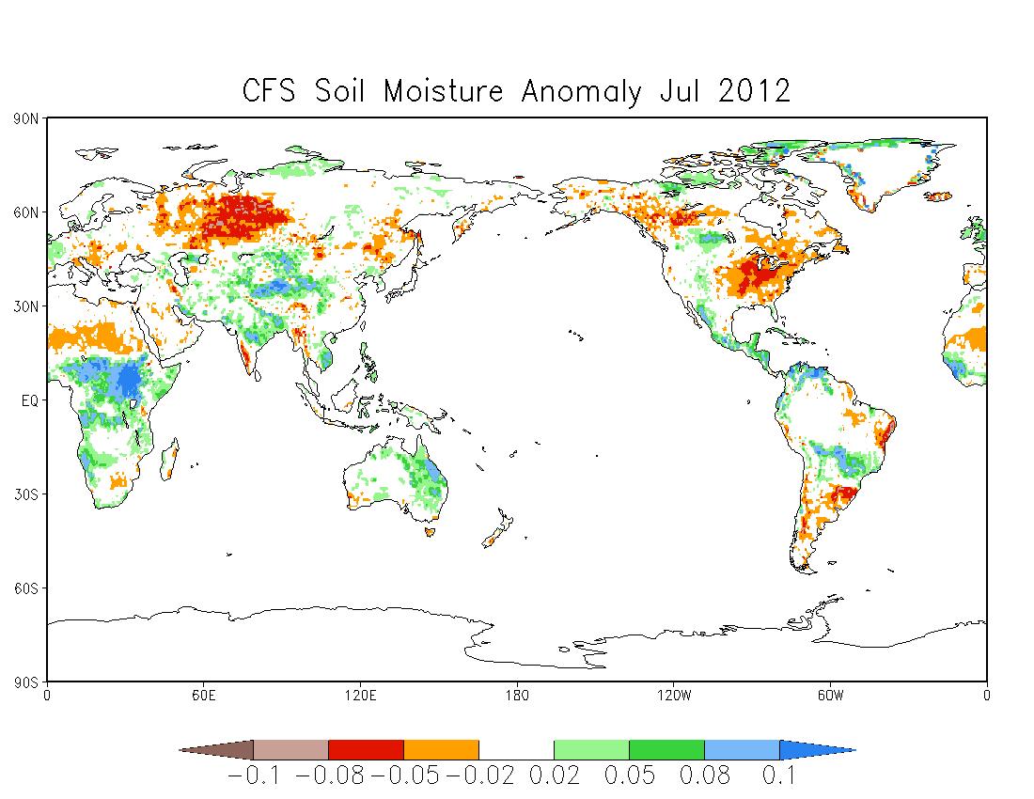
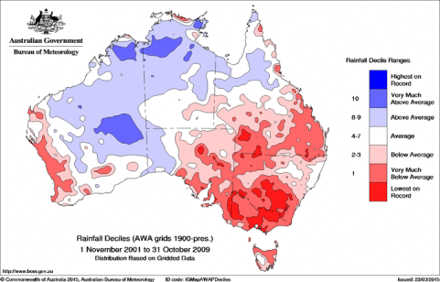
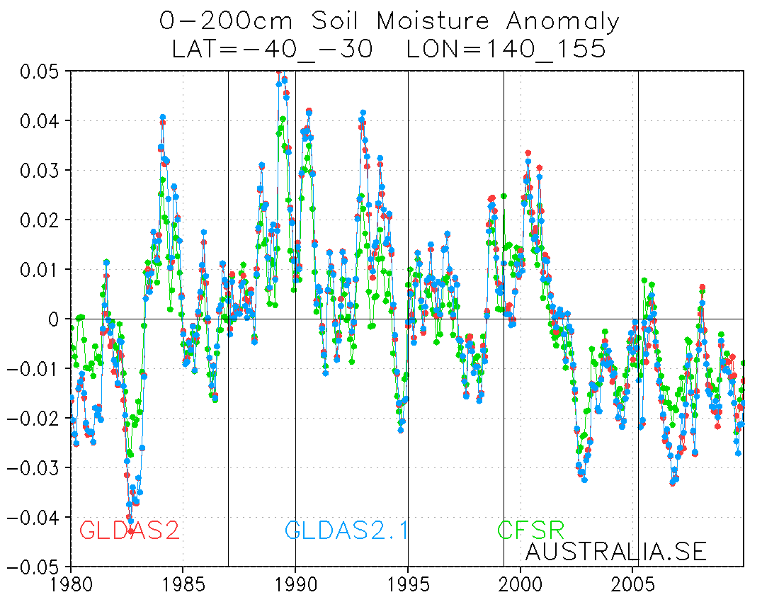
GLDAS Global Drought Monitor
Russian drought
US drought
July 2012 Soil Moisture Anomaly from NCEP GLDASv2
Uganda flooding
2002-2007, The Australian Millennium Drought
from NCEP GLDASv2
Jesse Meng, NCEP/EMC

Slide 12
Summary
Improve the CFSR GLDAS
GLDAS under NASA Land Information System (LIS): parallel run environment, latest land model physics, land data sets, data assimilation/validation tools.
land data sets, vegetation types, soil types, albedo, etc.
enhance land model spin-up procedures.
real time precipitation forcing.
snow data assimilation.
global river-routine.
global drought monitor.

