Slide 1
Improving the Prognostic Ozone Parameterization in the NCEP GFS and CFS for
Climate Reanalysis and Operational Forecasts
Gilbert P. Compo^{1,2}, Hai-Tien Lee³, Sarah Lu⁴, Shrinivas Moorthi⁴, John P. McCormack⁵, Craig Long³, Prashant D. Sardeshmukh^{1,2}, Jeffrey S. Whitaker²
¹University of Colorado/CIRES
²NOAA Earth System Research Laboratory/Physical Sciences Division
³NOAA, National Centers for Environmental Prediction, Climate Prediction Center
⁴NOAA, National Centers for Environmental Prediction, Environmental Modeling Center
⁵Naval Research Laboratory
1

Slide 2
Stratospheric Ozone
A key radiatively active constituent in both solar and infrared radiation
Affects temperature of stratosphere, troposphere, and surface
Reduces harmful ultraviolet light reaching surface
Ozone variations play role in climate variability of Northern and Southern Hemisphere
Reanalysis systems, and the weather models on which they rely, must accurately represent the ozone field and its effect on climate variations.
Complete ozone photochemistry is too computationally intensive to include in current weather and climate models
So, parameterize processes!
2

Slide 3
Naval Research Laboratory
CHEM2D Ozone Photochemistry Parameterization (CHEM2D-OPP, McCormack et al. (2006))
CHEM2D-OPP is based on gas-phase chemistry circa 2000.
Same approach as used in ECMWF IFS (Cariolle and Deque 1986).
Includes ozone depletion from CFCs.
Net ozone photochemical tendency:
functional form of Production P minus Loss L
Approximate as Taylor series linearized about
reference state (denoted by overbar).
prognostic Ozone mixing ratio
Temperature
column ozone above
3

Slide 4
Partial use of CHEM2D-OPP in the current NCEP Global Forecast System (GFS) atmosphere/land model
Reference tendency (P-L)₀ and all partial derivatives are computed from odd oxygen (Ox ≡ O₃+O) reaction rates in the CHEM2D photochemical transport model.
CHEM2D is a global model extending from the surface to ~120 km that solves 280 chemical reactions for 100 different species within a transformed Eulerian mean framework with fully interactive radiative heating and dynamics.
The partial CHEM2D-OPP is used in the 20th Century Reanalysis (20CR) and operational NCEP Global Forecast System (GFS) system, and atmosphere of Climate Forecast System (CFS) Reanalysis (CFSR) and operational CFSv2.
prognostic Ozone mixing ratio
Temperature
column ozone above
4

Slide 5
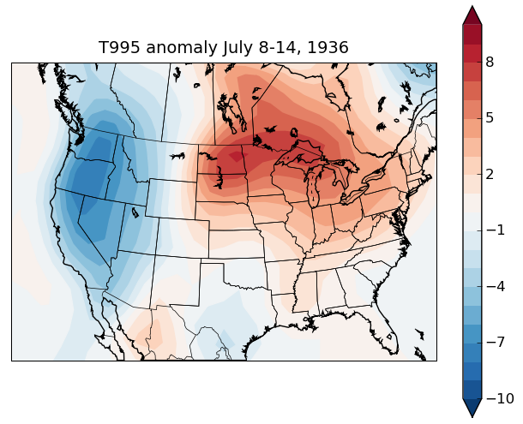
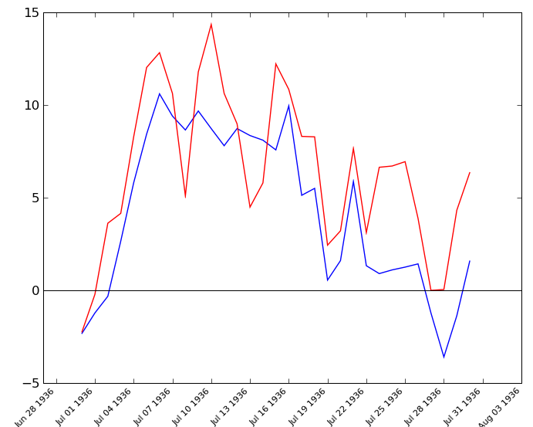
The 20th Century Reanalysis Project version 2 (1871-2011)
Summary: An international project led by NOAA and CIRES to produce 4-dimensional reanalysis datasets for climate applications extending back to the 19th century using an Ensemble Kalman Filter, NCEP GFS, and only surface pressure observations.
Weekly-averaged anomaly during
July 1936 United States Heat Wave (997 dead during 10-day span)
Daily variations compare well with in-situ data.
Weekly Near-surface Temperature
ºC
Bismark Stn
Reanalysis
*
Daily Near-surface Temperature Anomaly
Jul 1 7 13 19 25
The reanalyses provide:
-First-ever estimates of near-surface to tropopause 6-hourly fields extending back to the beginning of the 20th century;
-Estimates of uncertainties in the basic reanalyses and derived quantities (e.g., storm tracks).
Examples of uses:
Validating climate models.
Determining storminess and storm track variations.
Understanding historical climate variations (e.g., 1930s Dust Bowl, 1920-1940s Arctic warming).
Estimating risks of extreme events
Support from
US Dept of Energy Office of Science (BER), NOAA Climate Program Office
Compo et al. 2011
5

Slide 6
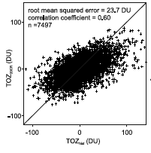
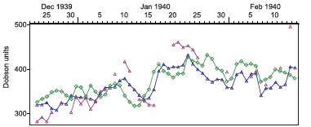
Daily column ozone measurements and
20CR daily ozone at Arosa, Switzerland (46.8N, 9.7E)
Anomaly comparison
spanning 1924 to 1963
measurements
20CR (56N, 18E)
R=0.60
20CR interpolated to Arosa
Despite assimilating only surface pressure observations,
20CR ozone field has large scale fluctuations that reflect
ozone highs associated with, e.g., cold air outbreaks
(Brönnimann and Compo 2012).
6

Slide 7
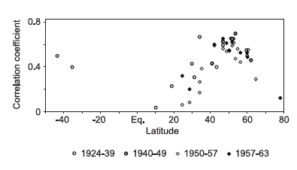
Column ozone from stations compared to 20CR
Period of
comparison
High correlations in Northern Hemisphere midlatitudes where dynamics are an important contributor to ozone variations.
Low correlations in Tropics and Poles.
Correlations are consistent with measurements taken throughout the record. (Brönnimann and Compo 2012)
7

Slide 8
Issue: Reference state ozone, temperature, and CHEM2D-OPP parameterization coefficients include the chemistry arising from CFCs throughout the 1871-2011 20CR record.
CFCs invented in 1930s.
Project: new CHEM2D-OPP coefficients and an appropriate ozone climatology will be generated for the period before widespread CFC usage.
Test effects on 20CR fields by comparing to historical ozone observations and to upper-air temperature observations.
But: Inclusion of CFC in early 20th century is probably not the whole story.
Some of the issues seen in 20CR ozone likely relate to
an effect seen in operational GFS ozone forecasts.
8

Slide 9
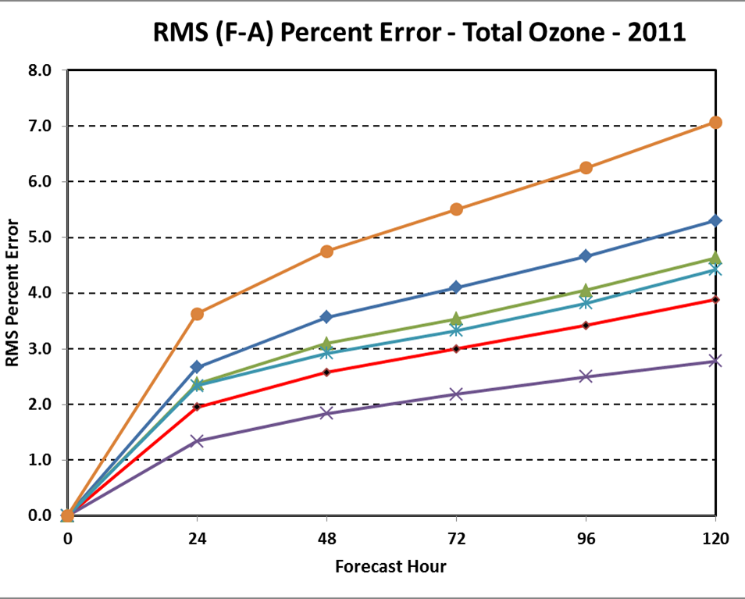
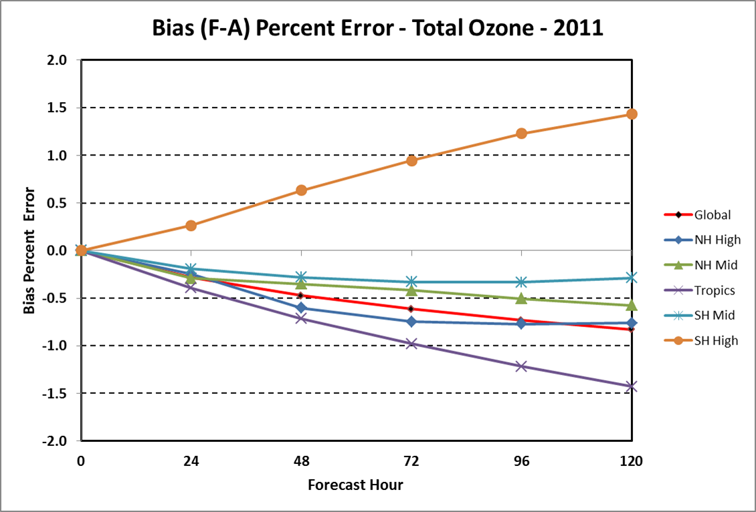
GFS ozone forecast skill for 2011
Root Mean Square Error
Bias
8.0
0
120
0
120
GFS ozone forecast skill degrades significantly after 5 days due, in part, to unrealistic losses over most of the globe resulting in a global negative bias.
Why the loss of ozone?
Long et al. 2013
9

Slide 10
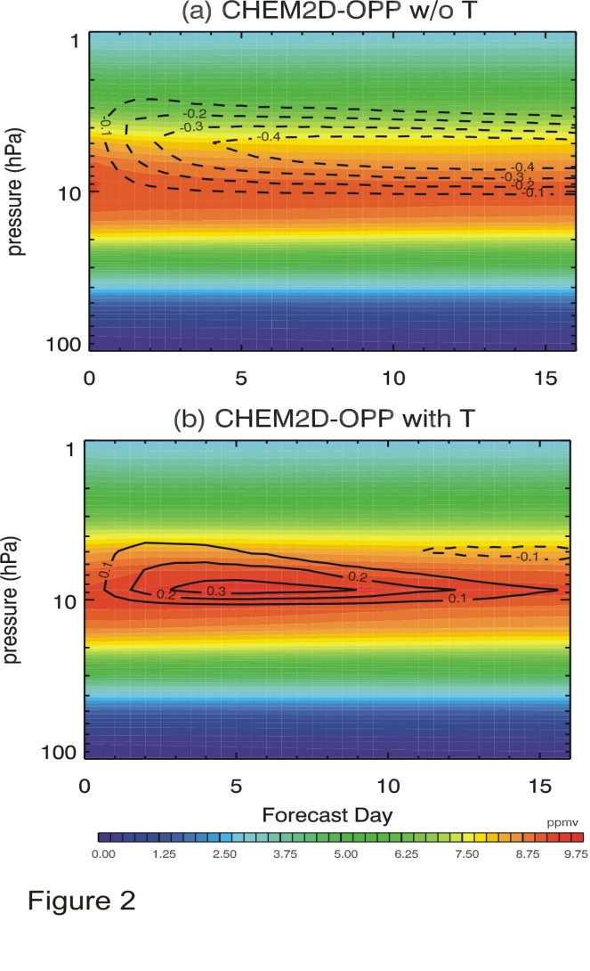
Forecasts of Equatorial Stratospheric O₃ mixing ratios using NOGAPS-ALPHA model with and without CHEM2D-OPP temperature term (June)
Without temperature term
With temperature term
Line
Contours
show O₃
Tendency
From initial condition
(dashed=
Loss)
Forecast Day
Forecast Day
ppmv
Adding temperature term should significantly reduce unrealistic loss in GFS-type implementation
prognostic Ozone mixing ratio
Temperature
column ozone
McCormack et al. 2013
10

Slide 11
Goal: Improve and reduce the errors in the weather and climate variability of the NOAA GFS model with a particular focus on the stratosphere.
Benefit to the NOAA Climate Reanalysis system and NCEP operational forecasts from
Improved treatment of stratospheric ozone by fully utilizing all 4 terms of CHEM2D-OPP.
Improved treatment of stratospheric ozone by accounting for the effect of the time-variation of CFCs in the parameterization.
Improved treatment of stratospheric water vapor by including a realistic climatology.
11

Slide 12
Compare new ozone implementation to NCEP operational
using 2015 NCEP Global Forecast System with daily 5-day
forecasts from January 2014 initial conditions
New Parameterization
NCEP Operational
New parameterization stops model ozone loss in tropics.
Too much ozone in summer pole (true for all seasons).

Slide 13
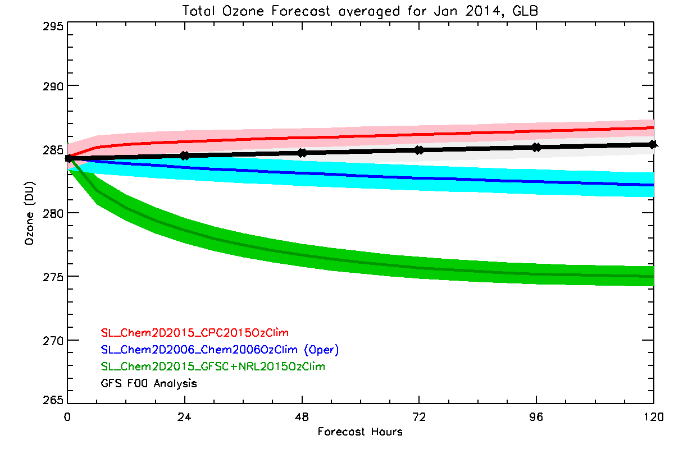
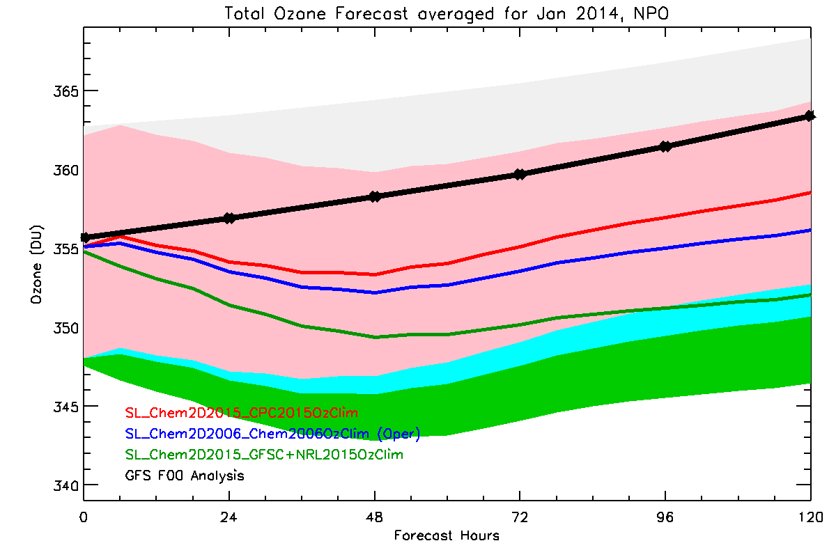
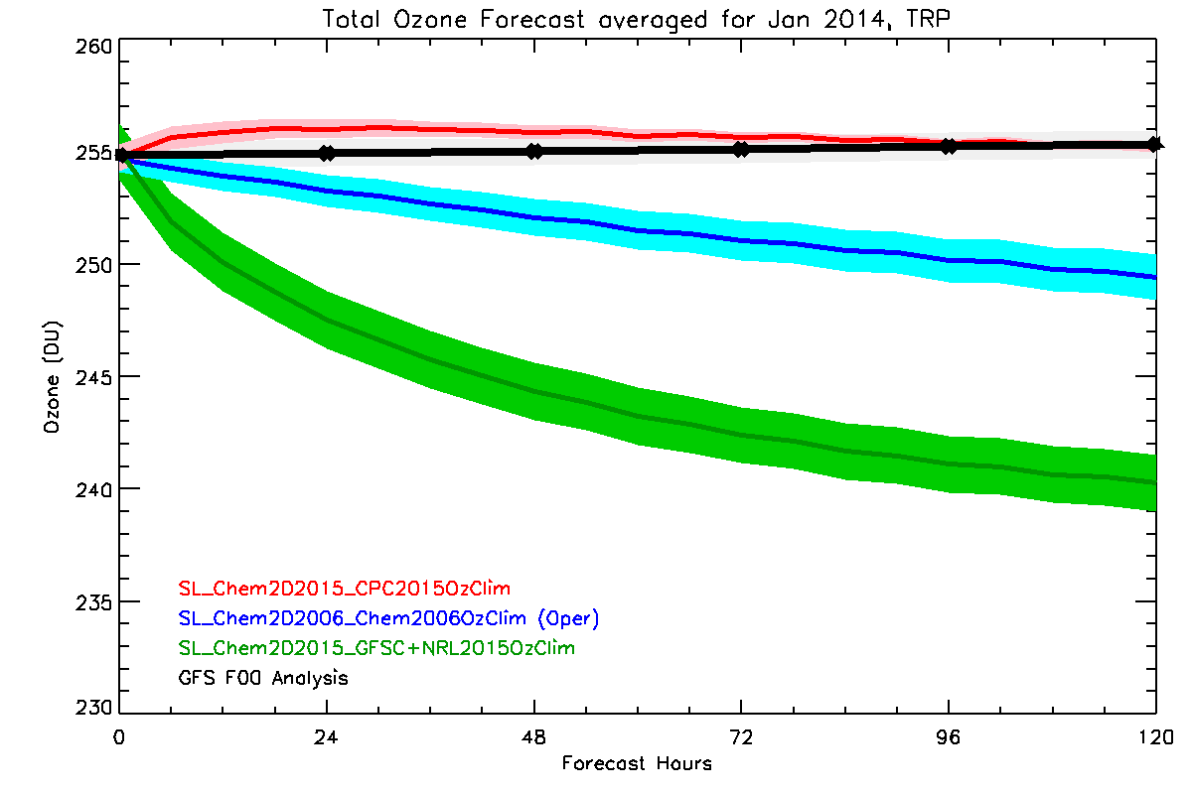
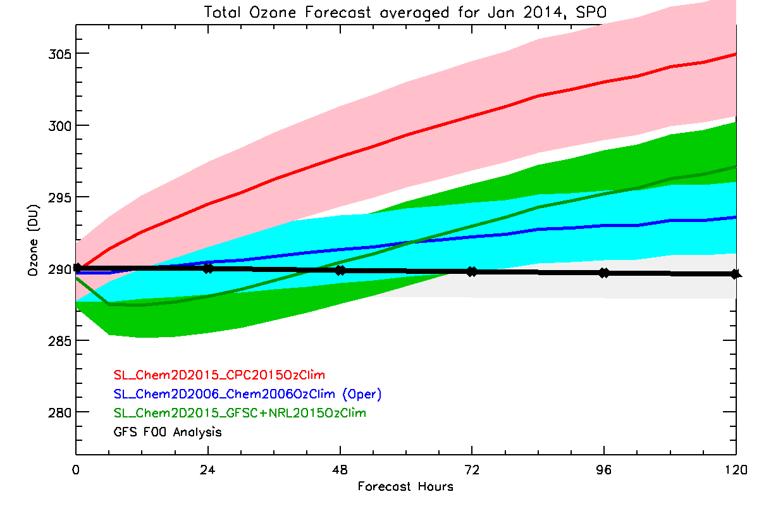
Average Evolution of 5 day total Ozone forecasts initialized daily for January 2014
Globe
N Hem >60N
0
120
0
120
Tropics
S Hem <60S
Problem with
reference ozone climatology
New Parameterization
NCEP Operational O3 parameterization
1st try at New Parameterization
GFS F00 Analysis
0
120

Slide 14
Conclusions
Linearized ozone parameterization is sensitive to specified reference climatology. 1st try including all 4 terms was worse than operational because reference ozone was low.
Inclusion of all 4 terms in from CHEM2D-OPP into NCEP GFS maintains global ozone in 5 day forecasts (and 30 day forecasts for all seasons). This is an improvement.
Current specified temperature reference is causing excessive ozone in summer pole. Improve reference climatology (combination of analyses and SPARC climatology for high altitudes).
Development continues and will include pre-CFC parameterization.

Slide 15
Project Plans
Implement more advanced O₃ parameterization using the full CHEM2D-OPP and an improved treatment of stratospheric water vapor for use in new versions of the GFS, CFS, and next generation NOAA climate reanalysis systems.
The O₃ parameterization will include the effect of changes in temperature, changes in the vertical distribution of O₃, and the time-variation of CFCs.
The upgraded parameterization and new climatology will be tested in climate reanalyses and weather and climate simulations.
Initially, the parameterization will be tested with two modes, one for times before CFCs and one for times after CFCs began to be released in large quantities.
Also implement a new stratospheric H₂O climatology as a necessary first step toward future implementation of parameterized H₂O photochemistry.
15

Slide 16
Thank you
Funding provided by the NOAA Modeling, Analysis, Predictions, and Projections program is acknowledged.
16

Slide 17
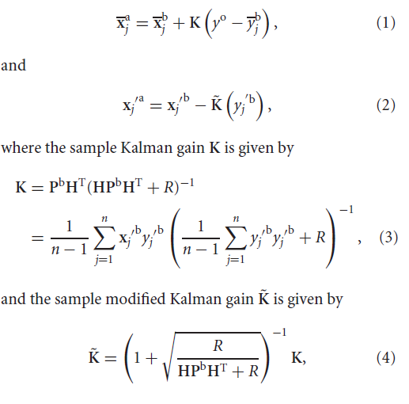
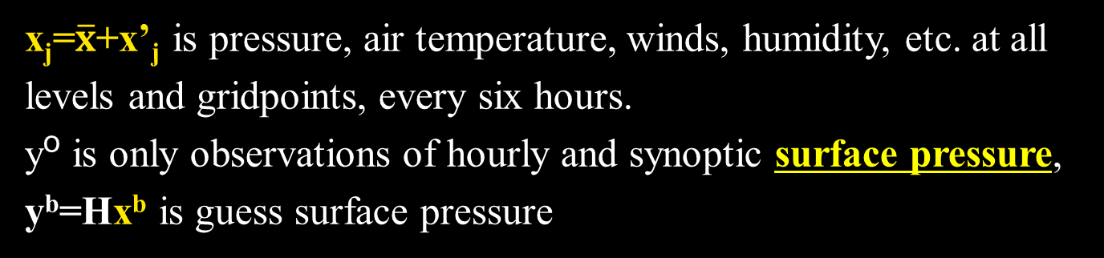
Ensemble Filter Algorithm (Whitaker and Hamill, 2002)
Ensemble mean
Ensemble deviations
Sample Kalman Gain
Sample Modified Kalman Gain
x_{j}=$\overline{x}$+x’_{j} is pressure, air temperature, winds, humidity, etc. at all levels and gridpoints, every six hours.
yº is only observations of hourly and synoptic surface pressure,
y^{b}=Hx^{b} is guess surface pressure
17

Slide 18
20th Century Reanalysis implementation of
Ensemble Filter Algorithm
(Whitaker et al. 2004, Compo et al. 2006, Compo et al. 2011)
Algorithm uses an ensemble of GCM runs to produce the weight K that varies with the atmospheric flow and the observation network every 6 hours
Using 56 member ensemble, HadISST1.1 prescribed SST and sea ice monthly boundary conditions (Rayner et al. 2003)
1871-2011: T62, 28 level NCEP GFS08ex atmosphere/land model
9 hour forecasts for 6 hour centered analysis window
- time-varying CO₂, solar and volcanic radiative forcing
- prognostic stratospheric ozone
Sampling and Model error parameterizations:
-Covariance localization (4000 km, 4 scale heights) and
-Latitude and time dependent multiplicative covariance inflation
(alpha = 1.01 to 1.12) [Anderson and Anderson, 1999; Houtekamer and Mitchell, 2001; Hamill et al. 2001; Whitaker et al., 2004]
18
http://go.usa.gov/XTd Compo et al. 2011, doi:10.1002/qj.776

Slide 19
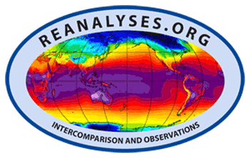
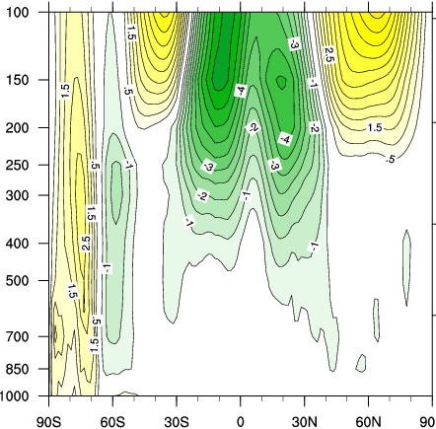
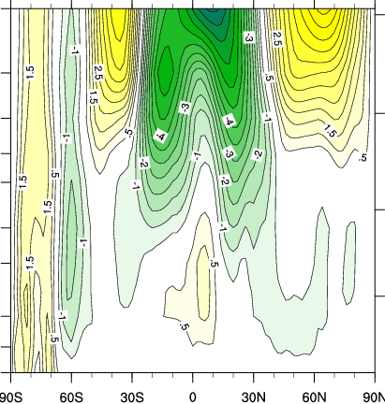
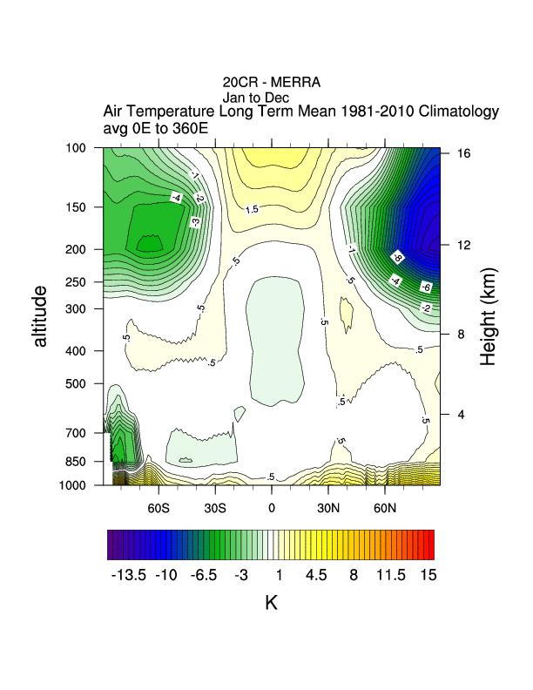
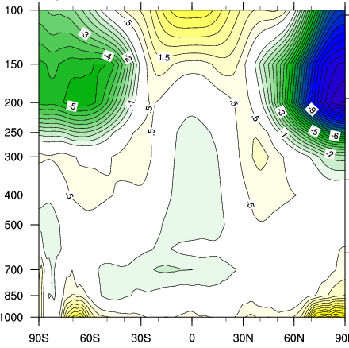
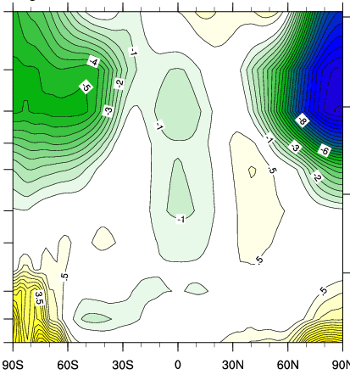
Zonal mean of annual differences between 20CR,
ERA-Interim and NNR (1981-2010)
ERA Interim
NNR
200
Zonal wind
CI:0.5 m/s
m/s
Biases
Over Poles
and
Stratosphere
1000
200
Air Temperature
K
CI:0.5 K
Courtesy of new NOAA-CIRES WRIT tool (C. Smith)
1000
20CR tropospheric biases are low and tend to be closer to ERA-Interim.
They are sometimes of opposite sign.
19
Adapted from Compo et al. (2011)
50S
EQ
50N
50S
EQ
50N

Slide 20
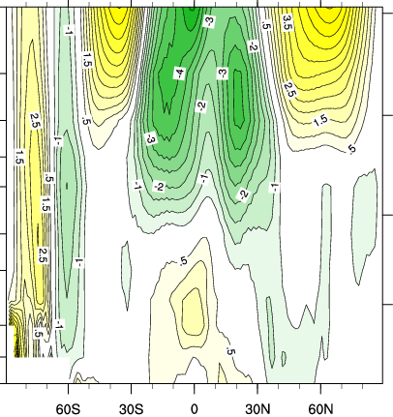
Zonal mean of annual differences between 20CR,
ERA-Interim and MERRA (1981-2010)
ERA Interim
MERRA
200
Zonal wind
CI:0.5 m/s
m/s
Biases
Over Poles
and
Stratosphere
1000
200
Air Temperature
K
CI:0.5 K
Courtesy of new NOAA-CIRES WRIT tool (C. Smith)
1000
20CR stratospheric biases are large and tend to be slightly closer to MERRA.
Sign of biases is similar.
Adapted from Compo et al. (2011)
20

