Slide 1
Progress on NOAA Climate Reanalyses development
Jack Woollen, NCEP/EMC
Wesley Ebisuzaki, NCEP/CPC
Leigh Zhang, NCEP/CPC
Hyun-Chul Lee, NCEP/CPC
November 18, 2015

Slide 2
Summary of Climate Reanalysis Project
Port NCEP Hybrid 3D EnVar system to Gaea for Reanalysis experiments
Began T254/T126runs starting in 1981, 1990, 1997 to investigate various CFSR issues
Good results for QBO representation, SSU analysis, forecast skill, compared with CFSR
EnVar system very slow on Gaea producing only 4-5 days/day progress
3DVar non=ens system faster, 10-12 days/day, but not as interesting
J. Whitaker developed a more efficient (21days/day) NOSAT ENKF system for testing
After initial assessment Decision was made to rerun R1 period with the new system
Streams were started in each decade to expeditre the rerun experiment
In the past year we have completed 46+ years in the 60 year period 1950-2010.
This report presents some of the preliminary evaluations of these runs

Slide 3
Summary of Climate Reanalysis Project
Port NCEP Hybrid 3D EnVar system to Gaea for Reanalysis experiments
Began T254/T126runs starting in 1981, 1990, 1997 to investigate various CFSR issues
Good results for QBO representation, SSU analysis, forecast skill, compared with CFSR
EnVar system very slow on Gaea producing only 4-5 days/day progress
3DVar non=ens system faster, 10-12 days/day, but not as interesting
Jeff Whitaker developed a more efficient (21days/day) NOSAT ENKF system for testing
After initial assessment decision was made to rerun R1 period with the new system
Streams were started in each decade to expeditre the rerun experiment
In the past year we have completed 46+ years in the 60 year period 1950-2010.
This report presents some of the preliminary evaluations of these runs

Slide 4
ESRL Single-Resolution EnKF Only System
Conventional obs only in this system
Possible R1 replacement
Used for forecast IC for next cycle
member 1
forecast
Generating new ensemble perturbations given the latest set of observations and a first-guess ensemble
Uses background error covariances computed from the ensemble
member 1
analysis
EnKF ensemble perturbations
are "re-centered" around the high-res analysis
T254L64
member 2
forecast
EnKF
member update
member 2
analysis
member 3
analysis
member 3
forecast
Previous Cycle
Current Update Cycle
Faster than a similar hybrid since no waiting on one branch or the other
Thanks to Jeff Whitaker
Notes:
1) Can you describe what happens in the box entitled "EnKF member update?" The EnKF is run at the late (GDAS) data cutoff, and updates every ensemble member using the EnKF algorithm, using background error covariances computed from the ensemble (no static component). The GSI cannot be used to update the ensemble, since it only provides a single deterministic analysis (analagous to the mean of the EnKF ensemble). However, since the high-res hybrid analysis then replaces the EnKF ensemble mean analysis, effectively only the ensemble perturbations are cycled using the EnKF update. You can think of the this update as doing the same thing as the current operational ETR scheme - it's generating new ensemble perturbations given the latest set of observations and a first-guess ensemble. The ETR does this without using any observational information, just be rescaling and rotating the first-guess perturbations. 2) Exactly what is meant by "re-centering the ensemble around the analysis?" The high-resolution analysis computed by the GSI, using the first-guess ensemble to estimate background error covariances, replaces the ensemble EnKF analysis computed by the EnKF update step. In other words, the EnKF ensemble perturbations are "re-centered" around the high-res analysis. 3) How are members 1-n of the analysis used (arrows going off page)? They are run forward by the GFS to form the first-guess ensemble for the next analysis time. 4) is it correct that the deterministic forecast is run off the analysis (bottom row)? Yes.

Slide 5
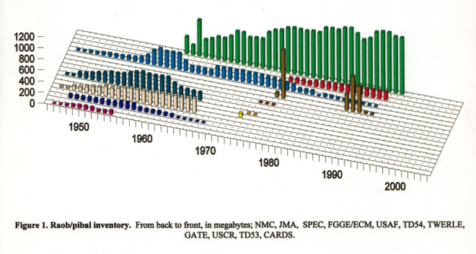
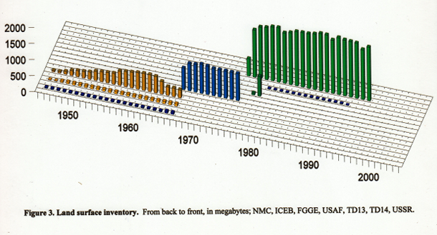
The NCEP 65+ Year Reanalysis Observation Database
NCEP partnered with NCAR, with contributions from other NWP research centers, to produce the first long term (50 years, 1948-1998) global reanalysis product, during the 1990’s. The database setup and data assimilation component carried out at NCEP was ongoing through the years 1993-2000. The project was known as the NCEP/NCAR Global Reanalysis (NNGR), or GR1. The observation preparation and preprocessing requirement for this project was significant. The bits and pieces of the data were stored in many different places and formats. The data rescue group of ~10 people at NCAR spent many man years cleaning up and time checking archived datasets and sending them to NCEP. Diagrams below, for example, show the major components of the PILOT/TEMP and the SYNOP datasets, 1948-1997.

Slide 6
The NCEP 65+ Year Reanalysis Observation Database
About four generations of improvements and additions have been made to the original dataset components (created by Roy Jenne’s group at NCAR) since 1993.
In the NCEP merge processing, duplicate radiosonde profiles are composited instead of only picking one to use.
X-Y-T balloon drift information is computed and stored for TEMP and PILOT, computed from wind profiles.
NCEP partnered with NCAR, with contributions from other NWP research centers, to produce the first long term (50 years, 1948-1998) global reanalysis product, during the 1990’s. The database setup and data assimilation component carried out at NCEP was ongoing through the years 1993-2000. The project was known as the NCEP/NCAR Global Reanalysis (NNGR), or GR1. The observation preparation and preprocessing requirement for this project was significant. The bits and pieces of the data were stored in many different places and formats. The data rescue group of ~10 people at NCAR spent many man years cleaning up and time checking archived datasets and sending them to NCEP. Diagrams below, for example, show the major components of the PILOT/TEMP and the SYNOP datasets, 1948-1997.

Slide 7
Initial assessments of the ENKF system was positive enough to decide to brgin rerun 1950-2010 with the new system
Comparative 500mb height anomaly correlation scores
HY1981 .838
EN1981 .801
ERAINT .830
GR1 .700
HY1998 .828
EN1998 .814
ERAINT .825
GR1 .700
EN1970 .777
ERA40 .710
GR1 .670
NH
01JAN1970
31DEC1970
01JUL1981
30JUN1982
01JAN1998
31DEC1998
EN1970 .545
ERA40 .555
GR1 .470
HY1981 .764
EN1981 .633
ERAINT .800
GR1 .444
HY1998 .715
EN1998 .656
ERAINT .810
GR1 .650
SH

Slide 8
The ENKF Reanalysis Stream Progress to date
JW1950 finished Jan1950-Apr1957
WE1960 finished Jan1960-Aug1965
JW1970 finished Jan1970-Nov1975
HY1981 finished Jan1981-Sep1991
LZ1990 finished Jan1990-Aug1998
LZ1998 finished Jan1998-Sep2005
HY=Hyun-Chul Lee
JW=Jack Woollen
LZ=Leigh Zhang
WE=Wesley Ebisuzaki

Slide 10
IGY begins mid-57
Equal SH skill in Y2K

Slide 11
Some diagnostics in various ENKF stream segments

Slide 12
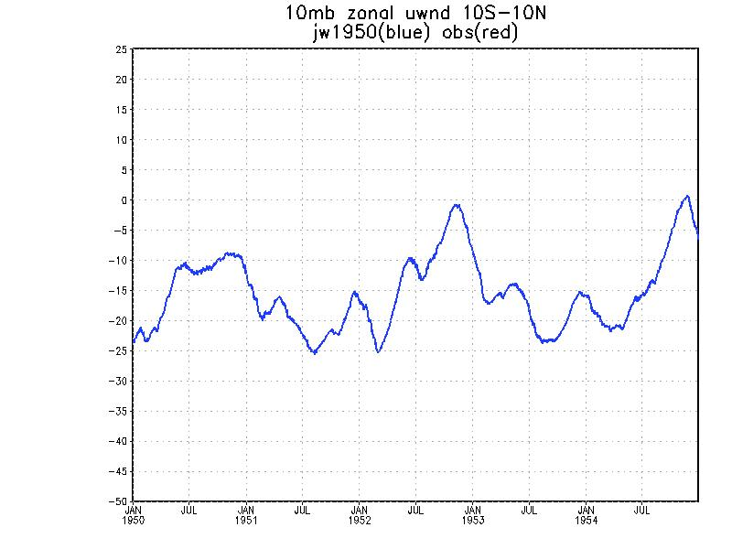
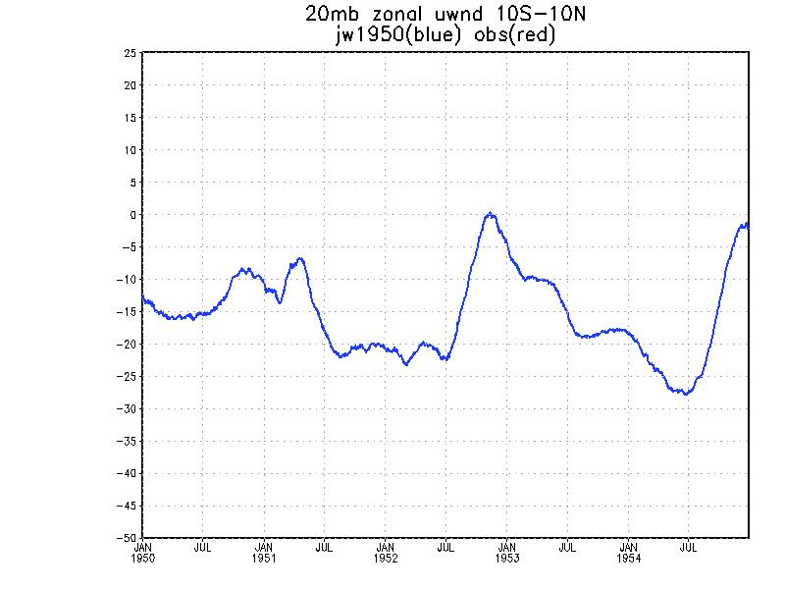
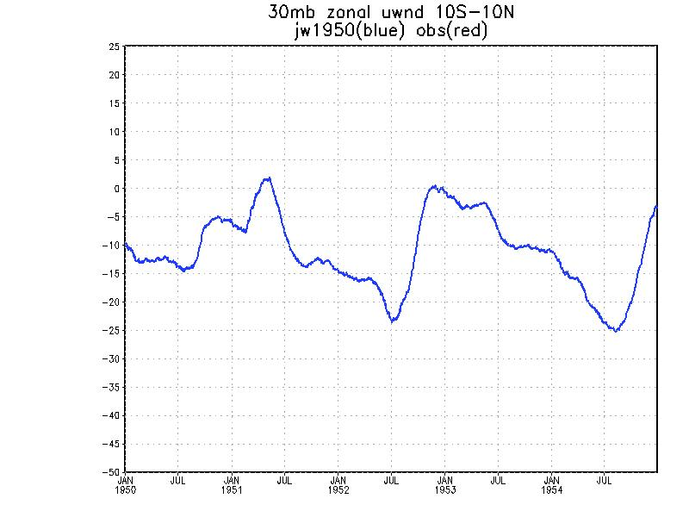
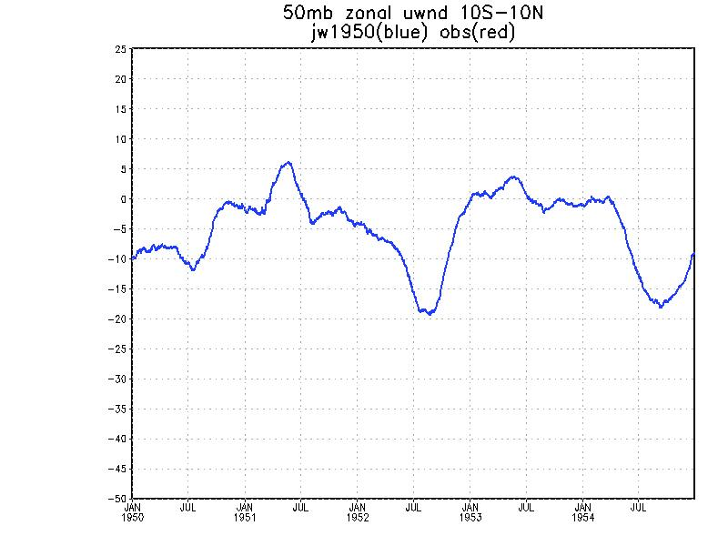
1950-1955
QBO

Slide 13
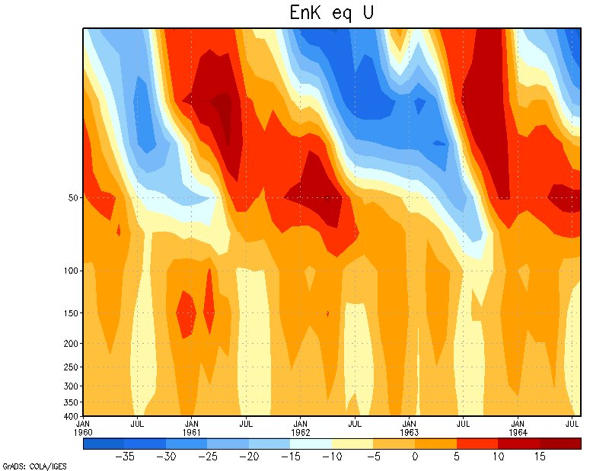
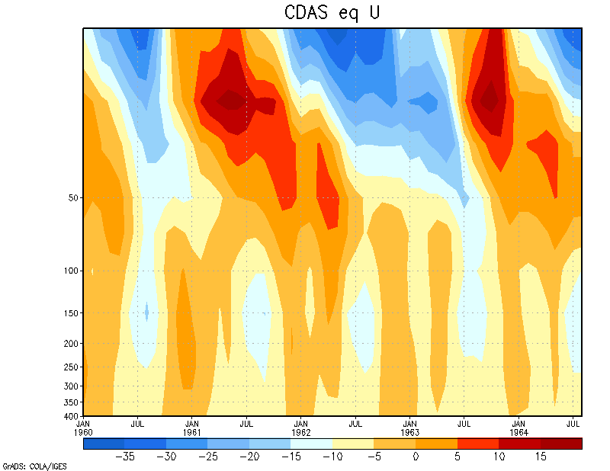
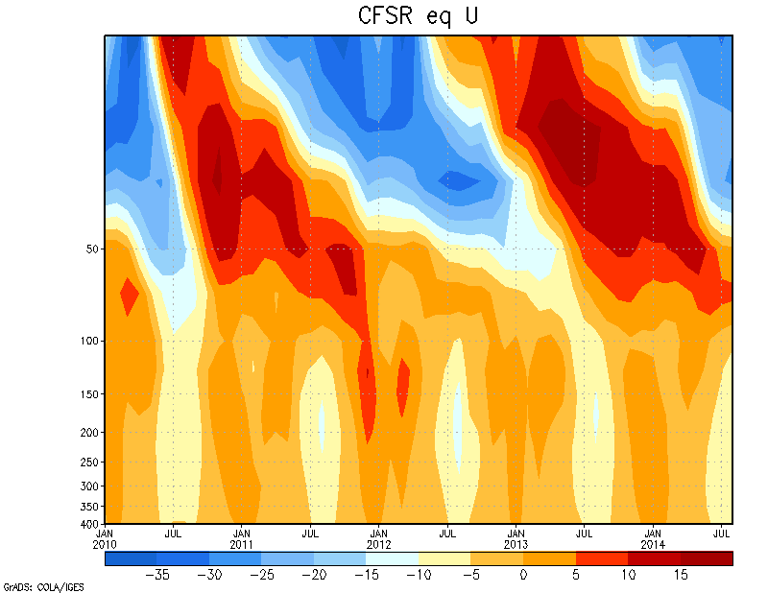
QBO in 1960s ENKF-R1-modern example
ENKF propagates further towards the tropopause, with a stronger westerly maximum at 50 mb.
ENKF QBO in 1960 is more similar than R1 to modern analyses using satellite data.
Note: CFSR is for 2010-2014

Slide 14
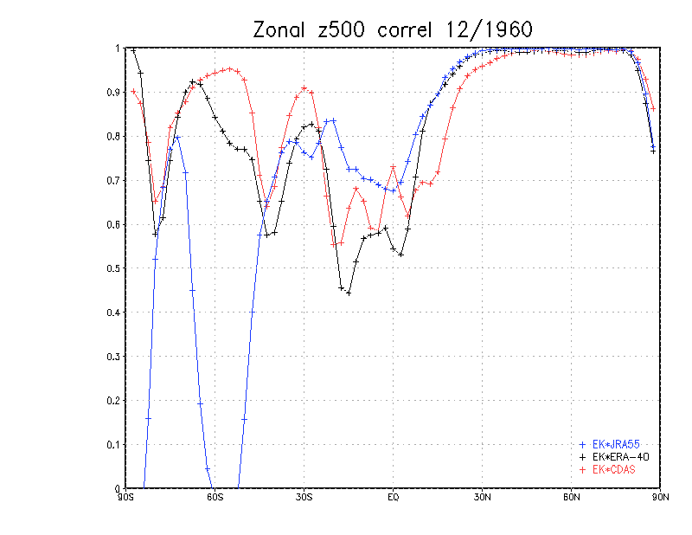
Zonal correlation: remove 1980-2009 CFSR climatology,
remove zonal mean, correlate on latitude circle.

Slide 15
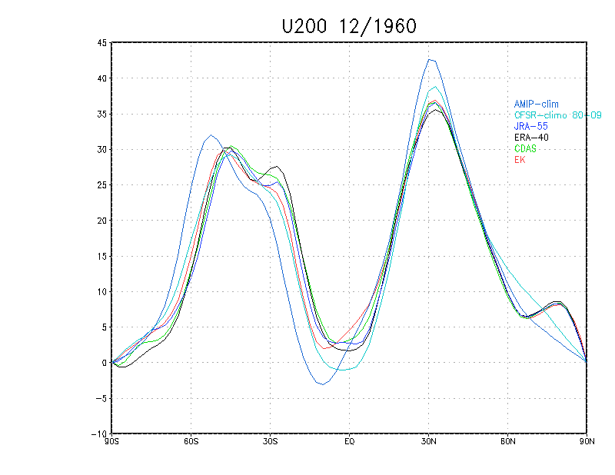

Slide 16
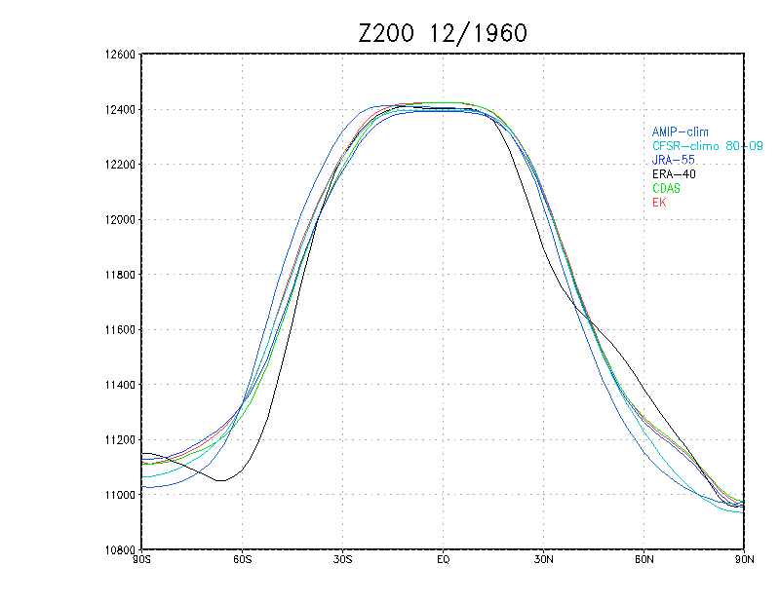

Slide 17
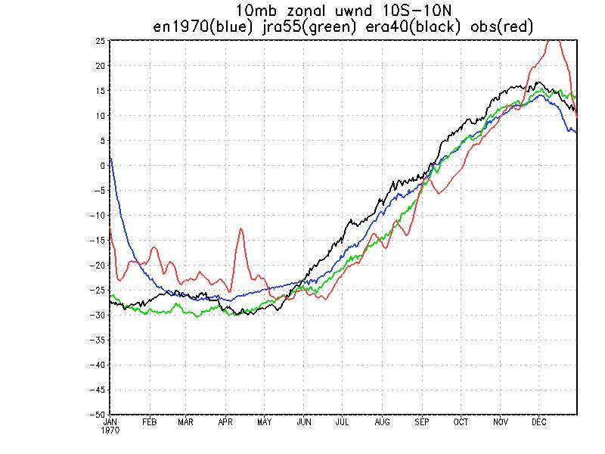
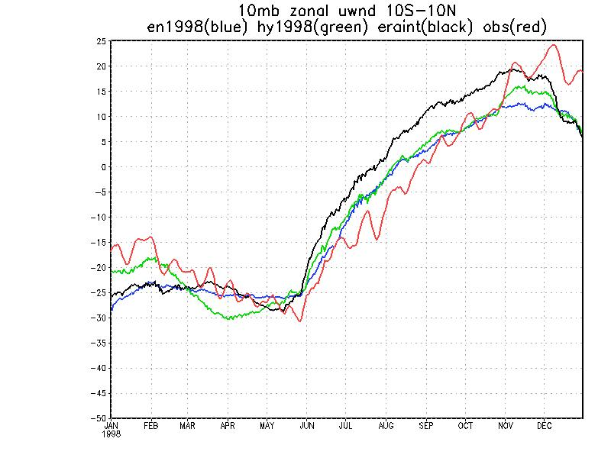
“Pure ENKF” 10mb QBO Phase Representation
1970 1998
Here the EN1970 was started from 20CR Initial conditions on 01jan1970. Since 20CR did not assimilate upper air observations, the EN1970 initial point is quite different from JRA55 or ERA40 . However it draws directly to the observations in less than one month.
The three systems displayed show fairly good attention to the obs and agreement with
one another. By 1998 the QBO is well defined in the
radiosonde data.

Slide 18
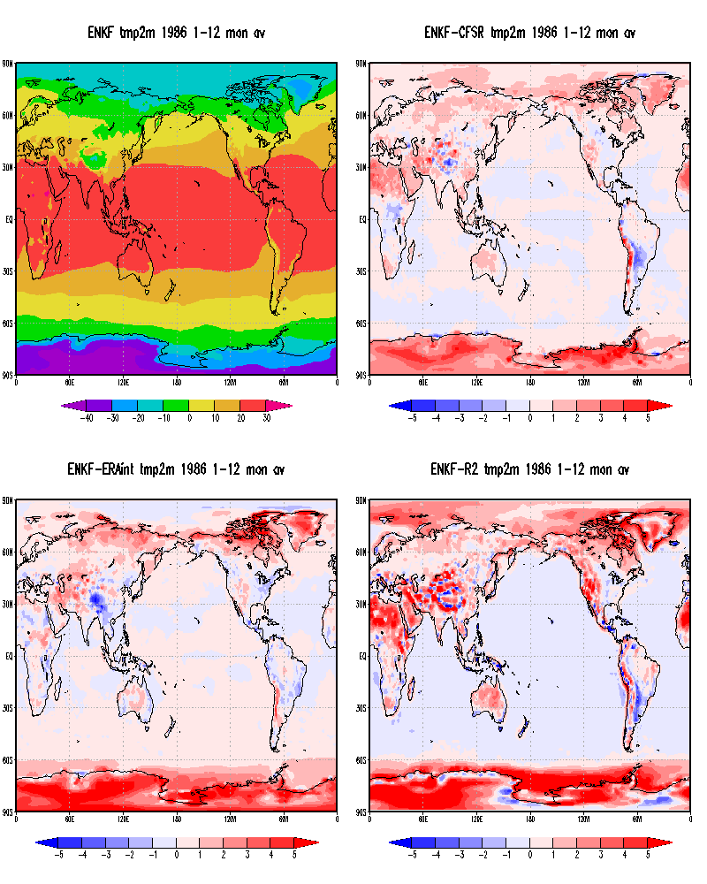

Slide 19
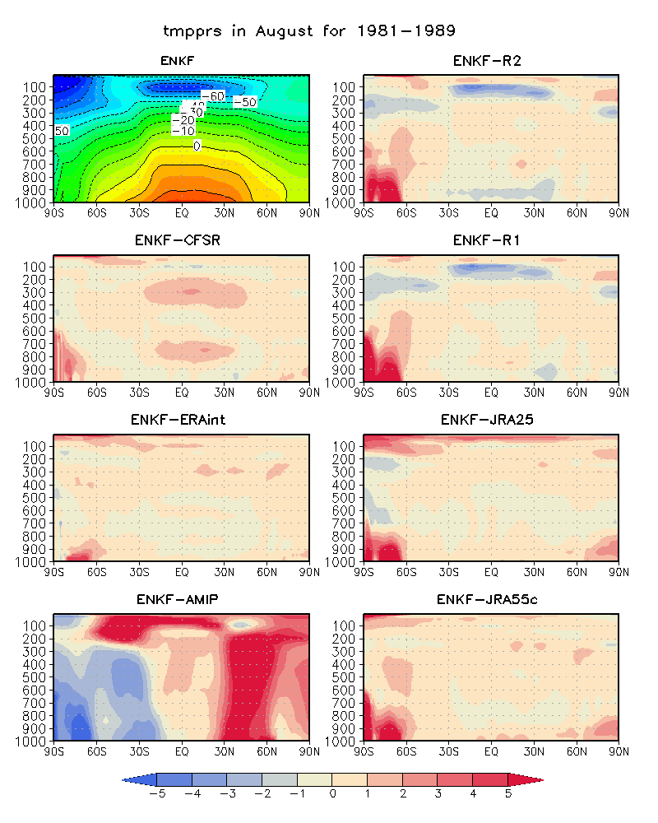

Slide 20
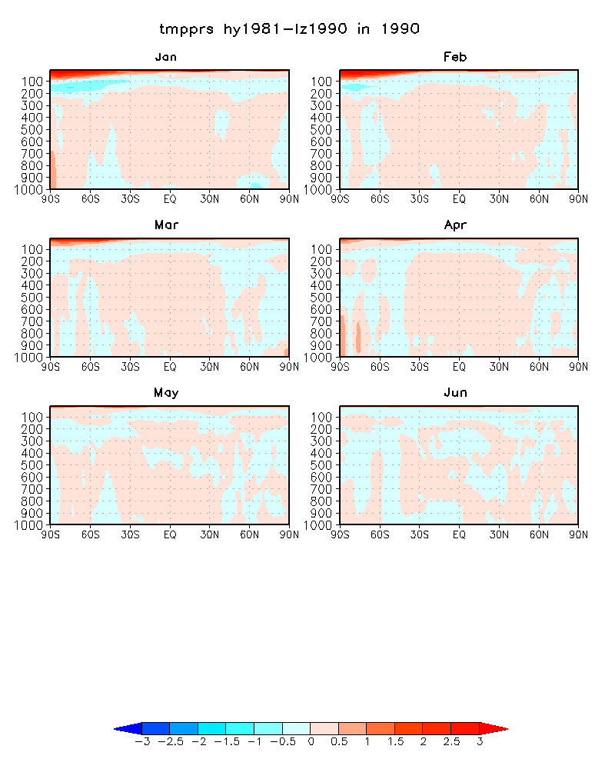
Difference in overlap of hy1981 stream and lz1990 stream
Jan-Jun 1990

Slide 21
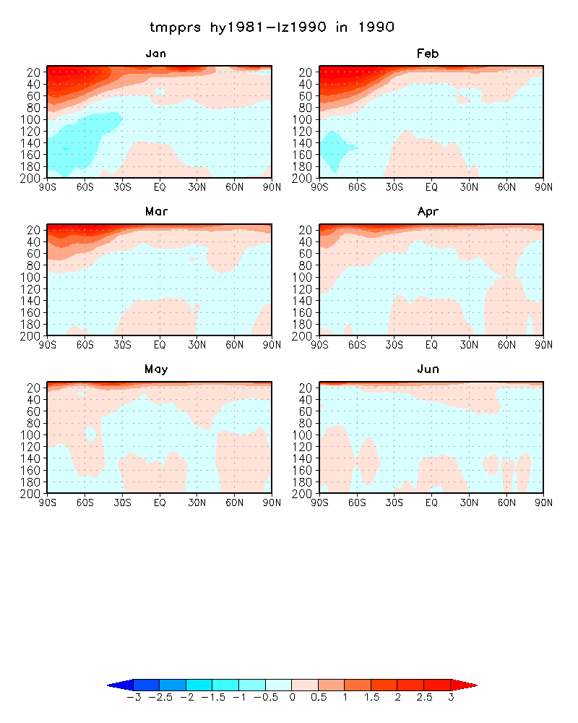
Difference in overlap of hy1981 stream and lz1990 stream
Jan-Jun 1990

Slide 22
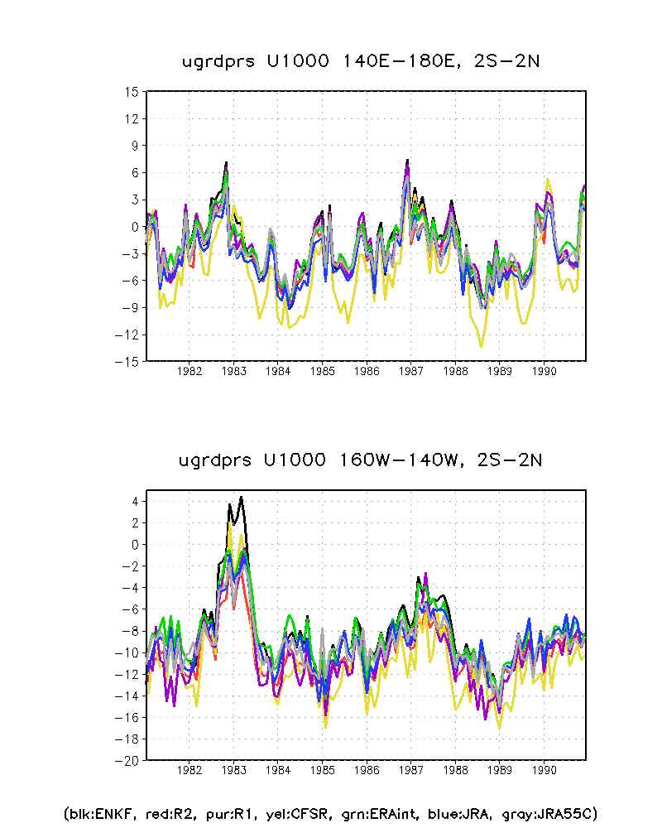

Slide 23
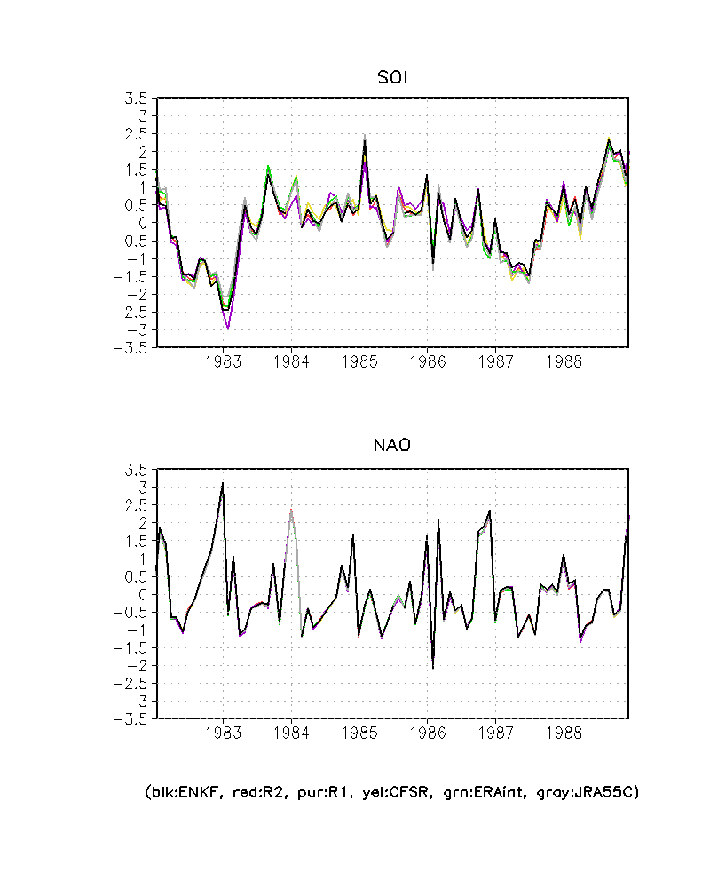
Comparison of SO and NAO indexes from ENKF with other reanalyses
1982-1989

Slide 24
EnKF from 1990-2004
199001-199803 from lz1990 run
199804-200412 from lz1998 run

Slide 25
Global mean temperature diff
CFSR-ERAI
EnKF-ERAI
EnKF-CFSR

Slide 26
Global mean temperature diff
CFSR-ERAI
CFSR sat bias correction problems
EnKF-ERAI
Warm bias in low model top
EnKF-CFSR

Slide 27
Equatorial Zonal Mean Wind
CFSR
ERA-I
EnKF

Slide 28
Equatorial Height at 10 and 200hPa
ENKF ERAI CFSR R2 R1

Slide 29
Global mean precipitation

