Slide 1
New uses for old weather
Philip Brohan and a cast of thousands
NOAA reanalysis task force: 2015-10-26 13 © Crown copyright Met Office

Slide 2
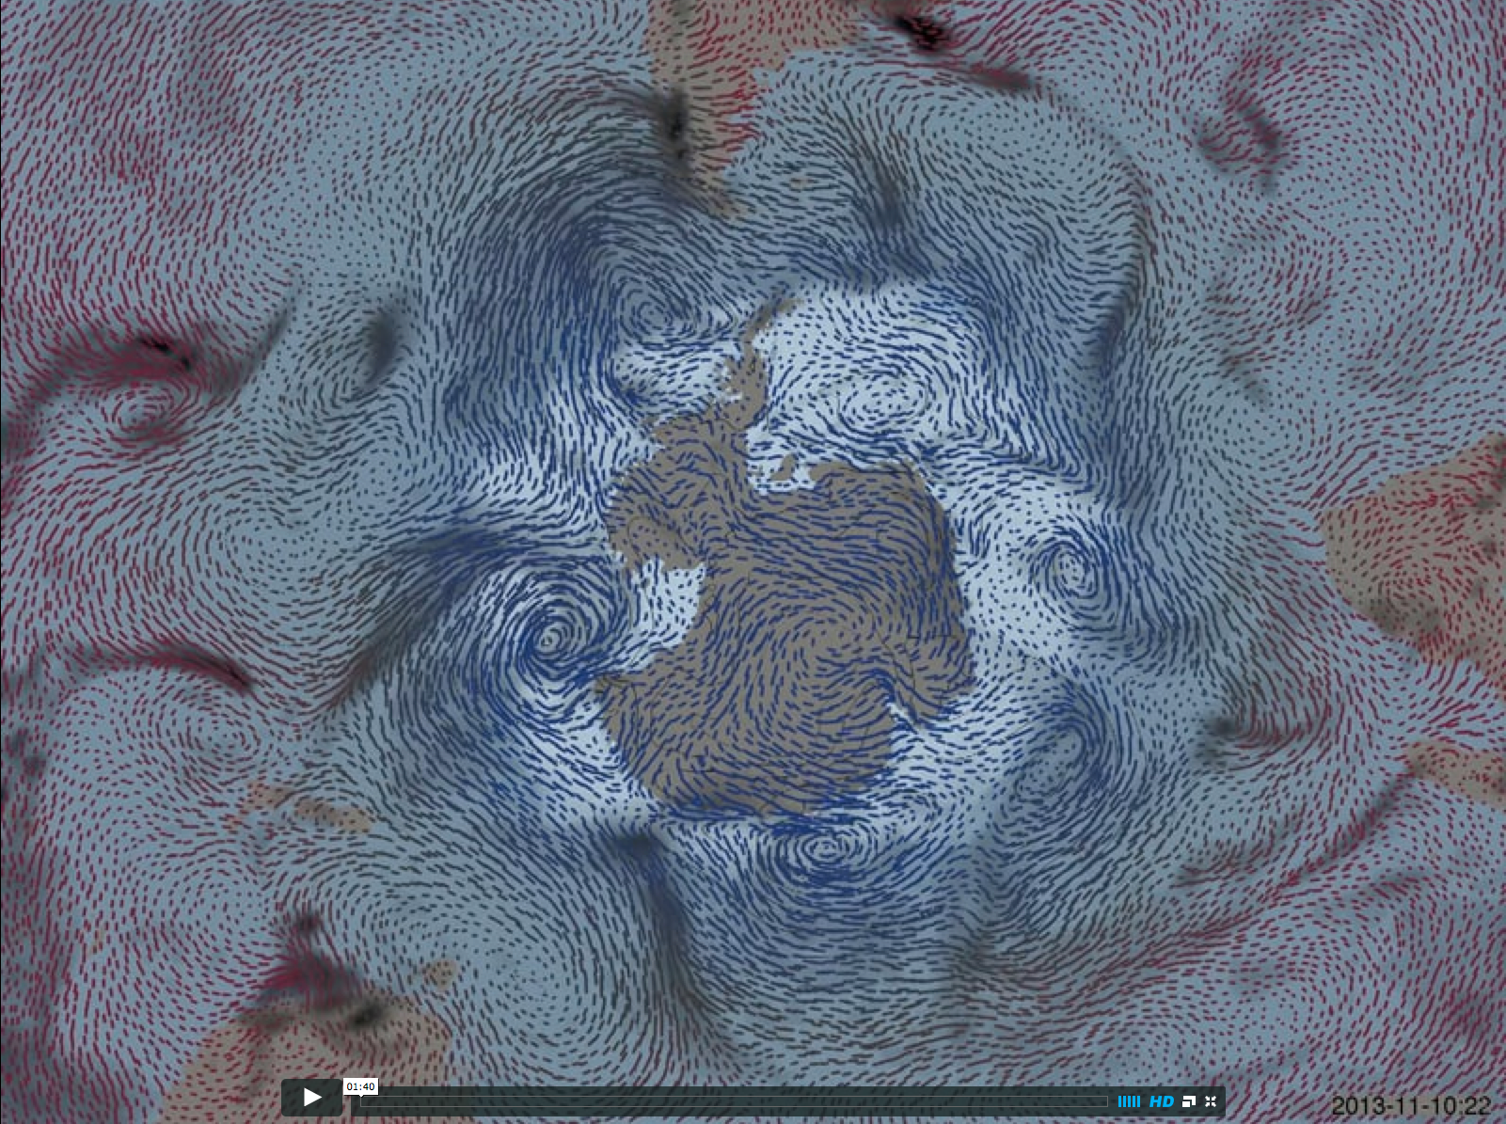
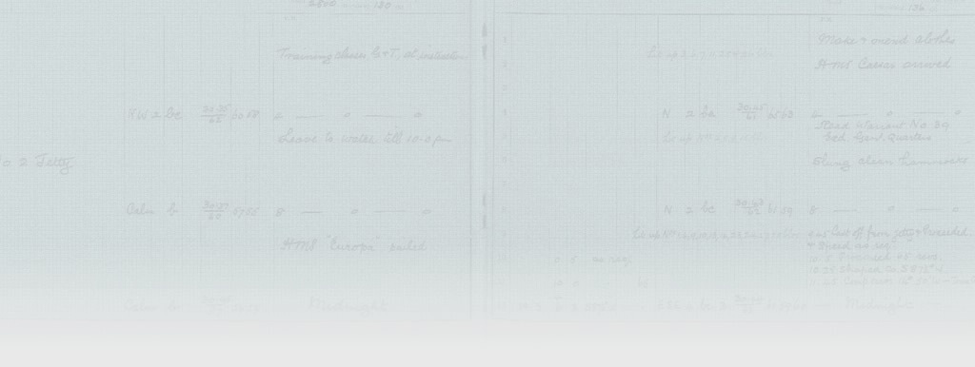
Video at https://vimeo.com/100094249

Slide 3
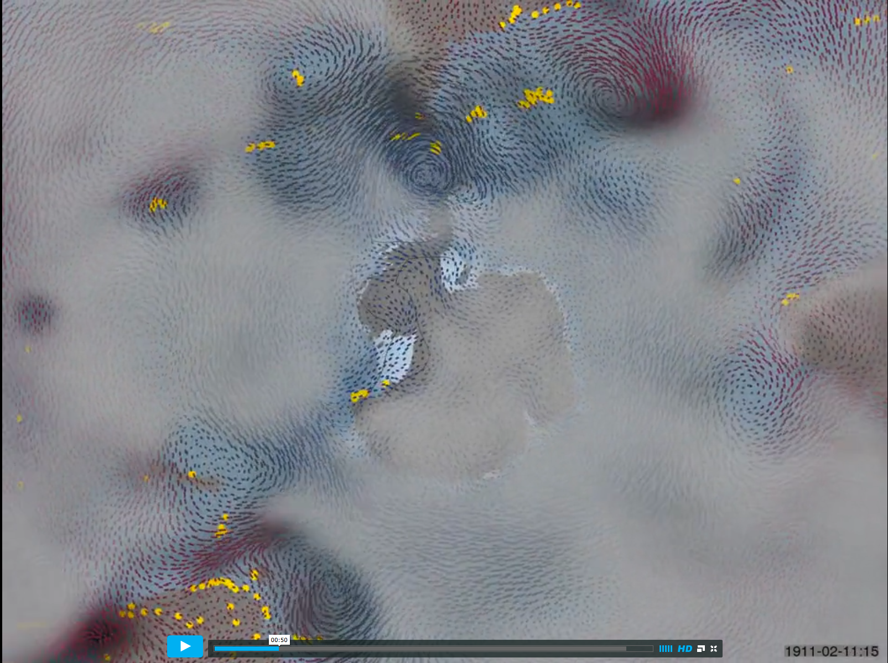
Video at https://vimeo.com/100102993

Slide 4
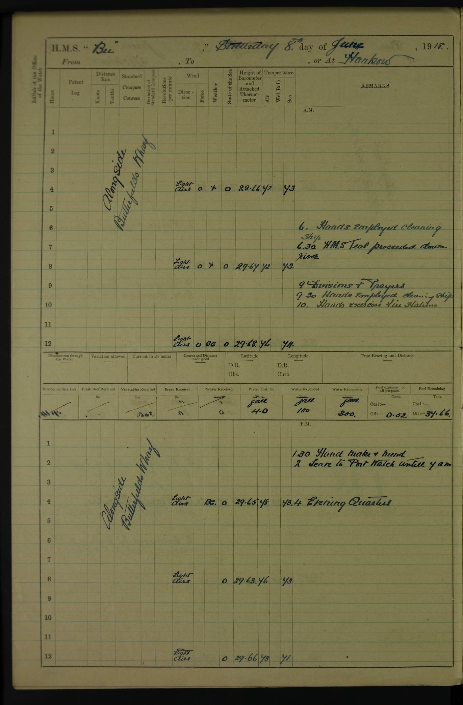

Slide 5
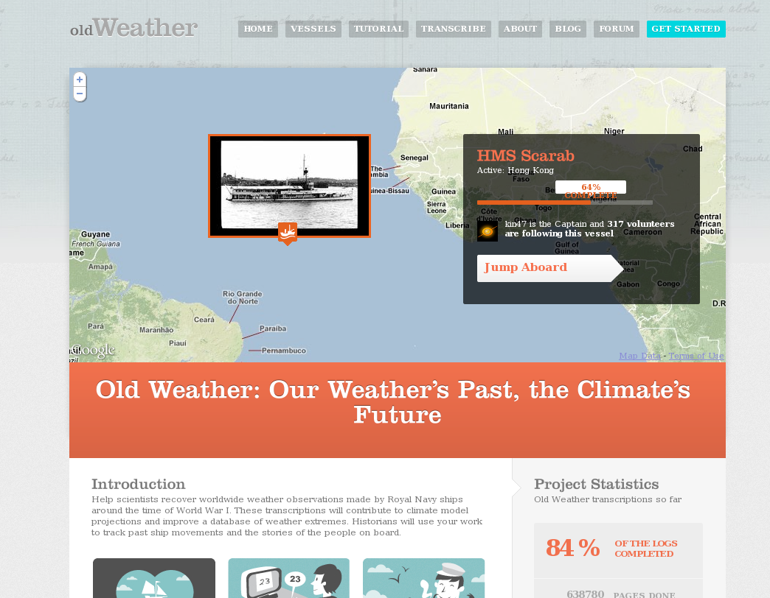
http://oldweather.org

Slide 6
Video at https://vimeo.com/64372102

Slide 7
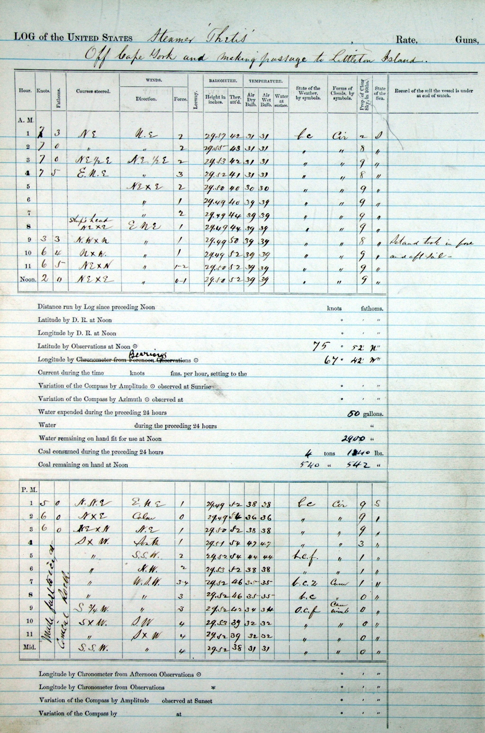
Notes:
Not quite mint, but a good reading copy – Royal Navy logs are a rich source of weather observations.
HMS Invincible, 1914-15 – TNA have 10s of thousands of logs like this, covering more than the last 200 years.

Slide 8
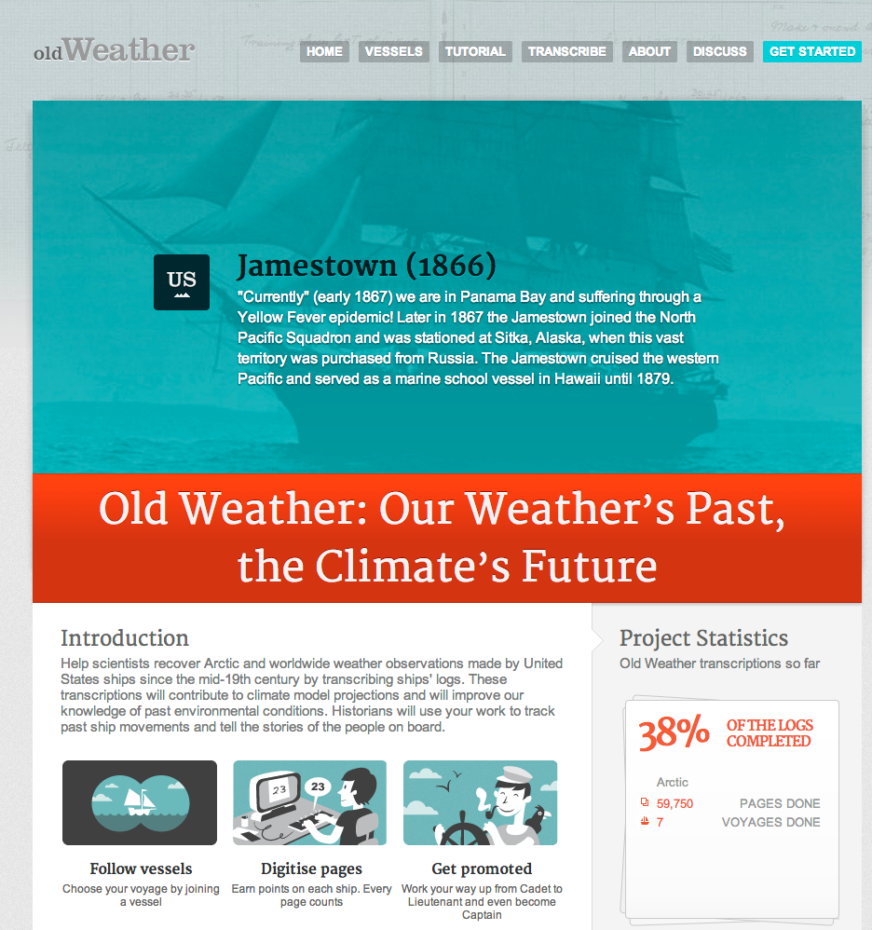

Slide 9
Video at https://vimeo.com/62031720

Slide 10
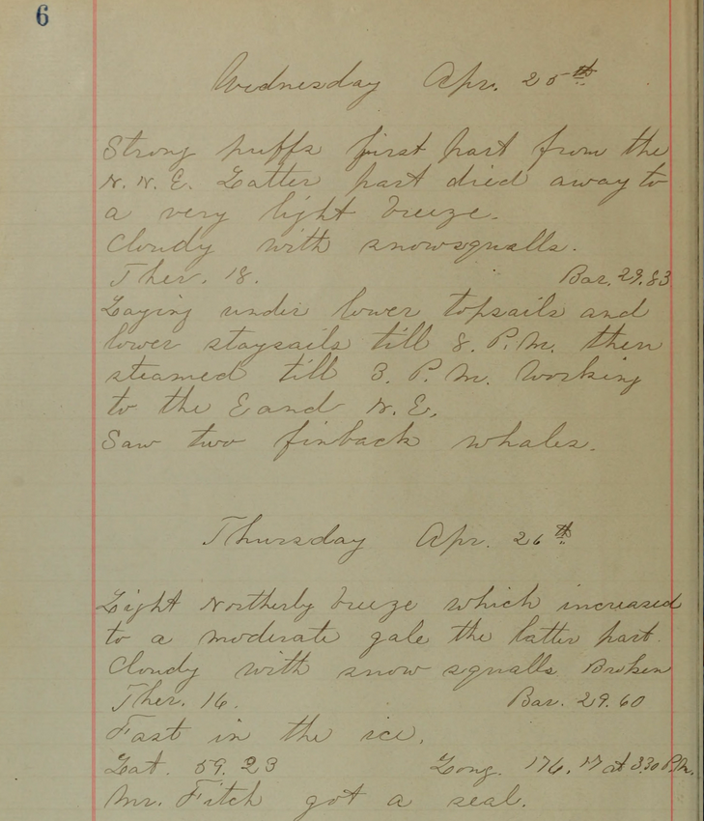

Slide 11
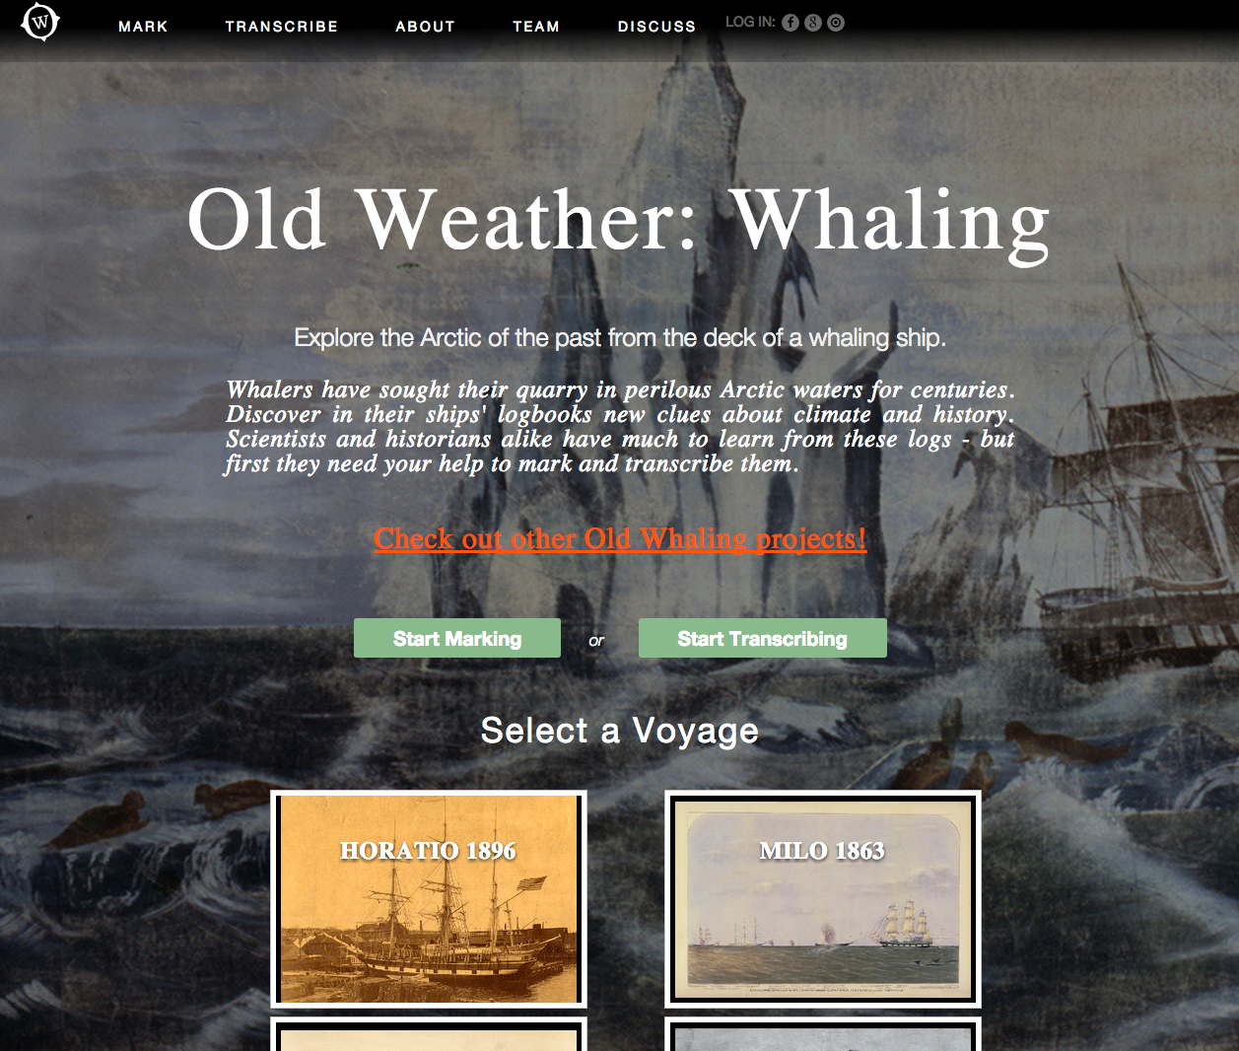

Slide 12
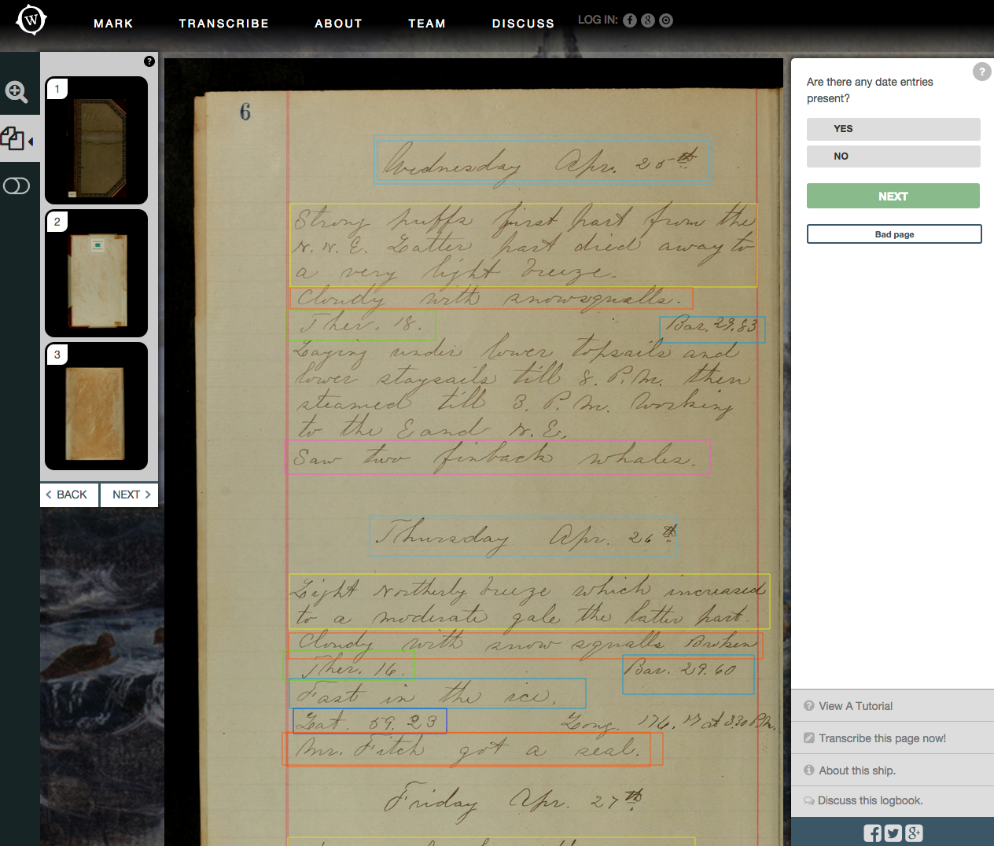

Slide 13
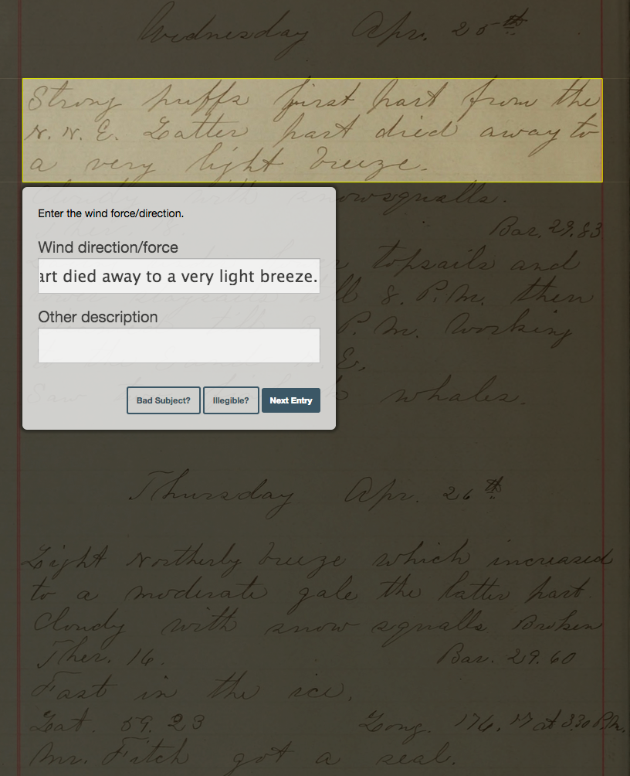

Slide 14
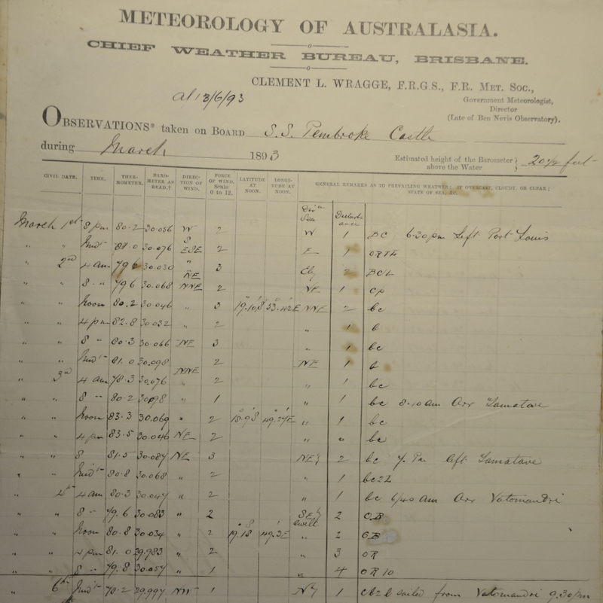

Slide 15
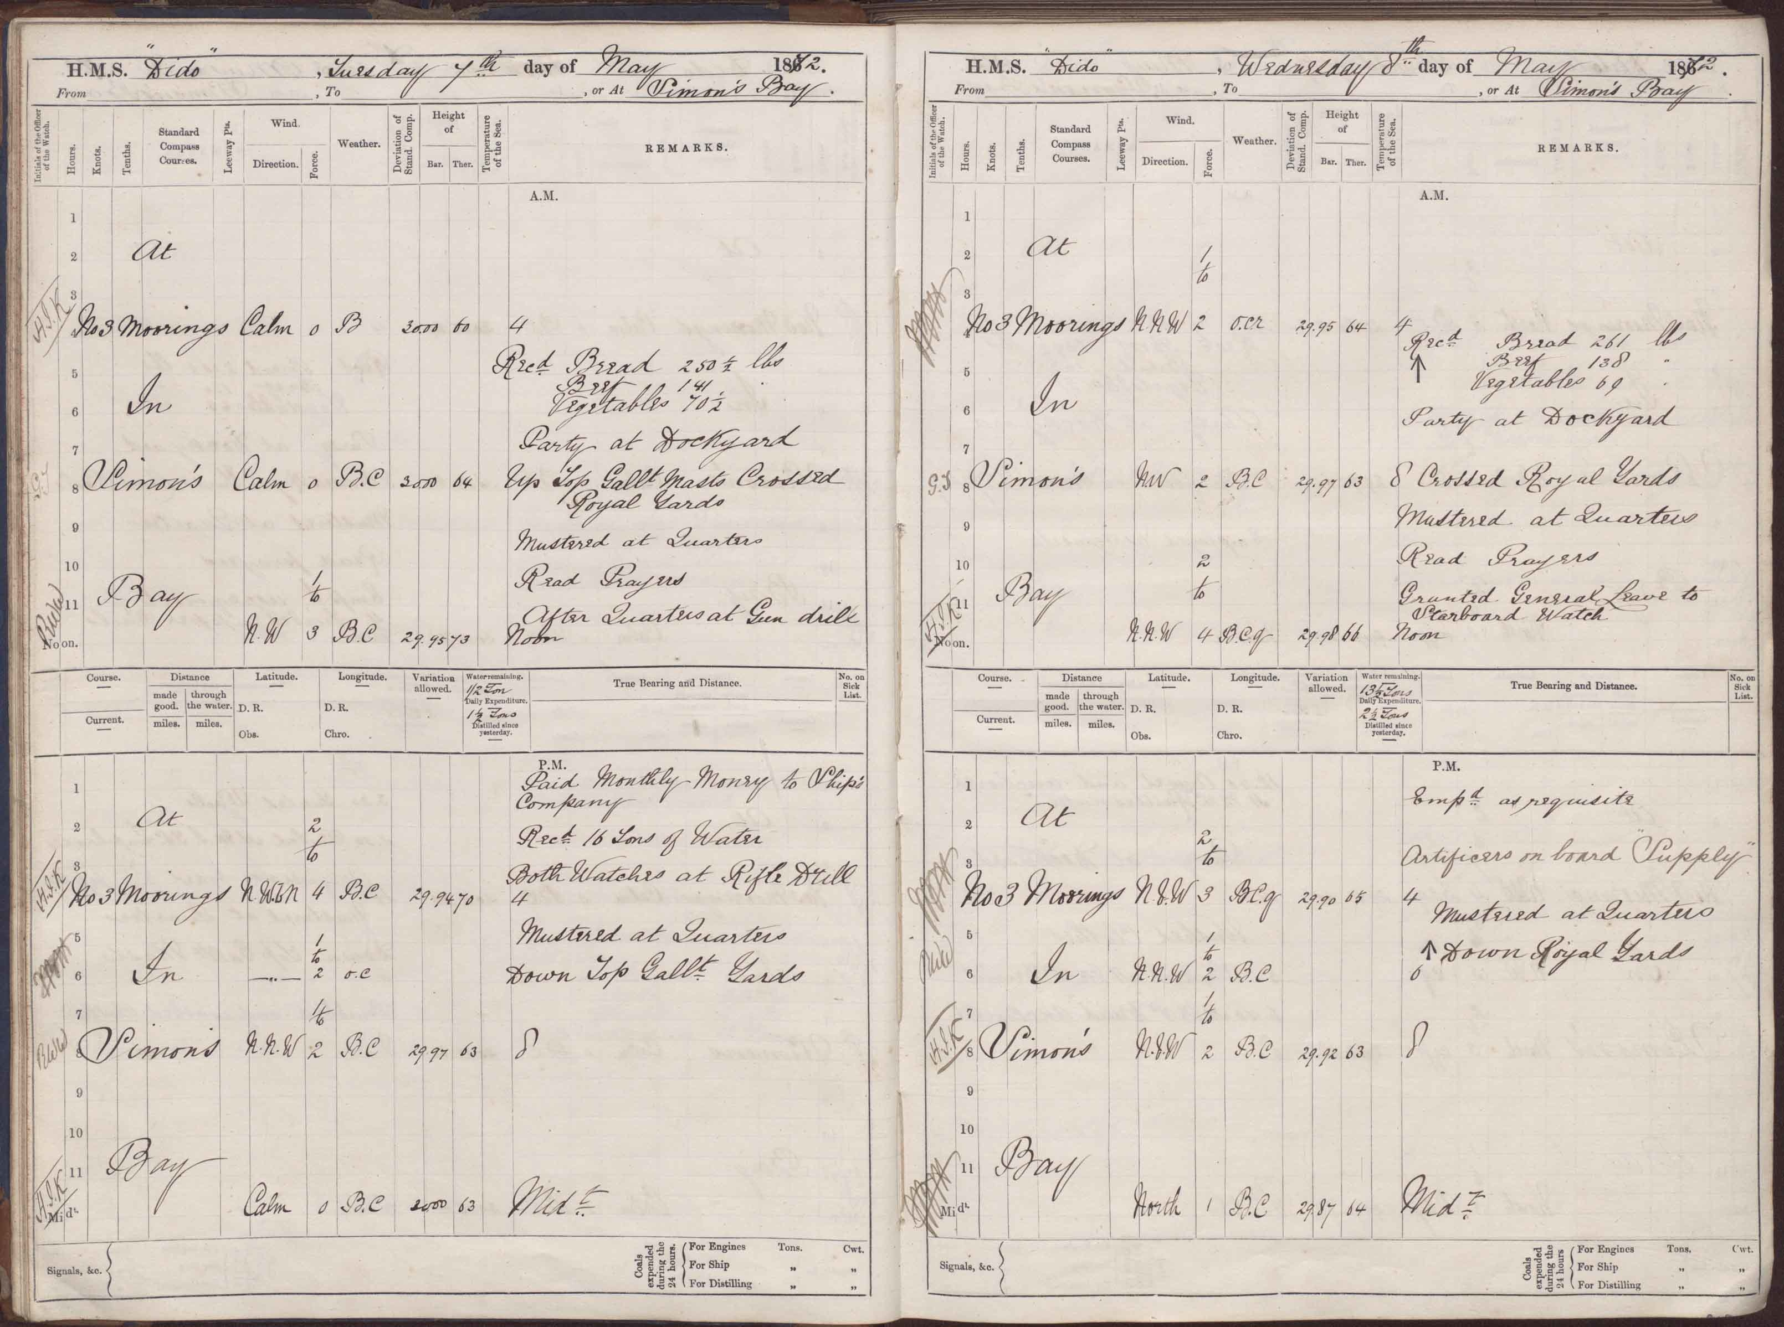

Slide 16
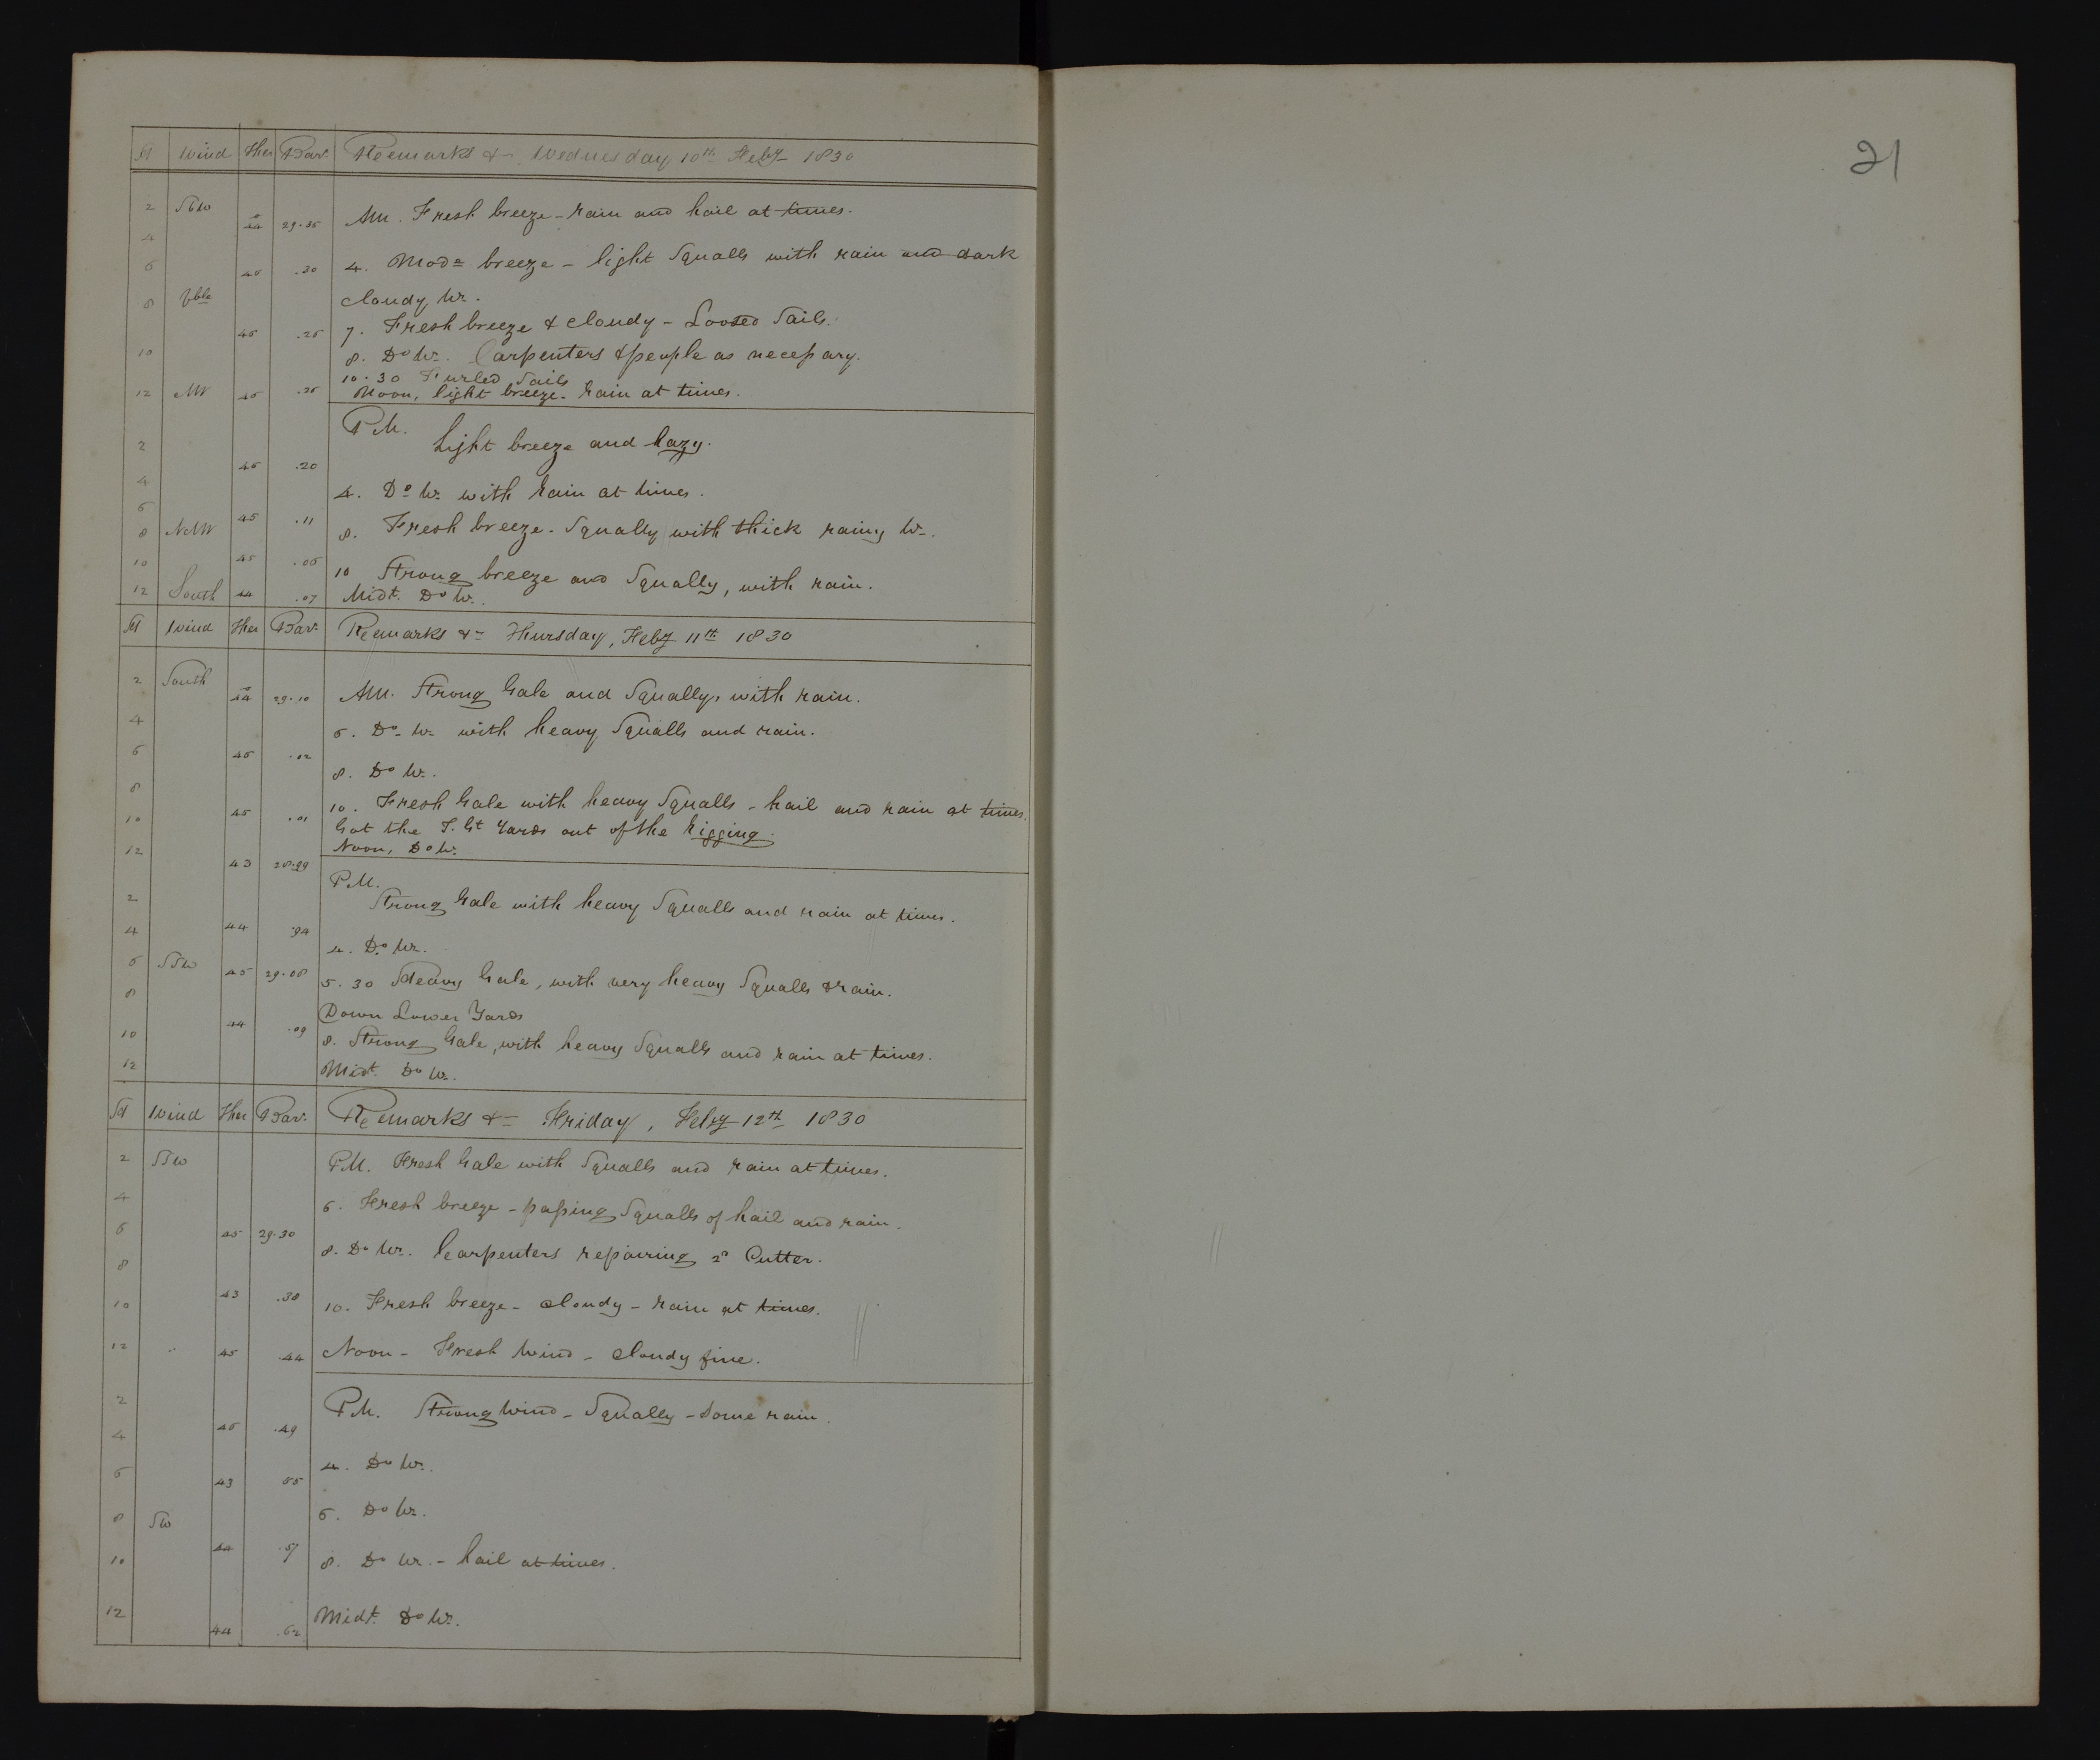

Slide 17
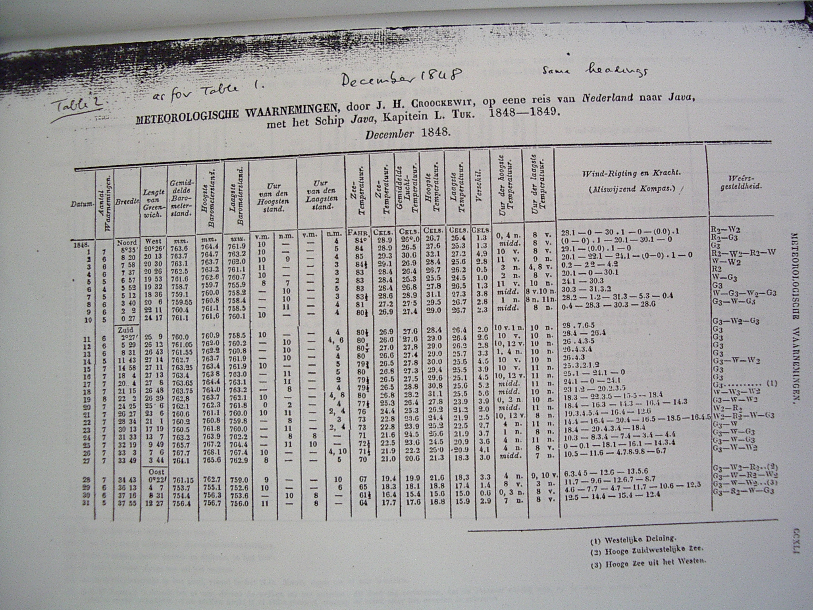

Slide 18
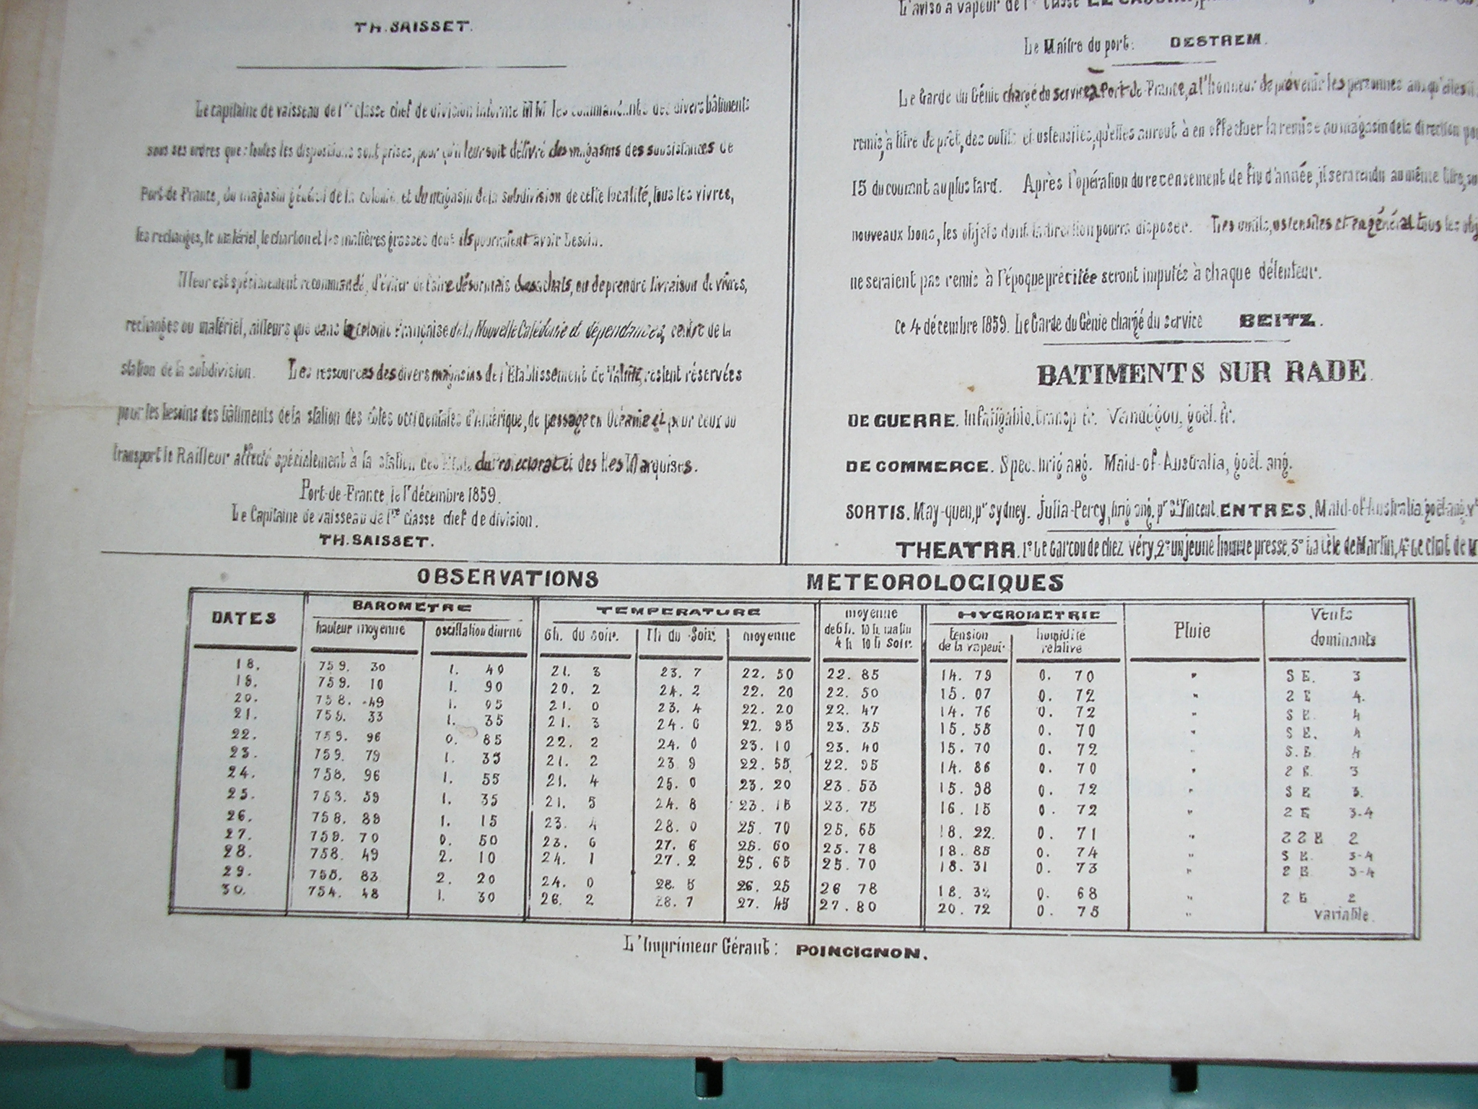

Slide 19
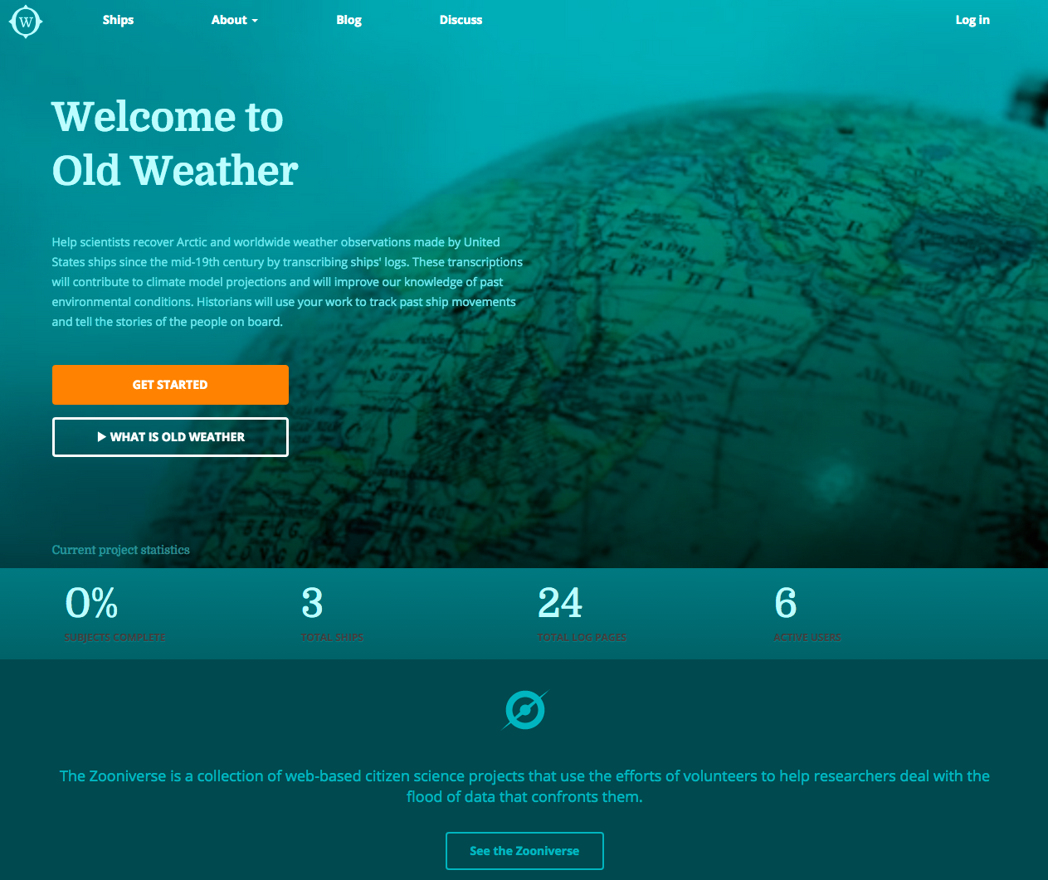

Slide 20
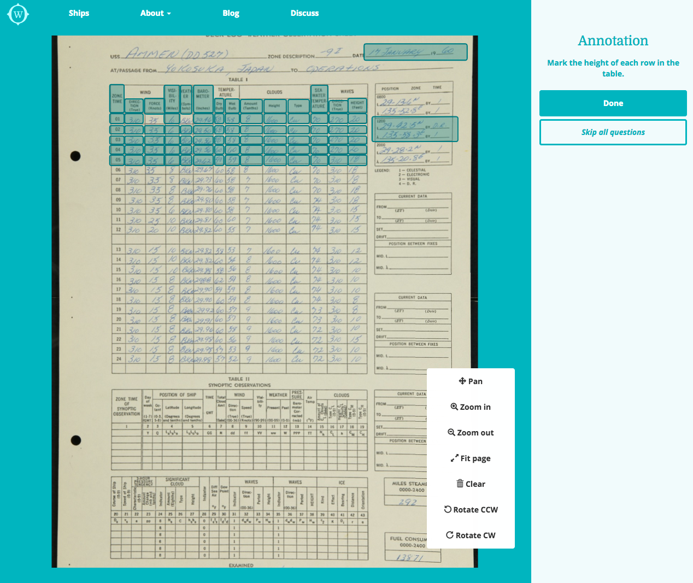

Slide 21
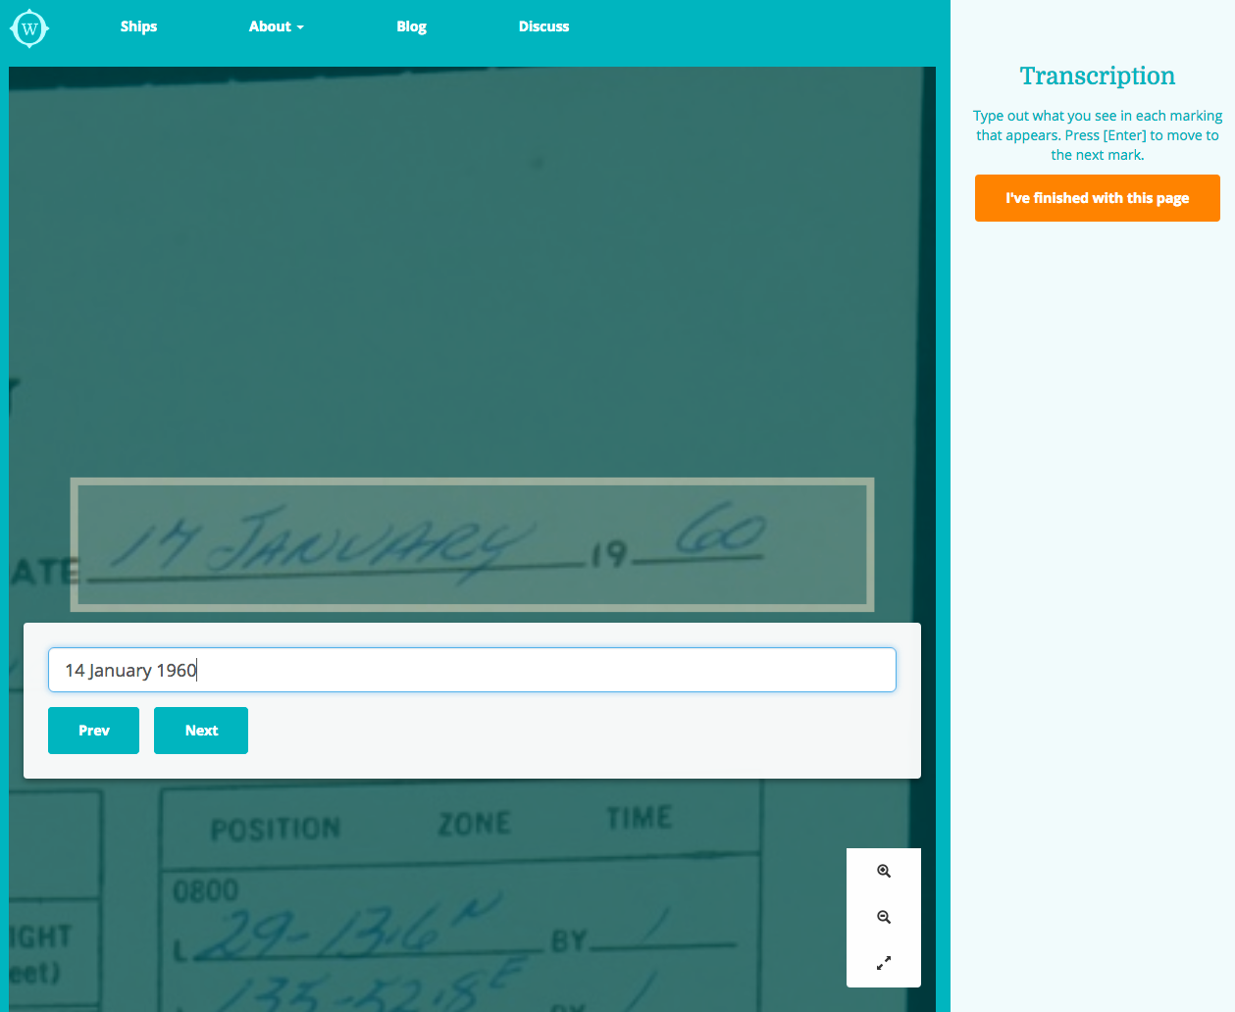

Slide 22
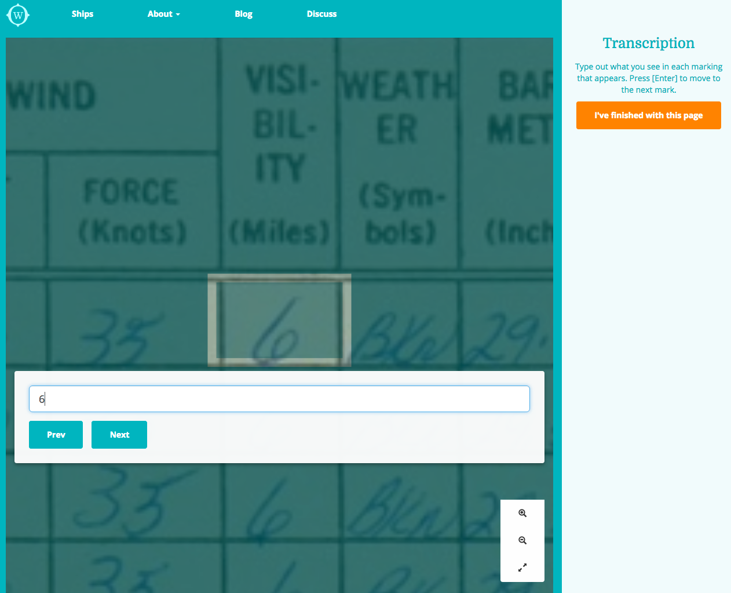

Slide 23
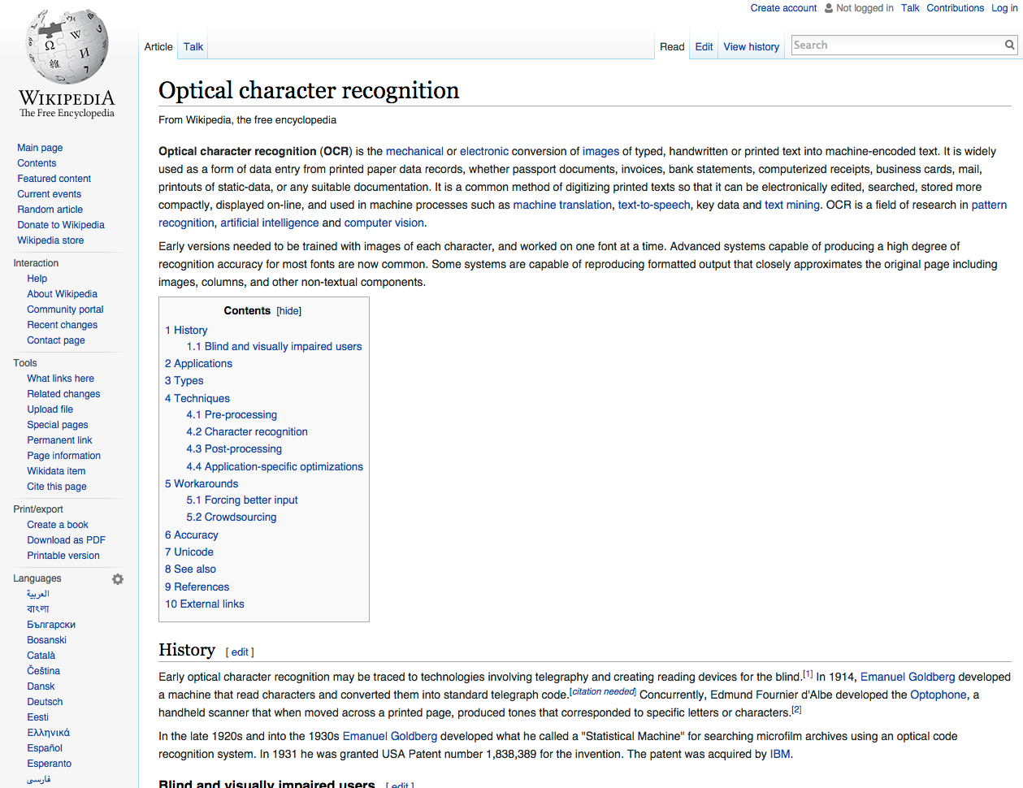
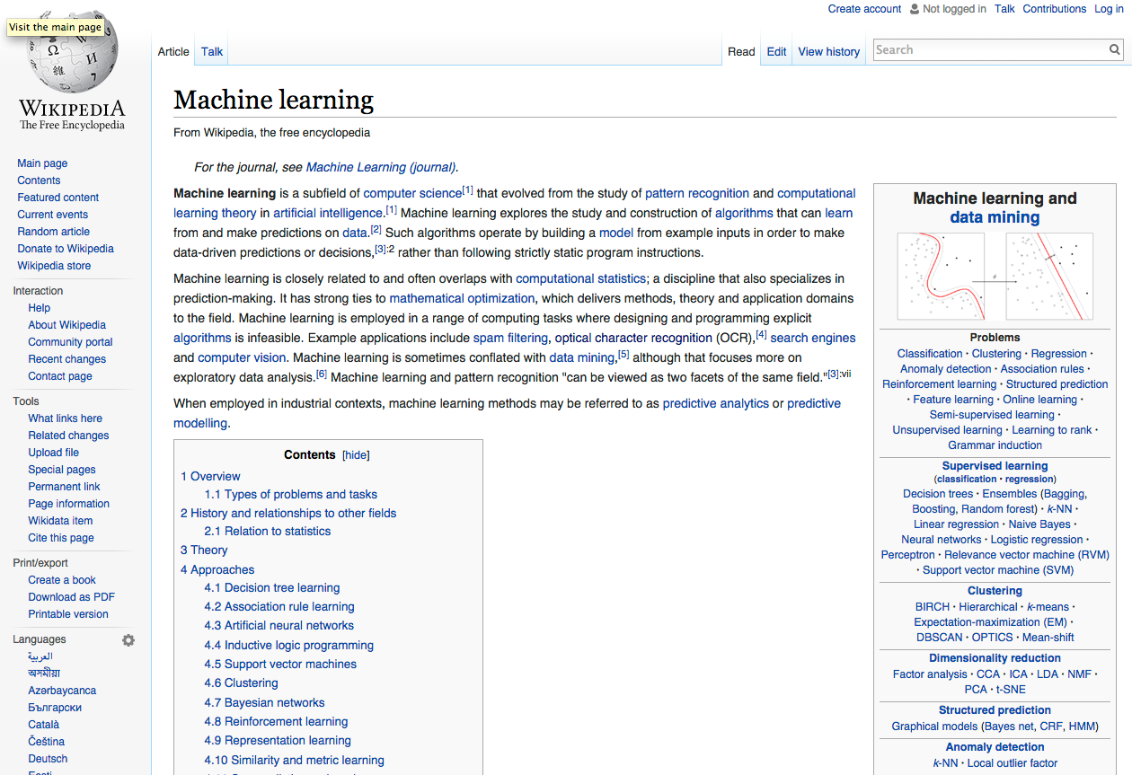

Slide 24
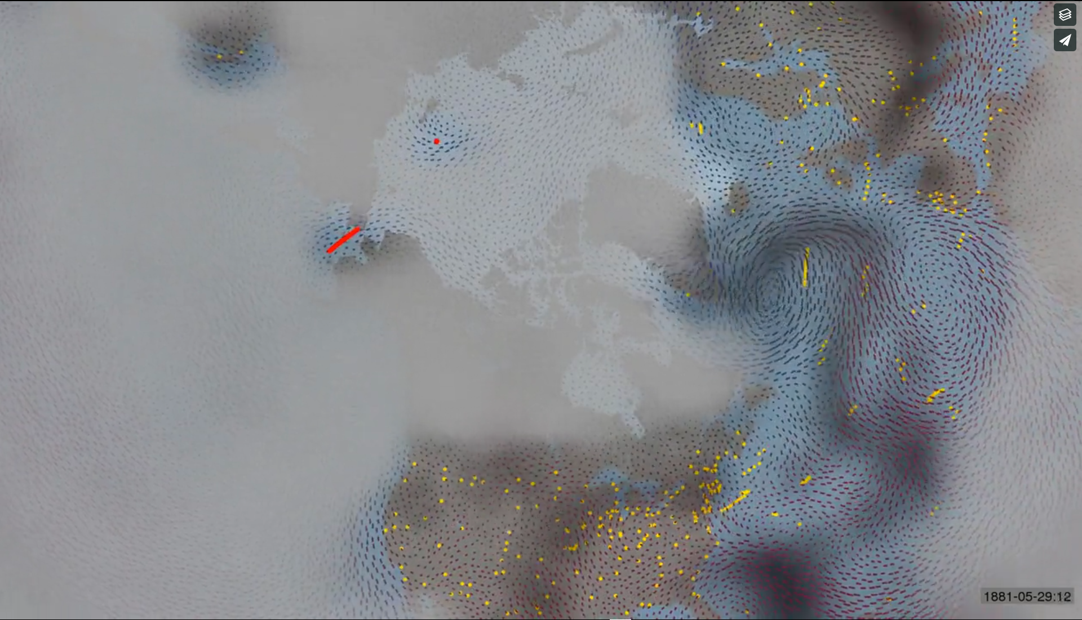
Video at https://vimeo.com/128684414

Slide 25
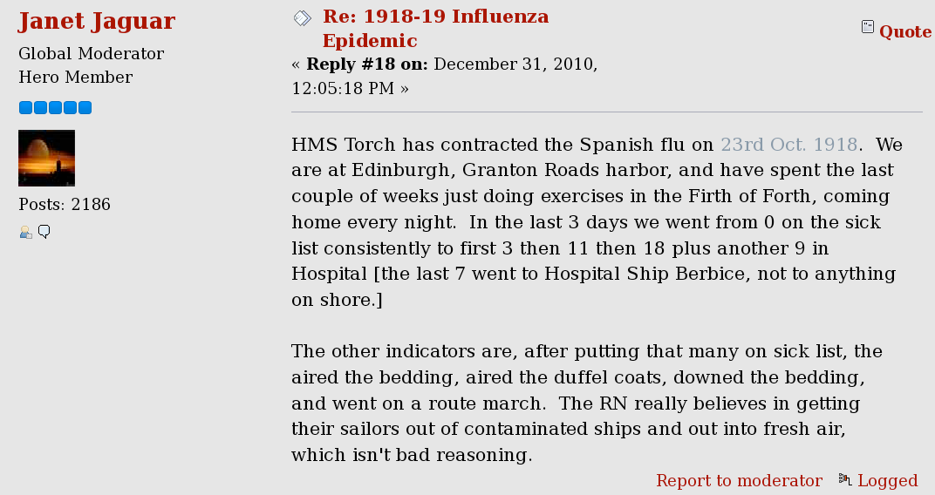

Slide 26
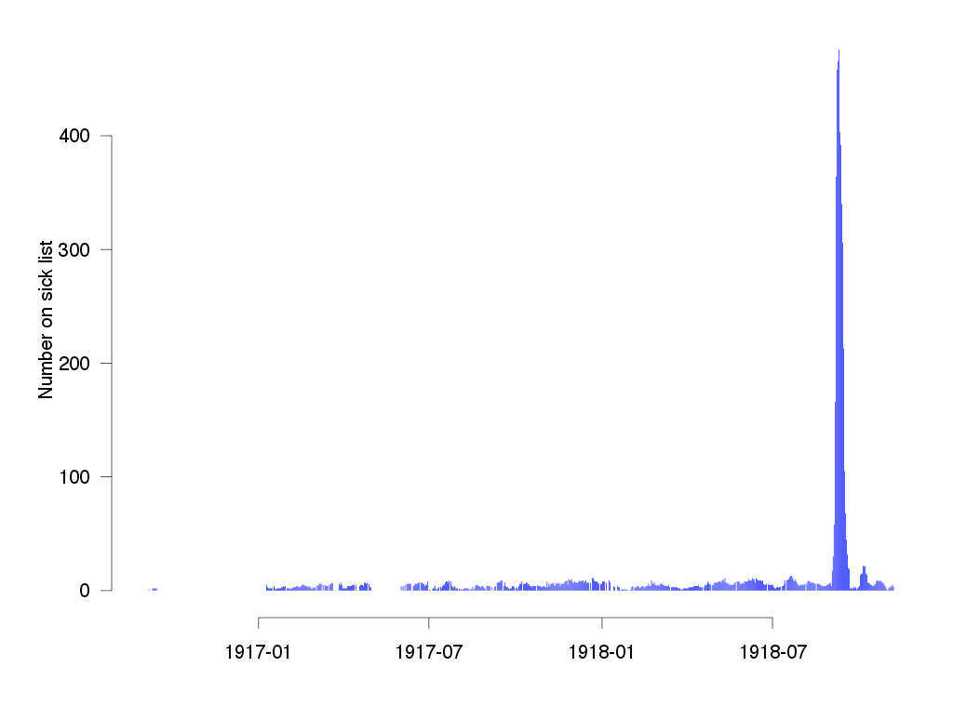

Slide 27
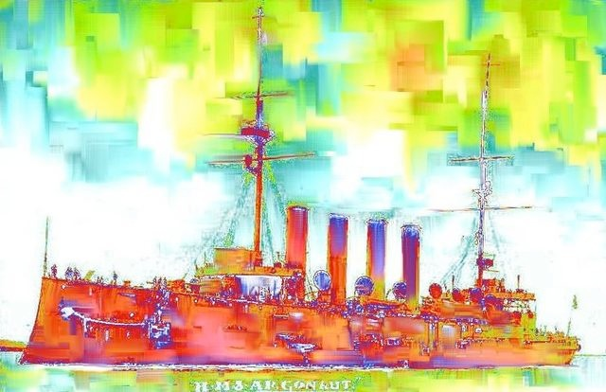

Slide 29
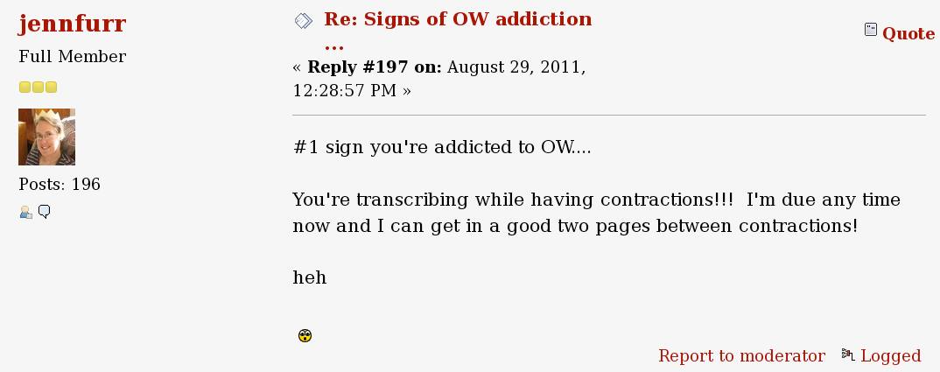

Slide 30
Credits
http://oldweather.org
http://forum.oldweather.org/index.php
@oldweather
http://whaling.oldweather.org
http://blog.oldweather.org

