Slide 1
Global Divergence in the new 20th Century Reanalysis version 2c (1851-2011)
Gilbert P. Compo and Prashant D. Sardeshmukh
Univ. of Colorado/CIRES and NOAA Earth System Research Laboratory/Physical Sciences Division
compo@colorado.edu
Includes results from Compo et al. QJRMS 2011 and
Sandeep, Stordal, Sardeshmukh, and Compo, Cli. Dyn., 2014
Global arguments do not apply to regional circulations.
Observed recent changes are relatively small compared to variations over the last 100 to 150 years.

Slide 2
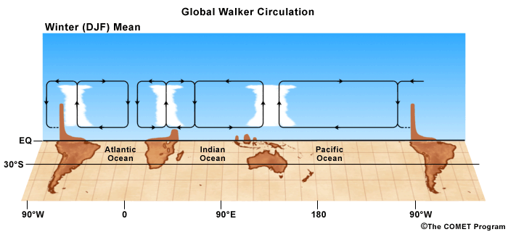
Walker Circulation is the east-west
part of the global overturning
circulation.
Global water vapor increases faster than precipitation in
coupled climate models forced with greenhouse gases.
Overturning circulation (global convective mass flux)
must weaken to compensate [Held and Soden 2006].
Sea Level Pressure-based Pacific Walker Circulation used
as proxy to investigate:
Vecchi et al. 2006 and others found weakening.
Meng et al. 2012 and others found strengthening.
Solomon and Newman 2012 found no change.

Slide 3
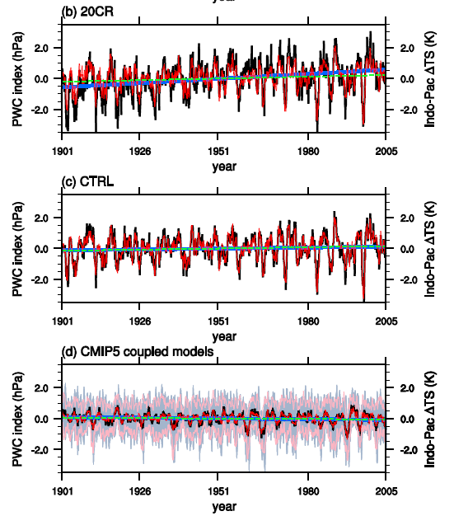
Anomalies of SLP-based Pacific Walker Circulation (PWC
and West minus East Equatorial Pacific SST (ΔTS)
r=0.84
PWC
ΔTS
ΔTS from HadISST1
20CR
increasing
ΔTS is average of
HadISST1, ERSSTv3b,
COBE1
r=0.93
PWC
ΔTS
SST-forced CAM4 (3 members)
Slightly increasing
Radiative forcings
CMIP5
(12 models)
r=0.89
PWC
ΔTS
Slightly decreasing
Sandeep et al. 2014
PWC trends and variability are closely related to ΔTS

Slide 4
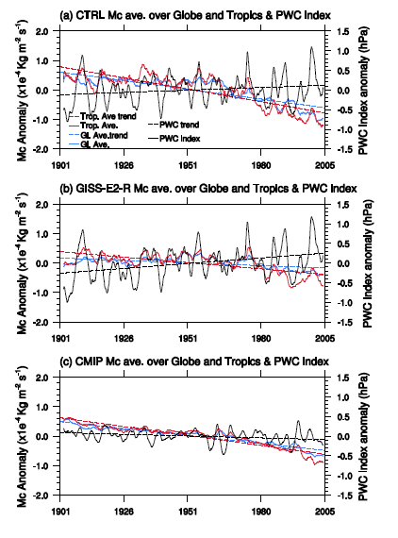
Pacific Walker Circulation compared to
Convective Mass Flux (Mc) from SST-forced and coupled GCMs
SST-forced CAM4
(3 members)
SST-forced
GISS-E2-R
(4 members)
PWC
Tropical Mc
Global Mc
Radiatively forced
CMIP5
(12 models)
1901
2005
Sandeep et al. 2014
Correlation between Pacific Walker Circulation and convective mass flux is low for all simulations. Trends can be opposite.
PWC most closely related to gradient of Pacific SST (Sandeep et al. 2014)

Slide 5
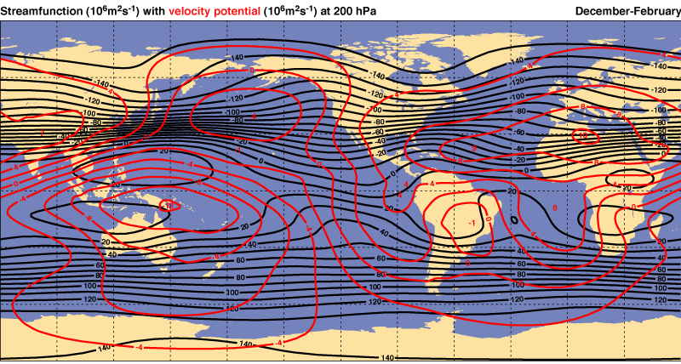
DJF Streamfunction and Velocity Potential at 200 hPa
Want a large-scale measure for Divergent Circulation
that represents entire upper-atmosphere: Vertically average
ERA40 Atlas

Slide 6
Upper-half of atmosphere, vertically-averaged
Velocity Potential: χ_{ω500}
Recall relationship between velocity potential and horizontal divergence

Slide 7
Use Reanalyses and SST-forced simulations
20CRv2c: Ensemble Kalman Filter (1851-2009) 56 members
Assimilates only pressure observations
specifies
SODAsi.2: 18 member ensemble of pentad SSTs (1846-2011)
COBE-2: monthly sea-ice concentration (1850-2013, Hirahara et al. 2014)
(Update and improvement to 20CRv2 Compo et al. 2011)
ERA-Interim: 4DVar (1979-2013)
Assimilates satellite, upper-air conventional, and surface observations
Dee et al. 2011
JRA-55: 4DVar (1958-2013)
Assimilates satellite, upper-air conventional, and surface observations
Kobayashi et al. 2015
AMIP type SST simulations with NCEP GFS2008, T62 [2 degree]:
56 members using HadISST1.1 (same as 20CRv2)
4 members using SODAsi.2 SST and COBE-2 ice (same as 20CRv2c)

Slide 8
NOAA-CIRES 20th Century Reanalysis version 2c
Gilbert P. Compo, Jeffrey S. Whitaker, Prashant D. Sardeshmukh, Robert J. Allan, Chesley McColl, Xungang Yin, Philip Brohan, Russell S. Vose, Linden Ashcroft, Renate Auchmann, Mac Benoy, Pierre Bessemoulin, Theo Brandsma, Manola Brunet, Joseph Comeaux, Thomas Cram, Richard Crouthamel, Pavel Y. Groisman, Hans Hersbach, Philip D. Jones, Trausti, Jónsson, Sylvie Jourdain, Gail Kelly, Kenneth R. Knapp, Andries Kruger, Hisayuki Kubota, Gianluca Lentini, Andrew Lorrey, Neal Lott, Sandra J. Lubker, Jürg Luterbacher, Gareth J. Marshall, Maurizio Maugeri, Cary J. Mock, Hing Y. Mok, Øyvind Nordli, Rajmund Przybylak, Mark J. Rodwell, Thomas F. Ross, Douglas Schuster, Lidija Srnec, Maria Antónia Valente, Zsuzsanna Vizi, Xiaolan L. Wang, Nancy Westcott, John S. Woollen, and Steven J. Worley
http://go.usa.gov/XTd Compo et al. 2011, doi:10.1002/qj.776

Slide 9
PSD’s 20th Century Reanalysis v2c implementation of
Ensemble Kalman Filter Algorithm (Whitaker and Hamill 2002, Whitaker et al. 2004, Compo et al. 2006, Compo et al. 2011)
PSD algorithm makes a weighted average of pressure observations and an ensemble of GCM forecasts.
The weight K varies with the atmospheric flow and the observation network.
Analysis = (1-K) Forecast + K * pressure obs
Using 56 member ensemble, new prescribed boundary conditions:
SODAsi.2c 18 member pentad SST and COBE-SST2 monthly sea ice
(fixes sea ice bug) [Giese et al. 2015, Hirahara et al. 2014]
New observations: International Surface Pressure Databank 3.2.9, millions of new observations from Oldweather.org, ACRE, NCDC, universities, Met services.
1851-2011: T62 (~200km), 28 level NCEP GFS08ex atmosphere/land model
9 hour forecasts for 6 hour centered analysis window
- time-varying CO₂, solar and volcanic radiative forcing (Sato et al.)
http://go.usa.gov/XTd Compo et al. 2011, doi:10.1002/qj.776

Slide 10
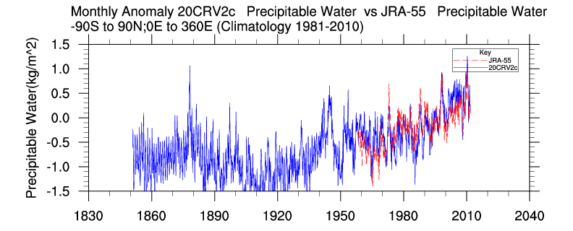
Monthly global anomalies of Precipitable water
(integrated column water vapor)
r=0.75
reanalyses.org/atmosphere/writ
Precipitable water is increasing in both datasets.
Same trend for 1958-2011. 1/3 trend from 1851-2011.

Slide 11
Upper-half of atmosphere vertically-averaged
Velocity Potential: χ_{ω500}
DJF (2000-2009)
20CRv2c
ERA-Interim
Thick: Positive, Thin: Negative, Contour interval 0.5 x 10⁶ m²s⁻²
Gradient of χ_{ω500} gives upper-tropospheric vertically-averaged divergent wind.
20CRv2c compares well with ERA-Interim, with regions of stronger and weaker χ_{ω500}

Slide 12
χ_{ω500} DJF (2000-2009) from 20CRv2c
Thick: Positive, Thin: Negative, Contour interval 0.5 x 10⁶ m²s⁻²

Slide 13
χ_{ω500} DJF (2000-2009) from 20CRv2c
Highlight contours -2.25 to -2.5 and -4.25 to -4.5 x10⁶ m²s⁻²
to characterize strength of Global Divergent Circulation

Slide 14
Compare average of 2000 to 2009 and 1980 to 1999
χ_{ω500} DJF from 20CRv2c
Highlight contours -2.25 to -2.5 and -4.25 to -4.5 10⁶ m²s⁻²
Strengthening of recent east-west Pacific Walker Circulation.
Poleward expansion of Hadley Circulation.
Largest change: westward expansion of Walker Circulation.

Slide 15
Compare average of 1960 to 2009 and 1910 to 1959
χ_{ω500} DJF from 20CRv2c
Highlight contours -2.25 to -2.5 and -4.25 to -4.5 10⁶ m²s⁻²
Much less change evident over 100 years.

Slide 16
Index for Global divergent circulation
Find minimum of χ_{ω500} for each DJF
from 1851 onward
Plot timeseries with 11 year running mean to
reduce noise of interannual variability

Slide 17
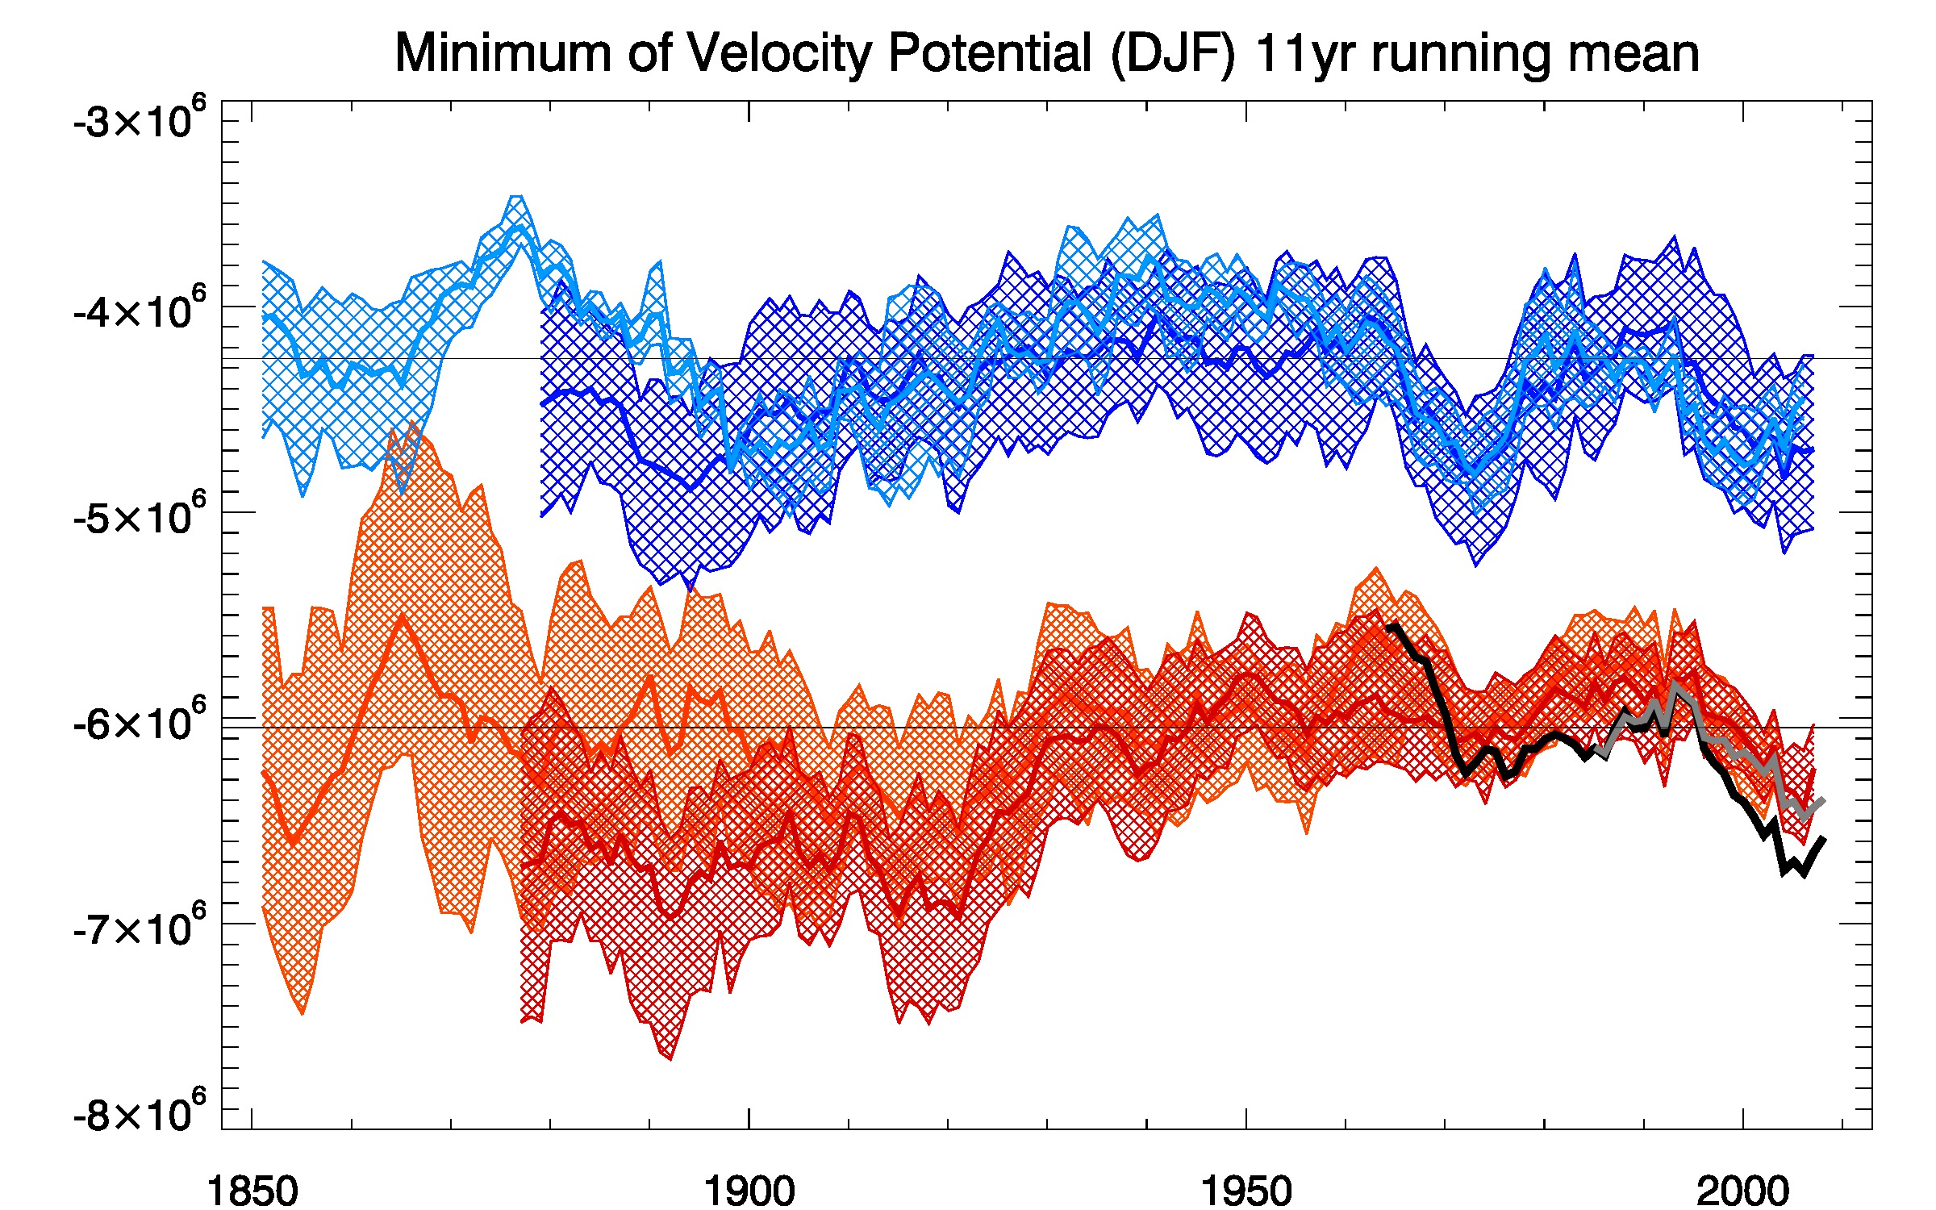
Strength of Global Divergent Circulation (DJF) from
AGCM, 20CRv2, 20CRv2c, ERA-Interim, and JRA-55
Minimum of χ_{ω500} from 1851 to 2013 (11-year running avg)
AGCM
bias
(m²s⁻²)
Stronger Weaker
Hatch:
Range
of the
members
ERA-Int
JRA-55
Multidecadal variability, recent strengthening, but no centennial
long term trend seen in reanalyses or SST-forced simulations.

Slide 18
Conclusions
1. Pacific Walker Circulation trends and variability depend on definition.
SLP-based definition almost unrelated even to Tropical overturning circulation.
(Sandeep et al. 2014: PWC most closely related to SST gradient)
2. SLP-based PWC index is not a proxy for
global or tropical convective mass flux.
Global arguments cannot be applied to regional circulation.
3. Broaden scope to examine Global Divergent Circulation using
large-scale vertically-integrated upper-level divergence: χ_{ω500}
4. Recent strengthening of DJF Global Divergent Circulation is small
compared to variations over the past 150 years.

Slide 19
Extra slides

Slide 20
1901-2005 Linear Trend from
CAM4 SST-forced simulations (3 ensemble members)
Sea
Level
Pressure
Each ensemble
member has
different SST
dataset prescribed.
500 hPa
vertical
velocity
Average of
HadISST1,
ERSSTv3b,
COBE SST
Land and
Sea Surface
Temperature
Sandeep et al. 2014
Trend patterns of SLP and vertical velocity correlate moderately (r=0.41).

Slide 21
SST and radiatively forced trends (1901-2005)
SST-forced CAM4 (3 members)
CMIP5 (12 models)
Different trends in various facets of Walker Circulation

Slide 22
Anomalies of SLP-based Pacific Walker Circulation (PWC
and West minus East Equatorial Pacific SST (ΔTS)
r=0.84
PWC
ΔTS
ΔTS from HadISST1
20CR
increasing
ΔTS is average of
HadISST1, ERSSTv3b,
COBE1
r=0.93
PWC
ΔTS
SST-forced CAM4 (3 members)
Slightly increasing
Radiative forcings
CMIP5
(12 models)
r=0.89
PWC
ΔTS
Slightly decreasing
Sandeep et al. 2014
PWC trends and variability are closely related to ΔTS

Slide 23
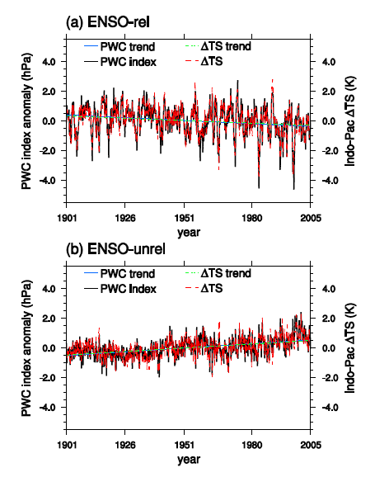
CAM4 AGCM simulations forced by ENSO-related and
ENSO-unrelated SSTs (filter from Compo and Sardeshmukh 2010)
SSTs filtered to
retain ENSO
(3 members)
ΔTS is average of
HadISST, ERSSTv3b,COBE
decreasing
SSTs filtered to
remove ENSO
(3 members)
increasing
Sandeep et al. 2014
Opposite SST gradient trends (ΔTS) force opposite PWC trends.

Slide 24
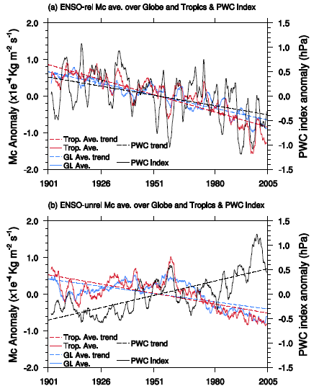
PWC compared to convective mass flux (Mc) in
ENSO-related and ENSO-unrelated SST-forced CAM4 simulations
SSTs filtered to
retain ENSO
(3 members)
PWC
Tropical Mc
Global Mc
SSTs filtered to
remove ENSO
(3 members)
Sandeep et al. 2014
Global convective mass flux decreases regardless of whether
Pacific Walker Circulation weakens or strengthens.

Slide 25
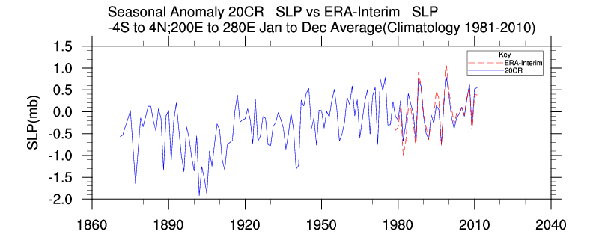
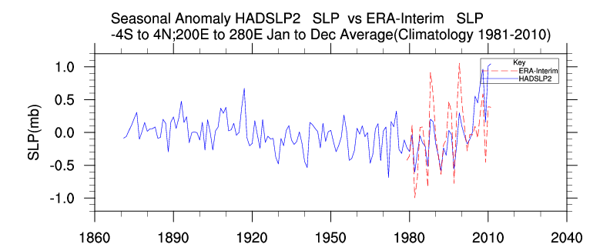
Annual anomalies of Eastern box of SLP-based PWC
r=0.93
NOTE:
Change of
Scale!
r=0.69
HadSLP2 has spurious increase after 2005 (becomes adjusted NCEP-NCAR reanalysis). Variance is consistently less than ERA-Int or 20CR.
Correlation is lower with ERA-Int compared to 20CR.

Slide 26
Pacific Walker Circulation from Statistical Reconstructions, AGCM integrations, and 20th Century, ERA-40, NCEP-NCAR, ERA-Interim Reanalyses.
500 hPa
vertical
velocity,
SONDJ
1870
2008
Climo
(ERA-Int)
PWC of Oort and Yienger (1996)
Agreement in overturning PWC:
correlations between ERA-40 and 20CRv2 > 0.95.
No significant trend in PWC since 1871 using pressure-based 20CRv2.
Compo et al. 2011

Slide 27
SODA sparse observational input v2
(1846-2011)
18 Ensemble Members
Parallel Ocean Program v2.0.1
0.4° longitude x 0.25° to 0.4° latitude
with 40 levels
Winds
20CRv2 ensemble member daily stress (1949 – 2011)
20CRv2 system with ISPDv3.2.4 and HadISST1.1
(1871-1948)
with ISPDv3.2.4 and climatological SST (1846-1870)
Heat and Salt fluxes
Bulk formulae using 20CR daily variables
SODA Observations
Only ICOADS 2.5 SST data with Hadley Bucket Correction
Giese et al. 2015

Slide 28
Table of correlations of 500 hPa vertical velocity PWC

