Slide 1

COUPLED DATA ASSIMILATION AT NCEP
THE NCEP CLIMATE FORECAST SYSTEM
Suru Saha
Jack Woollen, Daryl Kleist, Dave Behringer, Steve Penny, Xingren Wu, Bob Grumbine, Mike Ek, Jiarui Dong, Shrinivas Moorthi, Xu Li, Sarah Lu, Yu-Tai Hou, Arun Chawla, Henrique Alves
The Environmental Modeling Center, NCEP/NWS/NOAA
Department of Atmospheric and Oceanic Science, University of Maryland

Slide 2
A Historical Perspective
ONE DAY OF CFSR
12Z GDAS
18Z GDAS
0Z GDAS
6Z GDAS
0Z GLDAS
12Z GODAS
18Z GODAS
0Z GODAS
6Z GODAS
9-hr coupled T574L64 forecast guess (GFS + MOM4 + Noah)

Slide 3
 | R2 (1997) | CDASv2 (2011)
Vertical coordinate | Sigma | Sigma/pressure
Spectral resolution | T62 | T574
Horizontal resolution | ~210 km | ~27 km
Vertical layers | 28 | 64
Top level pressure | ~3 hPa | 0.266 hPa
Layers above 100 hPa | ~7 | ~24
Layers below 850 hPa | ~6 | ~13
Lowest layer thickness | ~40 m | ~20 m
Analysis scheme | SSI | GSI
Satellite data | NESDIS temperature retrievals (2 satellites) | Radiances (all satellites)
Bob Kistler, EMC

Slide 4
GODAS – 3DVAR
Version
  Changing from a version based on MOM V3 to one based on MOM4p0d
  As was the case with MOM4p0d, the code has been completely rewritten from Fortran 77 to Fortran 90.
Domain and Resolution
  Changing to a global domain.
  Increasing resolution to match the MOM4p0d configuration used in the CFS: 1/2ºx1/2º (1/4º within 10º of the equator); 40 Z-levels.
Functionality
  Adding the ability to compile the 3DVAR analysis in either an executable combining the analysis with MOM or an executable containing only the analysis. The latter formulation is used with the CFS where it reads the forecast from a restart file produced by the coupled CFS, does the analysis, and updates the restart file.
  Adding relaxation of surface temperature and salinity to observed fields under the control of the 3DVAR analysis.
Data
  The data sets that can be assimilated remain unchanged from the current operational GODAS: XBTs, tropical moorings (TAO, TRITON, PIRATA, RAMA), Argo floats, CTDs), altimetry (JASON-x).
Dave Behringer, EMC

Slide 5
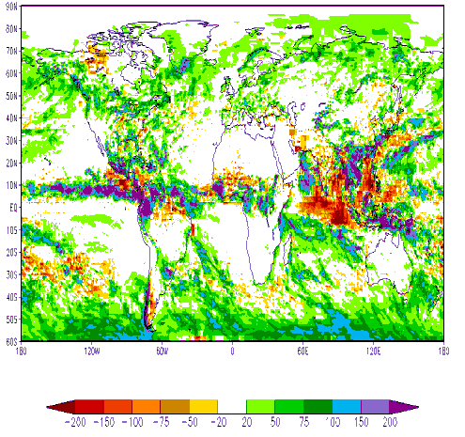
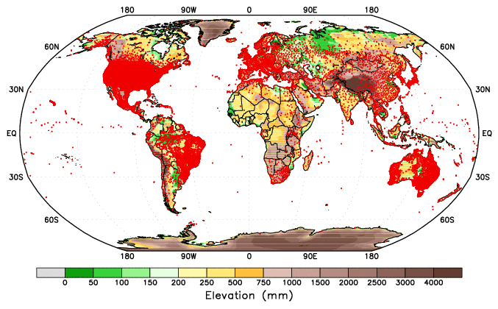
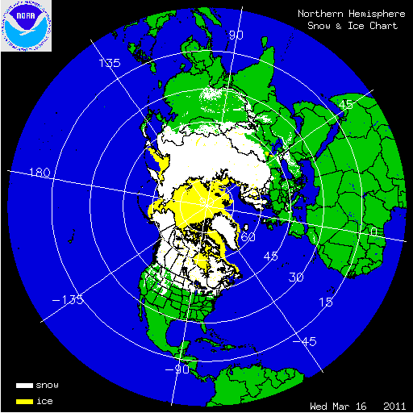
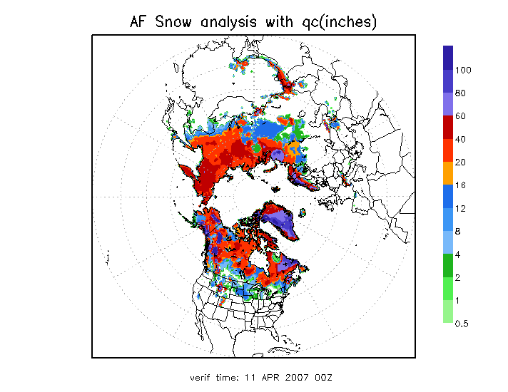
Global Land Data Assimilation System (GLDAS)
• GLDAS (running Noah LSM under NASA/Land Information System) forced with CFSv2/GDAS atmospheric data assimilation output and blended precipitation in a semi-coupled mode, versus no GLDAS in CFSv1, where CFSv2/GLDAS ingested into CFSv2/GDAS once every 24-hours.
• In CFSv2/GLDAS, blended precipitation a function of satellite (CMAP; heaviest weight in tropics), surface gauge (heaviest in middle latitudes) and GDAS (modeled; high latitude), vs use of model precipitation comparison with CMAP product and corresponding adjustment to soil moisture in CFSv1.
• Snow cycled in CFSv2/GLDAS if model within 0.5x to 2.0x of the observed value (IMS snow cover, and AFWA snow depth products), else adjusted to 0.5 or 2.0 of observed value.
GDAS-CMAP precip
Gauge locations
IMS snow cover
AFWA snow depth
Mike Ek, EMC

Slide 6
Another innovative feature of the CFSR GSI is the use of the historical concentrations of carbon dioxide when the historical TOVS instruments were retrofit into the CRTM.
Satellite Platform | Mission Mean (ppmv)b
TIROS-N | 337.10
NOAA-6 | 340.02
NOAA-7 | 342.96
NOAA-8 | 343.67
NOAA-9 | 355.01
NOAA-10 | 351.99
NOAA-11 | 363.03
NOAA-12 | 365.15
GEOS-8 | 367.54
GEOS-0 | 362.90
GEOS-10 | 370.27
NOAA-14 to NOAA-18 | 380.00
IASI METOP-A | 389.00
NOAA-19 | 391.00
Courtesy: http://gaw.kishou.go.jp

Slide 7
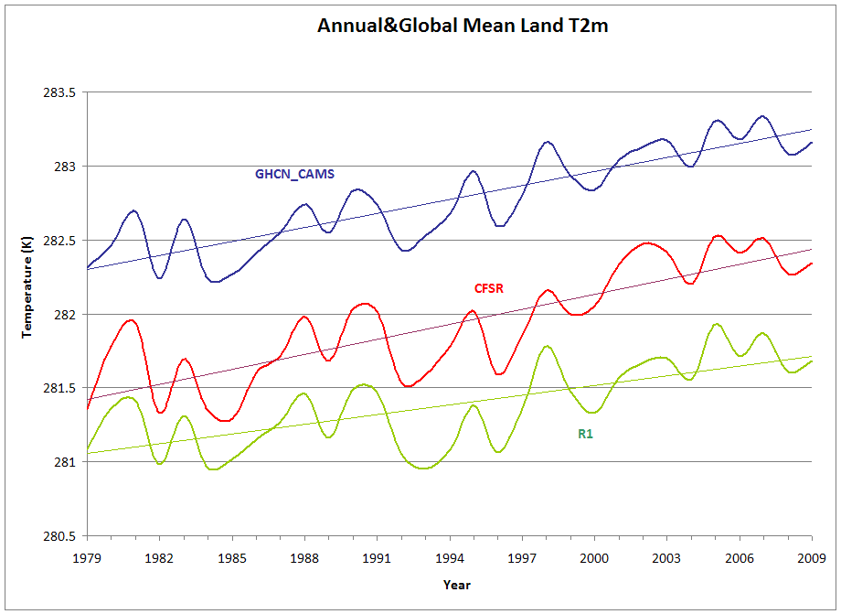
The linear trends are 0.66, 1.02 and 0.94K per 31 years for R1, CFSR and GHCN_CAMS respectively. (Keep in mind that straight lines may not be perfectly portraying climate change trends).
Huug van den Dool, CPC

Slide 8

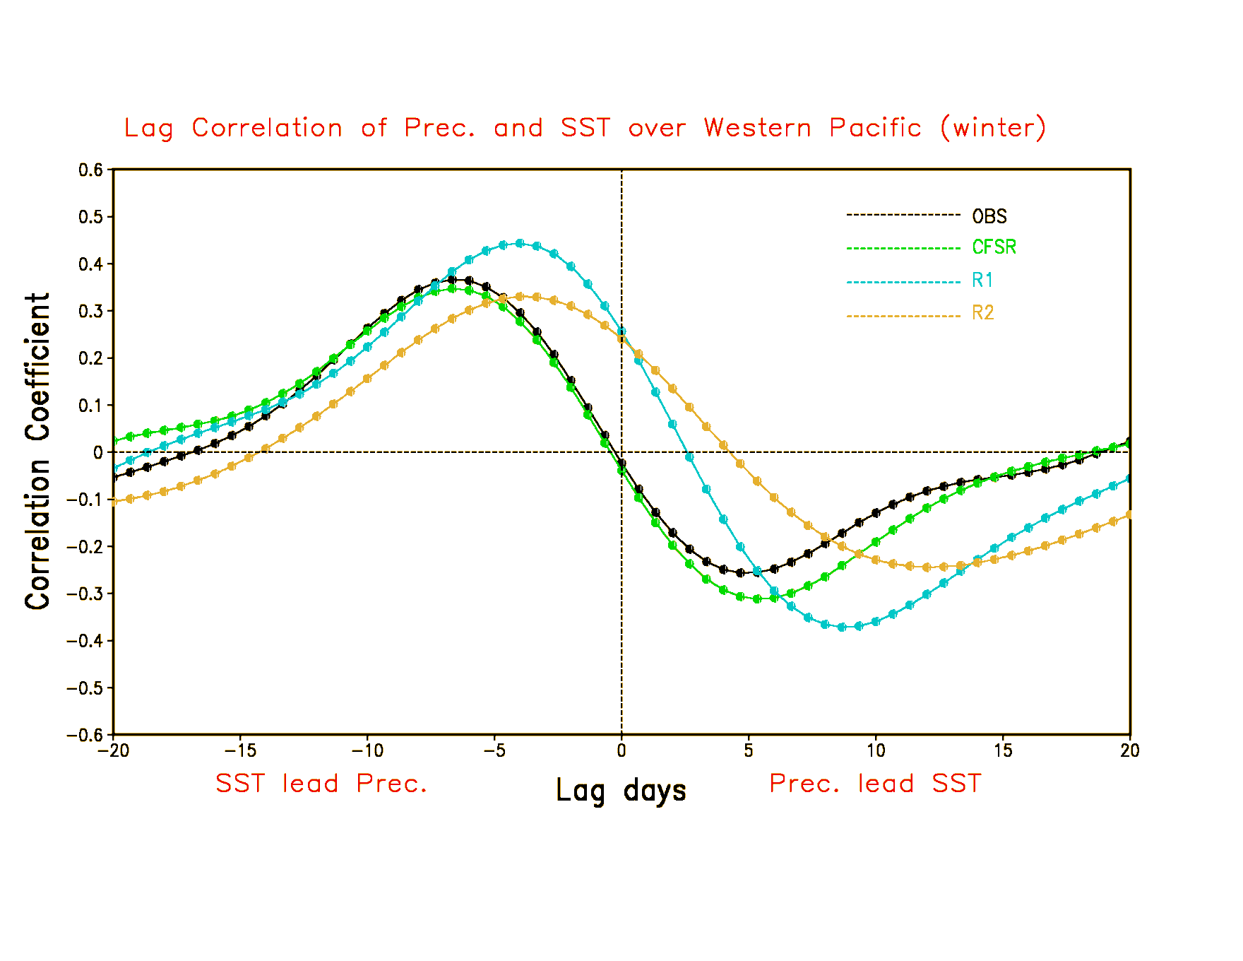
SST-Precipitation Relationship in CFSR
Precipitation-SST lag correlation in tropical Western Pacific
simultaneous positive correlation in R1 and R2
Response of Precip to SST warming is too quick in R1 and R2
Jiande Wang, EMC

Slide 9
TOWARDS BUILDING A PROTOTYPE OF THE NEXT GENERATION COUPLED ANALYSIS SYSTEM AT NCEP

Slide 10
PROOF OF CONCEPT
Use whatever components that are currently available to build this system on the research and development computer.
Atmosphere: Hybrid 3DVar/EnKF approach using a 40-member coupled forecast and analysis ensemble at low resolution, with soon to be operational Semi-lagrangian dynamics; T574 for 3DVar and T254 for ensembles, 64 levels in the vertical hybrid sigma/pressure coordinates.
Ocean/Seaice: GFDL/MOM5.1 for the ocean and seaice coupling, using the current operational CFSv2 coupler.
Aerosols: Inline GOCART for aerosol coupling
Waves: Inline WAVEWATCH III for wave coupling
Land: Inline Noah Land Model for land coupling

Slide 11
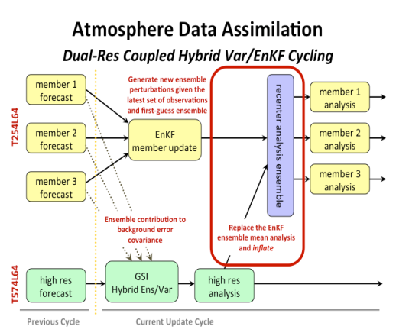
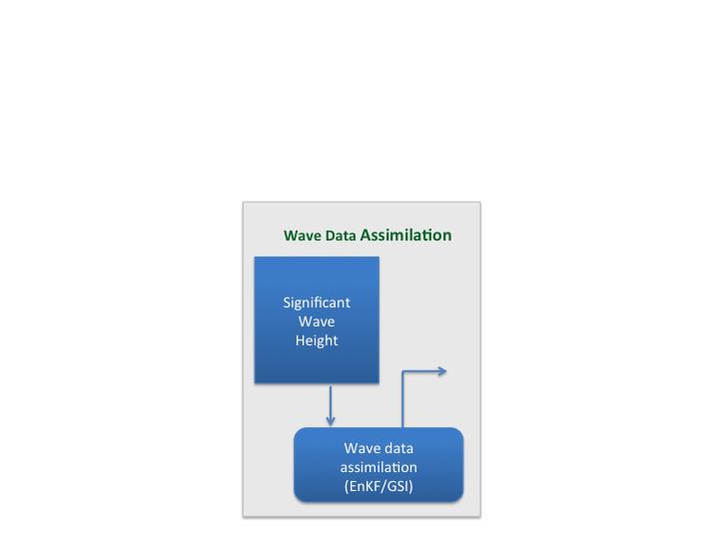
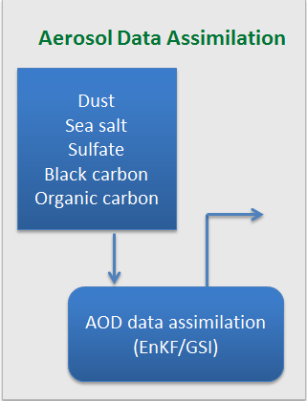
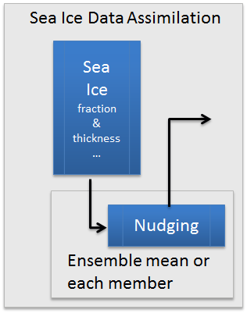
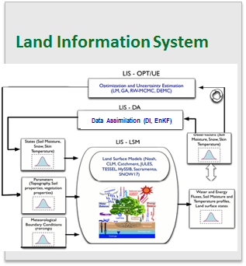
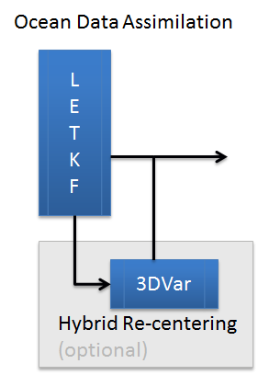
NCEP Coupled Hybrid-EnKF Data Assimilation System
NEMS
NEMS
ATMOS
AERO
LAND
WAVE
SEA-ICE
ATMOS
AERO
LAND
WAVE
OCEAN
SEA-ICE
OCEAN
Coupled Model Ensemble Forecast
Coupled Model Ensemble Forecast
Coupled Ensemble Forecast (N members)
Ensemble Analysis (N Members)
INPUT
OUTPUT

Slide 12
NEMS
The NOAA Environmental Modeling System is being built to unify
operational systems under a single framework, in order to more easily
share common structures/components and to expedite interoperability.
.
The first two systems under NEMS (NAM/NMMB and GOCART)
have been implemented into NCEP operations with others to follow
in the next few years, such as the GFS, etc.
The NUOPC (National Unified Operational Prediction Capability,
NOAA, Navy and Air Force) layer will be used to make collaboration
with other groups less difficult, when building/coupling modeling systems.
Incorporation of a NUOPC physics driver can help standardize the
often complex connections to physics packages, thereby enhancing
their portability.
Mark Iredell, EMC

Slide 13
NCEP Coupled Hybrid-EnKF Data Assimilation System
NEMS
NEMS
ATMOS
AERO
LAND
WAVE
SEA-ICE
ATMOS
AERO
LAND
WAVE
OCEAN
SEA-ICE
OCEAN
Coupled Model Ensemble Forecast
Coupled Model Ensemble Forecast
Coupled Ensemble Forecast (N members)
Ensemble Analysis (N Members)
INPUT
OUTPUT

Slide 14
Dual-Resolution Coupled Hybrid
Var/EnKF Cycling
member 1
forecast
Generate new ensemble perturbations given the latest set of observations and first-guess ensemble
member 1
analysis
T254L64
member 2
forecast
EnKF
member update
member 2
analysis
recenter analysis ensemble
member 3
analysis
member 3
forecast
Ensemble contribution to background error covariance
Replace the EnKF ensemble mean analysis
and inflate
GSI
Hybrid Ens/Var
T574L64
high res
forecast
high res
analysis
Previous Cycle
Current Update Cycle
Daryl Kleist, EMC

Slide 15
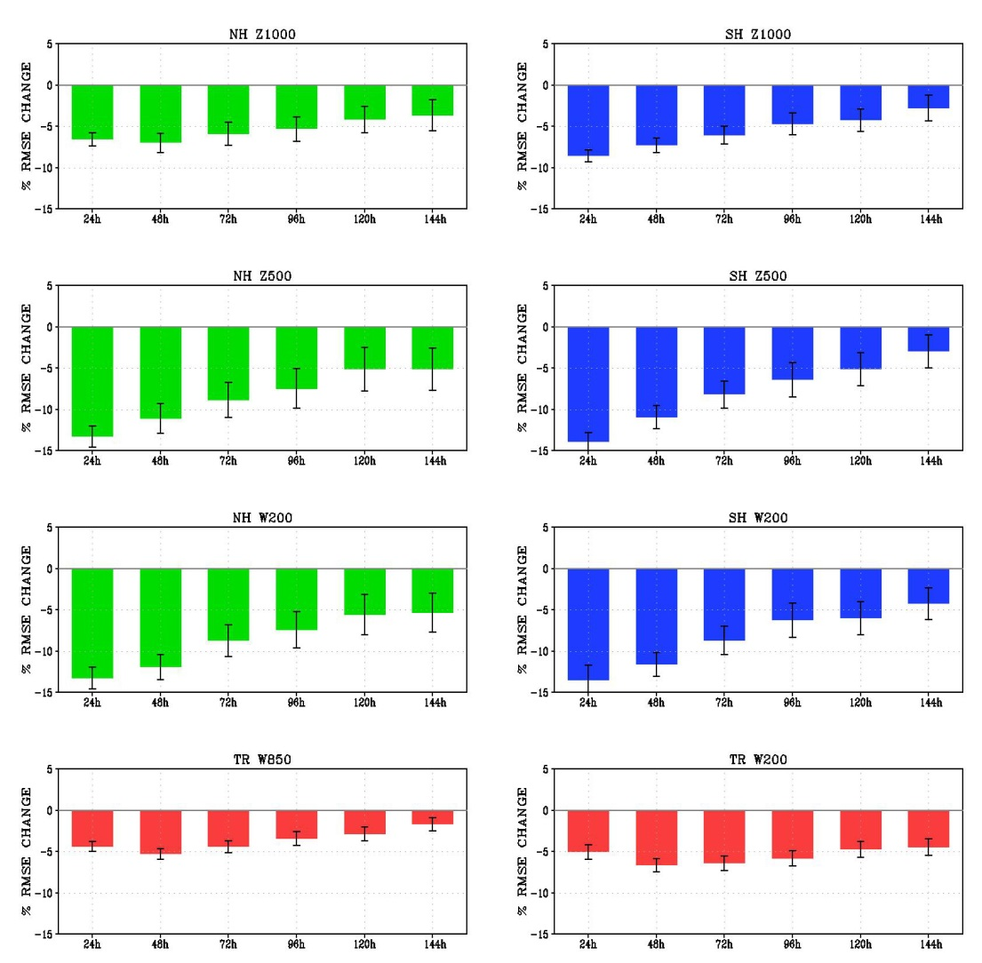
Impact (3DVAR to 3DHybrid)
Error reduction for NCEP GFS (Hybrid minus 3DVAR) for pre-implementation experiment, spanning 2012020100 through 2012051500, for several variables (Green NH, Blue SH, Red TR).
Daryl Kleist, EMC

Slide 16
Current status of operational atmospheric data assimilation at NCEP
3D Hybrid-EnVAR
80 member EnKF ensemble (multiplicative and additive inflation)
Higher resolution deterministic control with re-centering of the ensemble
6-hour cycling
Daryl Kleist, EMC

Slide 17
Proposed upgrade of the atmospheric DA at NCEP
Stochastic physics to replace additive inflation
New (totally) inline automated bias correction for satellite data (making reanalysis using radiances more straightforward and accurate)
By end of 2015:
The system will be upgraded to a Hybrid 4D-EnVAR, which is not the traditional 4D-VAR, ie. no tangent linear or adjoint model is used.
Can still perform an outer loop, as in the traditional 4DVAR
Potentially improved initialization of the forecast, due to 4D IAU (incremental analysis update) , which allows for the prescription of an incremental 4D trajectory, instead of a single time-level of analysis increment.
Daryl Kleist, UMD

Slide 18
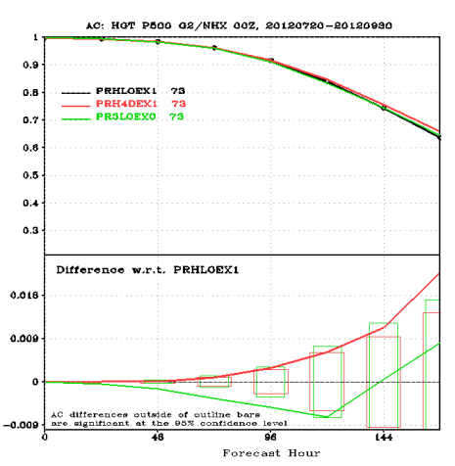
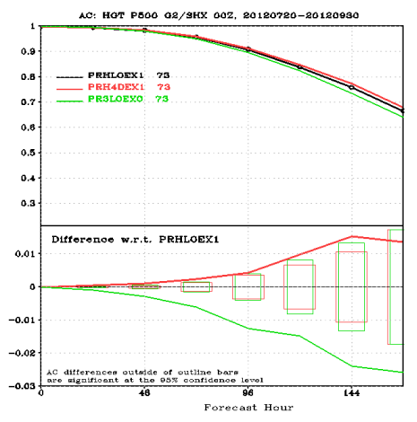
500 hPa Die Off Curves
Northern Hemisphere
Southern Hemisphere
4DHYB ----
3DHYB ----
3DVAR ----
4DHYB ----
3DHYB ----
3DVAR ----
4DHYB-3DHYB
3DVAR-3DHYB
Move from 3D Hybrid (current operations) to Hybrid 4D-EnVar yields improvement that is about 75% in amplitude in comparison from going to 3D Hybrid from 3DVAR.
Daryl Kleist, EMC

Slide 19
NCEP DA Plans: Next Global
Implementation (~ Dec. 2015)
Hybrid 4D EnVar
  Hourly time bins (7 time levels per analysis)
  80 ensemble members
  T1534L64 deterministic with T574L64 ensembles used for T574 analysis increments
  Modified thinning of data in time
Observation changes
  Cloudy Microwave Radiances
    Cloud analysis impacted by covariances from Hybrid and cloud impacted microwave radiances
  Upgraded CRTM2.2
  Additional aircraft and AMV data
  Bias correction of aircraft temperature observations
NSST
  Variation in Near Sea-Surface Temperature of ocean included in both forecast model and analysis
  Directly uses radiances and accounts for depth of observations in NSST analysis
  Diurnal cycle of Ocean and observations accounted for much better
John Derber

Slide 20
NCEP Coupled Hybrid-EnKF Data Assimilation System
NEMS
NEMS
ATMOS
AERO
LAND
WAVE
SEA-ICE
ATMOS
AERO
LAND
WAVE
OCEAN
SEA-ICE
OCEAN
Coupled Model Ensemble Forecast
Coupled Model Ensemble Forecast
Coupled Ensemble Forecast (N members)
Ensemble Analysis (N Members)
INPUT
OUTPUT

Slide 21
Hybrid GODAS
Hybrid Method:
The Hybrid-Gain method of Penny (2014)
EnKF Component:
The Local Ensemble Transform Kalman Filter (LETKF) developed by Hunt et al. (2007) at the University of Maryland (UMD)
Variational Component:
NCEP’s operational 3DVar used in the Global Ocean Data Assimilation System (GODAS) described by Derber and Rosati (1989) and Behringer (2007)
Penny, S.G., 2014: The Hybrid Local Ensemble Transform Kalman Filter. Mon. Wea. Rev., 142, 2139–2149. doi: http://dx.doi.org/ 10.1175/MWR-D-13-00131.1
Hunt, B.R., E.J. Kostelich, and I. Szunyogh, 2007: Efficient Data Assimilation for Spatiotemporal Chaos: A Local Ensemble Transform Kalman Filter. Physica D, 230, 112-126.
Derber, J. D., and A. Rosati, 1989: A global oceanic data assimilation system. J. Phys. Oceanogr., 19, 1333–1347.
Behringer, D. W., 2007: The Global Ocean Data Assimilation System at NCEP. Preprints, 11th Symp. on Integrated Observing and Assimilation Systems for Atmosphere, Oceans and Land Surface, San Antonio, TX, Amer. Meteor. Soc., 14–18.
Steve Penny, UMD

Slide 22
Hybrid-GODAS Algorithm
Standard-LETKF
Analysis is performed locally at each grid point, using any specified radius of localization
Use 3D-Var minimization to search larger dimension subspace around the LETKF analysis
3D-Var
Since B is an overestimate of the analysis error, backtrack toward the LETKF analysis solution
Notes:
The EnKF updates the whole ensemble
The 3DVar updates only the mean

Slide 23
Hybrid/Mean-LETKF Algorithm
Standard-LETKF
Analysis is performed locally at each grid point, using any specified radius of localization
The Hybrid applies the 3DVar correction (xª) to the EnKF mean
The Hybrid centers the ensemble perturbations (Xª) on this new mean estimate
Use 3D-Var minimization to search larger dimension subspace around the LETKF analysis
3D-Var
I.e. Since B is an overestimate of the analysis error, backtrack toward the LETKF analysis solution

Slide 24
Ocean OSSE Configuration
Purpose:
Evaluate effectiveness of the Hybrid-GODAS in a controlled environment
Duration:
8 Years (Jan. 1991- Dec. 1998)
Model:
GFDL MOM4p1, 1/2º-1/4º, 40-vertical level
Observations:
Synthetic Temperature and Salinity profiles (XBT/CTD historical locations) with realistic magnitude observation errors (representativeness + instrument errors)
Surface forcing:
28-member 20th Century Reanalysis (20CRv2: Compo et al. 2011),
re-centered at NCEP R2 (members 1-28 selected from 56 after re-centering)
Inflation:
none
Horizontal Localization:
Latitude dependent: 720km at Eq. down to 200km at poles
Vertical Localization:
none (=> more accurate, computationally faster, & facilitates use of satellite data)
Initialization:
6-year spinup from Jan 1st 1985 CFSR ocean state (same for all 56 members), forced by re-centered 56-member 20CRv2
Steve Penny, UMD

Slide 25
Error in 20º C Isotherm
Eq. Pacific 97-98 ENSO
Control
3DVar
LETKF
Hybrid
(analysis - nature)
(averaged 5ºS to 5ºN)
Notes:
Control run uses perfect forcing and perfect initial conditions. Errors in control are caused by observational noise.
The Hybrid reduces errors in the 20º isotherm towards the control run – indicating an improvement in the representation of the thermocline depth.

Slide 26
Error in 20º C Isotherm
Eq. Pacific 97-98 ENSO
Control
3DVar
LETKF
Hybrid
The hybrid reduces errors where 3DVar and EnKF are in disagreement
The Control run uses perfect forcing;
these errors are all strictly caused by observational noise.
Error here is due to surface forcing
Ensemble can account for surface forcing uncertainty
Observational noise reduced by Hybrid
(analysis - nature)
(averaged 5ºS to 5ºN)
Notes:
Control run uses perfect forcing and perfect initial conditions. Errors in control are caused by observational noise.
The Hybrid reduces errors in the 20º isotherm towards the control run – indicating an improvement in the representation of the thermocline depth.

Slide 27
Summary
Experiments with Hybrid-GODAS using synthetic observation data show the new Hybrid consistently outperforms the operational 3DVar data assimilation method.
The Hybrid typically outperforms the Control case in well-observed regions, where 3DVar allows too much observational noise into the assimilation cycling. This particular error reduction is due to improved background error covariance representation.
The Hybrid shows considerable improvement in the equatorial Pacific during the strong 97-98 ENSO period.
Steve Penny, UMD
Notes:
3DVar allows too much obs error into analysis cycle.

Slide 28
NSST (Near-Surface Sea Temperature)
The ocean model does not produce an actual SST. The NSST determines a T-Profile just below the sea surface, where the vertical thermal structure is due to diurnal thermocline layer warming and thermal skin layer cooling.
Diurnal Warming Profile
T
Mixed Layer
Thermocline
z
Deeper
Ocean
Skin Layer Cooling Profile
z
z
28
Xu Li, EMC

Slide 29
Incorporation of the NSST into an air-sea coupled
data assimilation and prediction system
ANALYSIS
FORECAST
Hybrid ENKF GSI
with Tf analysis built in
Atmospheric FCST Model
with NSST Model built in
IC
: Atmospheric state
vector
Get skin-depth dependent T(z) with and NSST T-Profile
Get and then for
the coupling with NSST T-Profile
and Oceanic model
T-Profile
Observation
innovation
in Tf analysis
T(z) = T_{f} (z_{w} ) + T’(z)
SST(z) = SST_{fnd} + T_{w}’(z) - T_{c}’(z)
Hybrid GODAS
Oceanic FCST Model
BG
: Oceanic state vector
NSST algorithm is part of both the analysis and forecast system. In the analysis, the NSST provides an analysis of the the interfacial temperature (“SST”) in the hybrid ENKF GSI using satellite radiances. In the forecast, the NSST provides the interfacial temperature (SST) in the free, coupled forecast instead of the temperature at 5-meter depth that is predicted by the ocean model.
Xu Li, EMC
Notes:
NSST algorithm is part of both the analysis and forecast system. In the analysis, the NSST provides an analysis of the the interfacial temperature (“SST”) in the hybrid ENKF GSI using satellite radiances. In the forecast, the NSST provides the interfacial temperature (SST) in the free, coupled forecast instead of the temperature at 5-meter depth that is predicted by the ocean model.

Slide 30
NCEP Coupled Hybrid-EnKF Data Assimilation System
NEMS
NEMS
ATMOS
AERO
LAND
WAVE
SEA-ICE
ATMOS
AERO
LAND
WAVE
OCEAN
SEA-ICE
OCEAN
Coupled Model Ensemble Forecast
Coupled Model Ensemble Forecast
Coupled Ensemble Forecast (N members)
Ensemble Analysis (N Members)
INPUT
OUTPUT

Slide 31
Current status of GLDAS in CDASv2
Noah land surface model version 2.7.1
Global observed precipitation forcing at 0.5º resolution (CPC daily gauge, pentad satellite observation, and high latitude GDAS)
Greenness Vegetation Fraction (GVF, 5-year 0.144 degree climatology), UMD land cover (global 1 degree), Zobler (global 1 degree)
Snow cover (IMS) and snow depth (AFWA)
J. Dong, M. Ek, H. Wei, J. Meng, EMC

Slide 32
Proposed upgrade to GLDAS in CDASv3
Methodology upgrades: NASA’s Land Information System (LIS) integrates NOAA NCEP’s operational land model, high-resolution satellite and observational data, and land DA tools (EnKF).
Global observed precipitation forcing at 0.25º resolution (CPC daily, 1979-present).
Model upgrades: Noah 3.x, Noah-MP (e.g, dynamic vegetation, explicit canopy, CO2-based photosynthesis, groundwater, multi-layer snow pack, river routing).
J. Dong, M. Ek, H. Wei, J. Meng, EMC

Slide 33
Proposed upgrades to GLDAS in CDASv3 (cont.)
Land use dataset upgrades:
Near-realtime GVF (global 16-km, 1981-present, and 25-year climatology), land-use/vegetation (IGBP-MODIS, global 1km), soil type (STATSGO-FAO, global 1km), MODIS snow-free albedo (global 5km), maximum snow albedo (U. Arizona, global 5km).
SMOPS soil moisture (AMSR-E (2002-2011), SMOS (2010-present), ASCAT, AMSR2 (2012-present), SMAP (launched 2014).
Snow cover: IMS (global 24km (1997-present) & 4km (2004-present).
Snow water equivalent: SMMR (1978-1987), SSM/I (1987-2007), AMSR-E (2002-2011), AMSR2 (2012-present).
J. Dong, M. Ek, H. Wei, J. Meng, EMC

Slide 34
NCEP Coupled Hybrid-EnKF Data Assimilation System
NEMS
NEMS
ATMOS
AERO
LAND
WAVE
SEA-ICE
ATMOS
AERO
LAND
WAVE
OCEAN
SEA-ICE
OCEAN
Coupled Model Ensemble Forecast
Coupled Model Ensemble Forecast
Coupled Ensemble Forecast (N members)
Ensemble Analysis (N Members)
INPUT
OUTPUT

Slide 35
Aerosol Data Assimilation
Observations
Aerosol Optical Depth (satellite & in-situ)
Smoke Emissions (satellite)
INPUT
In
Dust
Sea salt
Sulfate
Black carbon
Organic carbon
INPUT
OUTPUT
AOD data assimilation (EnKF/GSI)
Sarah Lu, EMC
Notes:
The aerosol coupling workflow is contributed by Sarah Lu, Jun Wang, Yu-Tai Hou, Shrinivas Moorthi and Partha Bhattacharjee

Slide 36
Current status of modeling aerosols at NCEP
The current high resolution GFS uses a 5x5 degree climatology for all the aerosol species (dust, sea salt, organic carbon, black carbon and sulphate) which is interactive with the radiation in the model (direct effect).
There is a low resolution (T126) system, called NGAC, which is GFS coupled inline with GOCART in the NEMS framework. The transport mixing, convective transport, etc is done in the GFS every dynamic time step of the model.
GOCART considers emission, wet removal and dry removal processes and simple sulfate chemistry.
Sarah Lu, EMC

Slide 37
Proposed upgrades to data assimilation
and modeling of aerosols
Model upgrades:
To introduce aerosol-cloud interaction (indirect effect) in the GFS
Methodology upgrades
To use much higher resolutions for NGAC to couple with higher resolution of the GFS.
Upgrade the Hybrid DA system to enable assimilation of AOD observations.
Emissions dataset upgrades:
Use satellite-based smoke emissions (MODIS fire radiative power) for organic carbon, black carbon and sulfate.
Data assimilation upgrades:
The AOD observations will be from MODIS (satellite) and AERONET (in-situ).
Aerosol data assimilation is proposed for the EOS era (2002 to present).
Sarah Lu, EMC

Slide 38
NCEP Coupled Hybrid-EnKF Data Assimilation System
NEMS
NEMS
ATMOS
AERO
LAND
WAVE
SEA-ICE
ATMOS
AERO
LAND
WAVE
OCEAN
SEA-ICE
OCEAN
Coupled Model Ensemble Forecast
Coupled Model Ensemble Forecast
Coupled Ensemble Forecast (N members)
Ensemble Analysis (N Members)
INPUT
OUTPUT

Slide 39

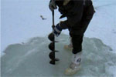
Sea Ice Data Assimilation
Observations (remote & in-situ)
(real time or climatology)
IN
Sea Ice Data Assimilation
Sea Ice fraction & thickness
…
INPUT
OUTPUT
Nudging
Ensemble mean or each member
Xingren Wu, EMC

Slide 40
Sea Ice Data Assimilation
Nudging of sea ice concentration in the CFSv2 has been successful; a continuation using the same technique may be acceptable.
The inclusion of sea ice thickness assimilation may be a minimum requirement for the next CFS.
However, the lack of observational data needs to be resolved, and the strategy to handle the situation could require some development.
A fully coupled ocean-seaice or atmosphere-seaice data assimilation may not be feasible at the present time, but the application of the ensemble information from the fully coupled model forecast guess fields (atmosphere/ocean/seaice/land/waves) should be very useful.
Xingren Wu, EMC

Slide 41
NCEP Coupled Hybrid-EnKF Data Assimilation System
NEMS
NEMS
ATMOS
AERO
LAND
WAVE
SEA-ICE
ATMOS
AERO
LAND
WAVE
OCEAN
SEA-ICE
OCEAN
Coupled Model Ensemble Forecast
Coupled Model Ensemble Forecast
Coupled Ensemble Forecast (N members)
Ensemble Analysis (N Members)
INPUT
OUTPUT

Slide 42
Wave Coupling
GFS
SST
Charnock
Q_{air}
U_{c}
U_{ref}
R_{air}
τ_{air}
Ocean
τ_{diff}
τ_{coriol}
λ
WAVEWATCH III
U_{c}
GFS model air-sea fluxes depend on sea state (roughness -> Charnock).
WAVEWATCH III model forced by wind from GFS and currents from Ocean.
Ocean model forced by heat flux, sea state dependent wind stress modified by growing or decaying wave fields and Coriolis-Stokes effect.

Slide 43
WAVEWATCH III
Current Status
  Wave model is driven in uncoupled mode with GFS 10m winds for global forecasts (4 cycles a day out to 180 h of forecast)
  Hurricane wave model uses a blend of GFS and HWRF winds for forecasts (4 cycles a day out to 126 h of forecast)
  Use first guess model results from previous cycle as final wave analysis
Arun Chawla, Henrique Alves, Hendrik Tolman, EMC

Slide 44
WAVEWATCH III
Planned Upgrades
  Drive the wave model in a coupled mode with atmospheric winds (for wave dependent boundary conditions in atmospheric models)
  Include wave - ocean coupling (currents from ocean model to wave model and wave induced langmuir mixing and stokes drift from wave model to ocean model)
  Data assimilation of significant wave heights to develop a wave analysis
    GSI approach
    LETKF approach
  Planned sources of data
    Spectral data from ocean buoys
    Satellite data from altimeters
Arun Chawla, Henrique Alves, Hendrik Tolman, EMC

Slide 45
CFS VERSION 3
Improve analysis coupling
The operational CFSR uses a coupled atmosphere-ocean-land-sea ice forecast for the analysis background but the analysis is done separately for each of the domains.
In the next reanalysis, the goal is to increase the coupling so that, e.g., the ocean analysis influences the atmospheric analysis (and vice versa). This will be achieved mainly by using a coupled ensemble system to provide the background and the EnKF to generate structure functions that extend across the sea-atmosphere interface.
The same can be done for the atmosphere and land, because assimilation of land data will be improved for soil temperature and soil moisture content.

Slide 46
CFS VERSION 3
Increased resolution of the system
The resolution of all parts of the system will be increased in proportion to the increased computing power currently available, with the possibility of exploring cheaper cloud computing options.
This will result in better assimilation of isolated data observed in the vicinity of steep topography.

Slide 47
CFS VERSION 3
Increased resolution of the system (contd)
It will also allow a better description of extremes over the period 1979-2020, along with changes in climate that can be guided by forcing functions (aerosols, GHGs), and observations amenable to assimilation.
One example of an improved description of assimilating extremes would be hurricanes and storm surge events that become better resolved at high resolution.
Another example is better hydrology to improve the realism of extremes in droughts, floods and river flow.

Slide 48
CFS VERSION 3
Increased resolution of the system (contd)
Higher resolution and better topography, along with improved physics of the boundary layer and improvements to both shallow and deep convection, will help the analysis at the interfaces, ie. sea surface temperature, 2-meter air temperature and precipitation. Producing a better daily cycle in each of these three interface variables is absolutely necessary.
An increase in resolution and the embedding of regional models into the global domain will also help in make more realistic downscaling studies possible.

Slide 49
CFS VERSION 3
Increased resolution of the system (contd)
Increased resolution of the coupled system will also improve the representation of waves, shallow coastal oceans and ecosystems.
Increased resolution into the stratosphere and higher comes at an opportune time, now that nature offers us an experiment with a quiet sun from 2008 onward, followed by an extremely weak solar cycle 24. This should yield insight into the chemistry of such vital elements as ozone, and give a better description of both the trend and interannual variation of the ozone hole from 1979-present.
Increased vertical resolution in the stratosphere will potentially help in the prediction/simulation of the QBO.

Slide 50
CFS VERSION 3
Mitigate some of the problems in the operational CFSR
Among the toughest problems is the analysis of sea-ice. The period 1979-2020 offers hitherto hard to explain, variations in the extent and thickness of the sea-ice in both polar regions. The modeling of sea ice, shelf ice, sheet ice and glacial ice needs to improve.
Special attention has to be given to the coupling of seaice to fresh water from atmosphere and continental runoff, and its interaction with meridional overturning currents in all ocean basins (especially the North Atlantic) and marginal seas (Mediterranean, Baltic etc).

Slide 51
NCEP Coupled Hybrid-EnKF Data Assimilation System
NEMS
NEMS
ATMOS
AERO
LAND
WAVE
SEA-ICE
ATMOS
AERO
LAND
WAVE
OCEAN
SEA-ICE
OCEAN
Coupled Model Ensemble Forecast
Coupled Model Ensemble Forecast
Coupled Ensemble Forecast (N members)
Coupled Ensemble Analysis (N Members)
INPUT
OUTPUT

Slide 52
THANK YOU

