Slide 1
Some ECCO project highlights from the 2014 ECCO meeting
22 to 24 January, 2014
Massachusetts Institute of Technology
Cambridge, MA 02139

Slide 2
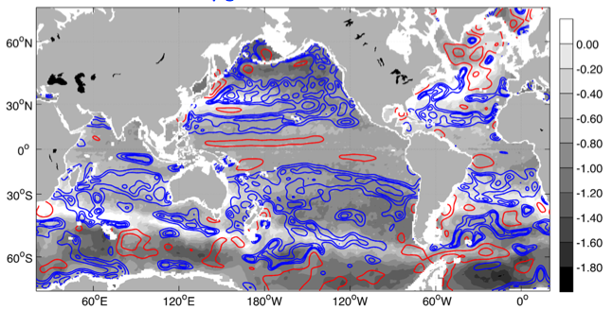
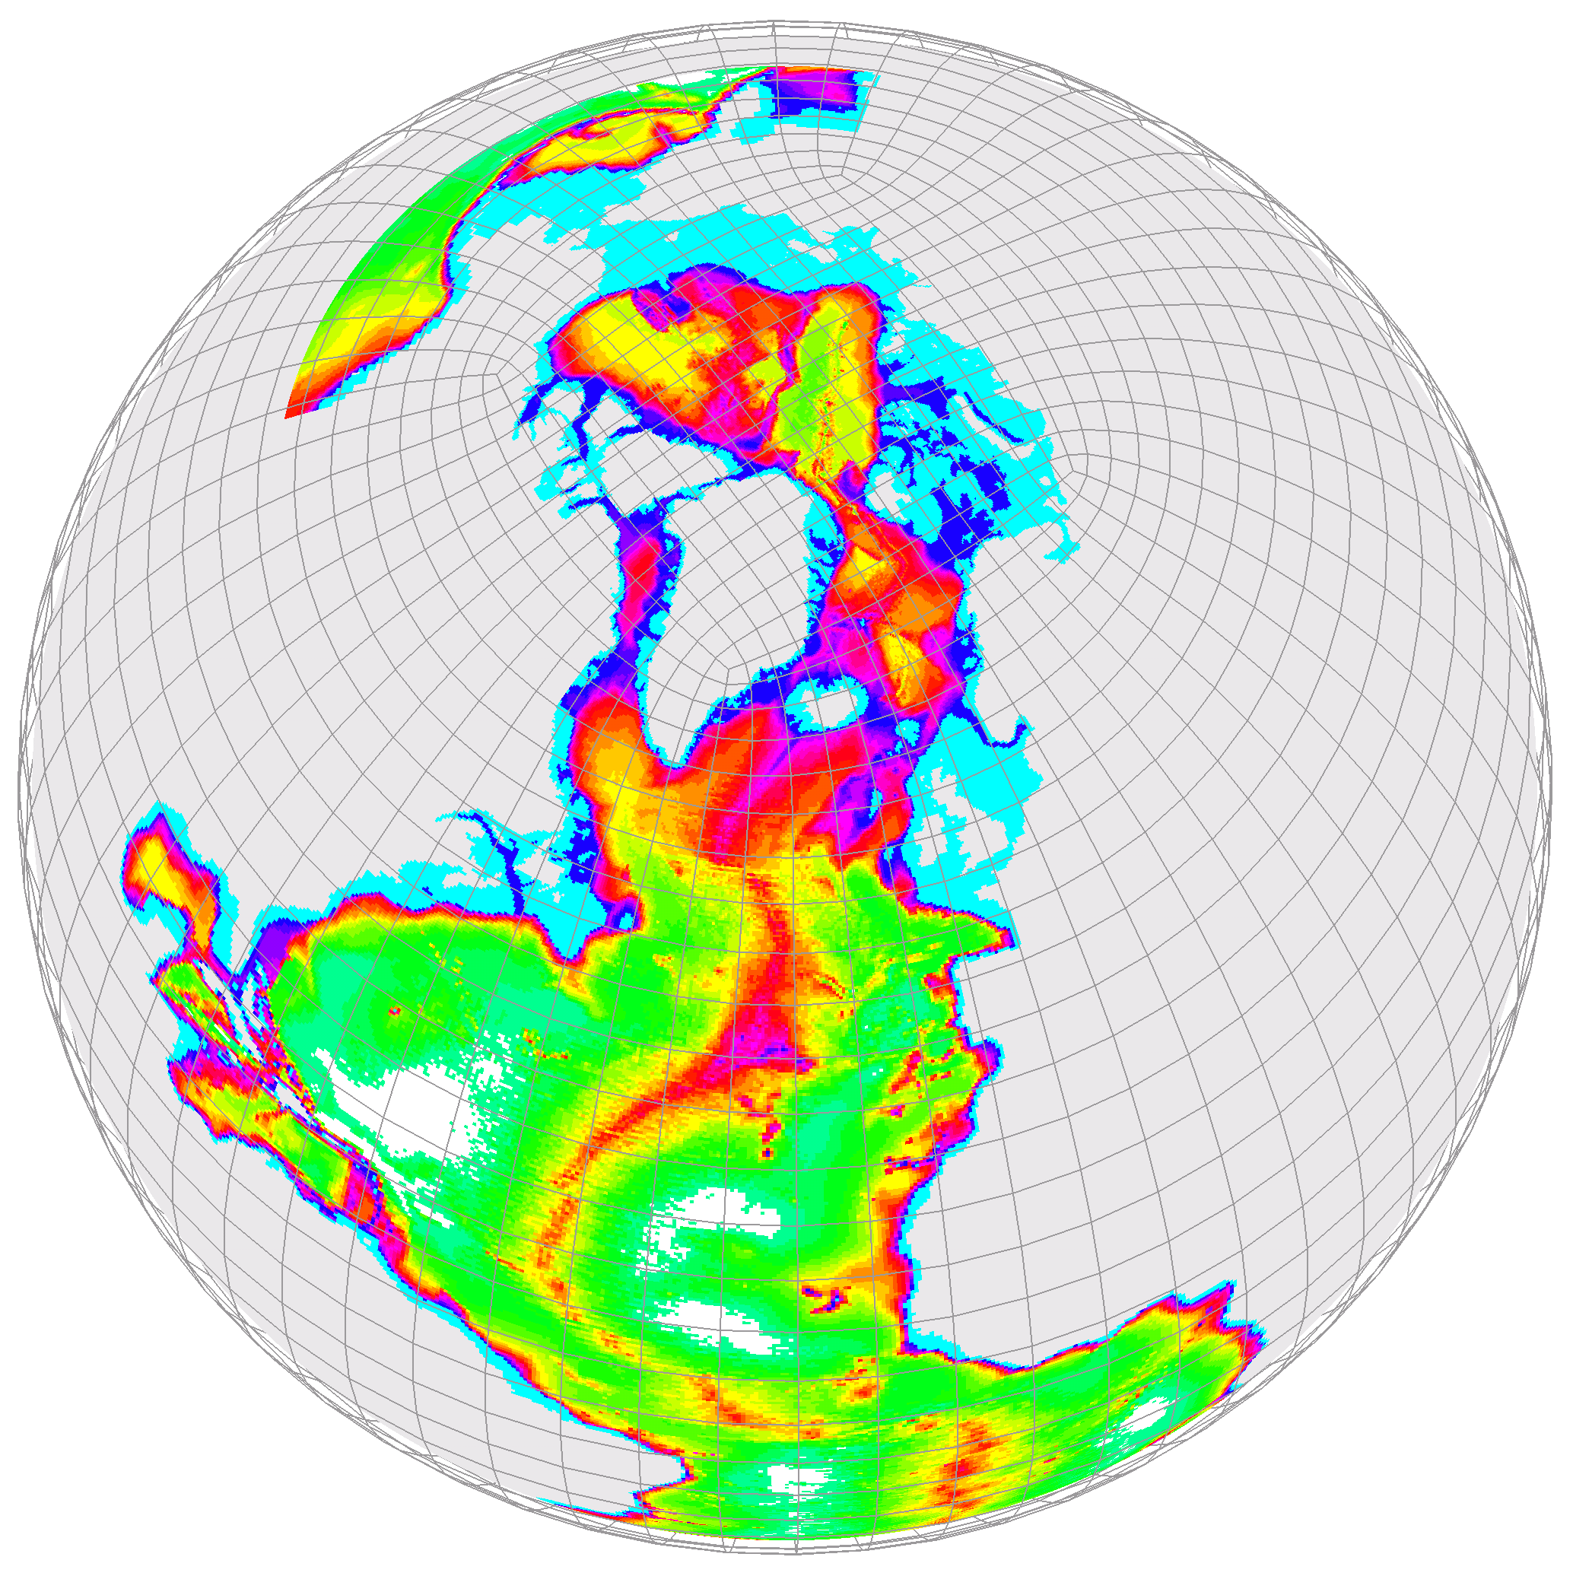
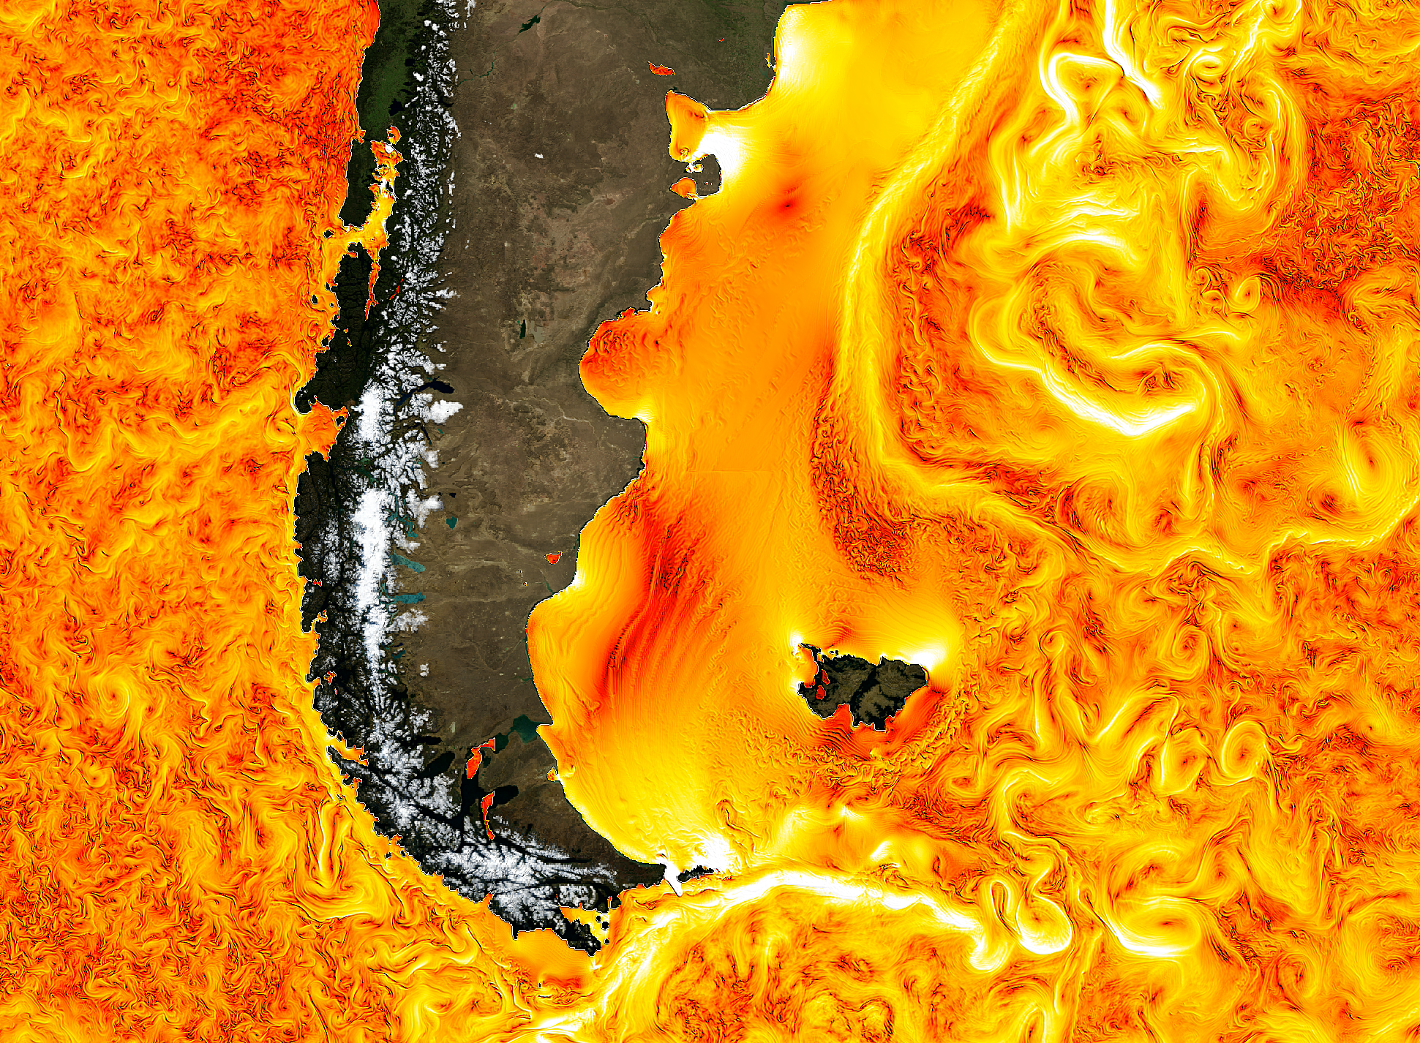
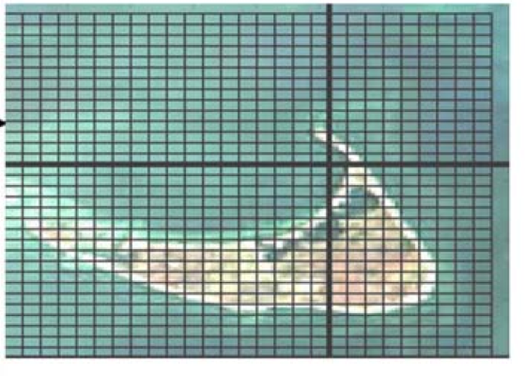
Towards standardization of ECCO solutions around lat/lon/cap grids
Gael Forget et al.: Release of ECCO-Production version 4 on llc90 grid
An Nguyen: Arctic Subpolar State Estimate (ASTE) on llc270 grid
Dimitris Menemenlis et al.: Global simulations on the llc1080, llc2160, and llc4320 grids
Chris Hill: Toward global 1-km simulation

Slide 3
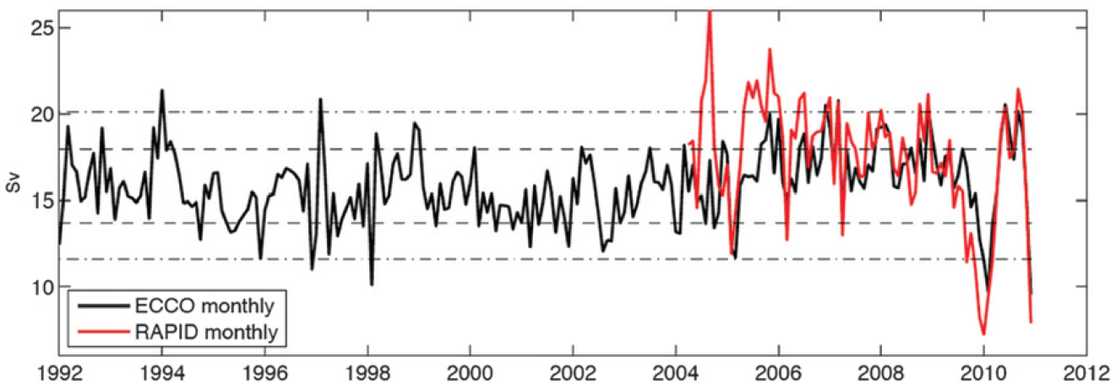
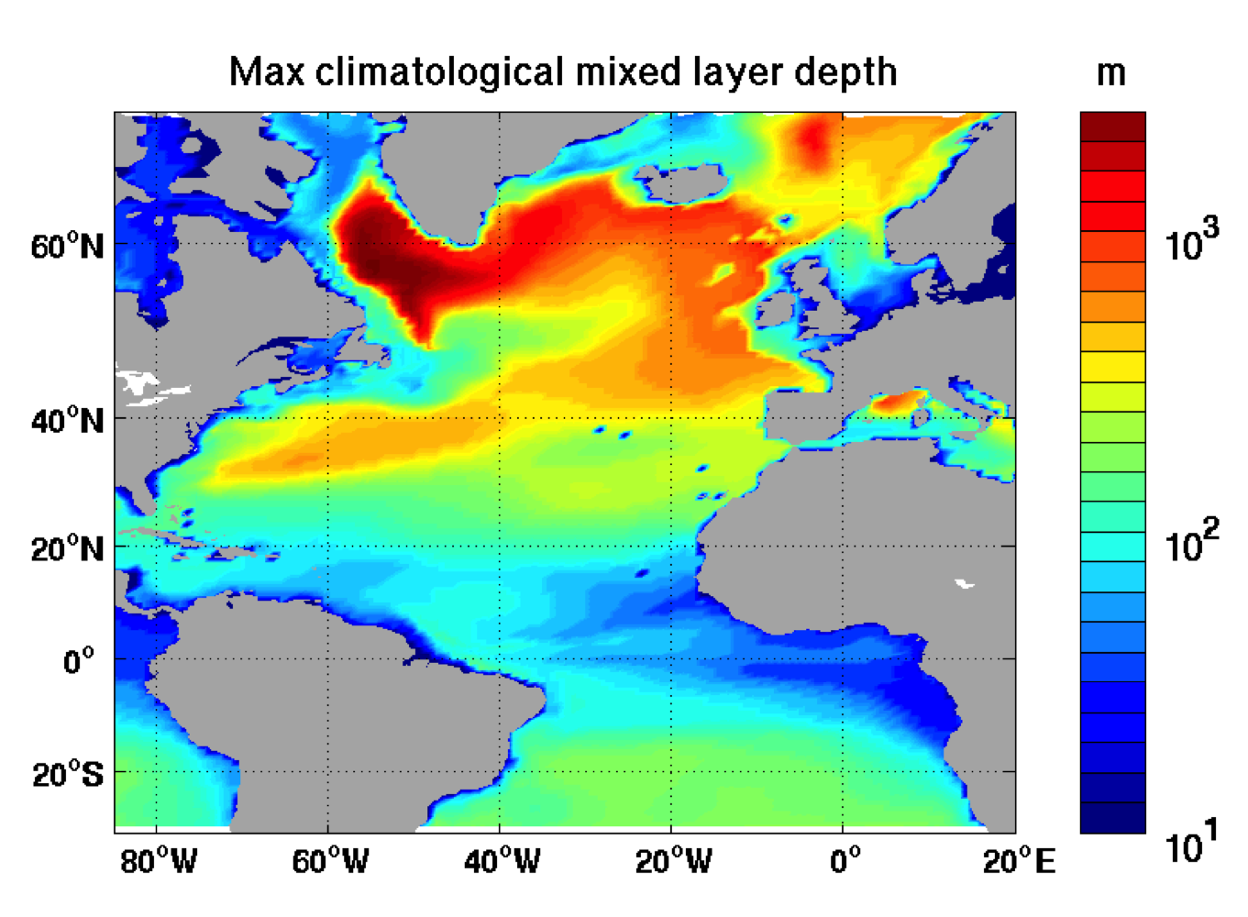
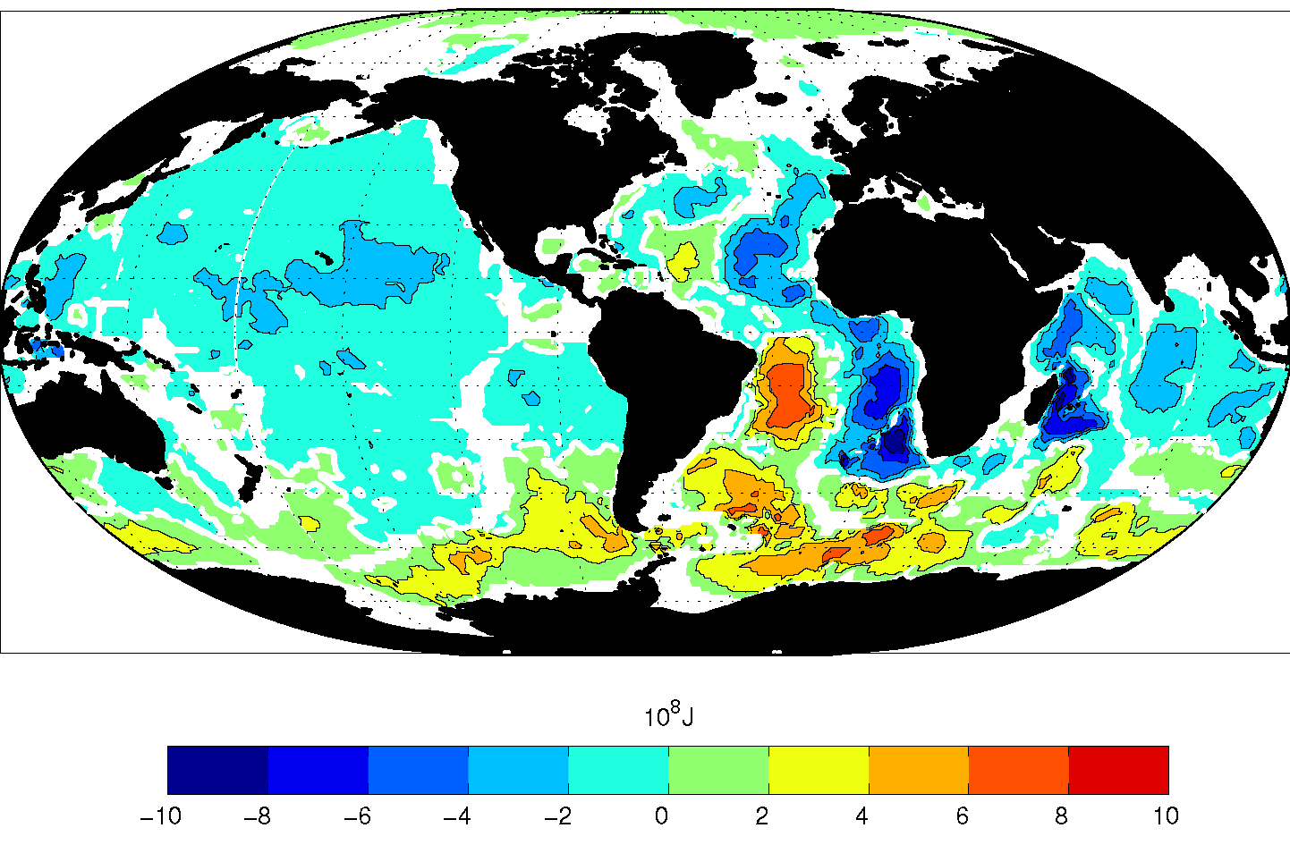
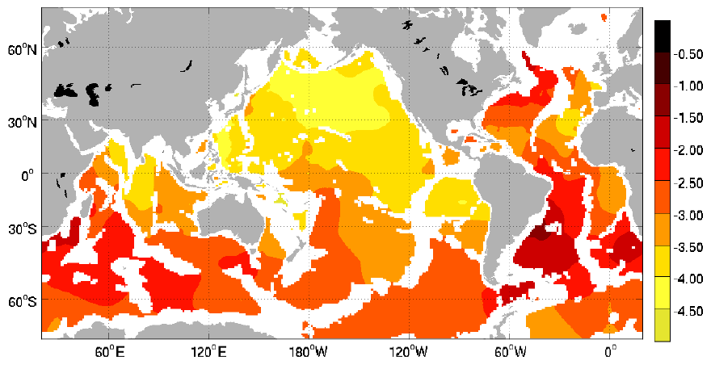
Science analyses of ECCO solutions
Wunsch & Heimbach: Two decades of Atlantic MOC estimates from ECCO
Buckley et al.: Origin of North Atlantic heat content variability
Wunsch & Heimbach: Bidecadal thermal changes in the abyssal ocean
Forget: Abyssal hydrographic variability

Slide 4
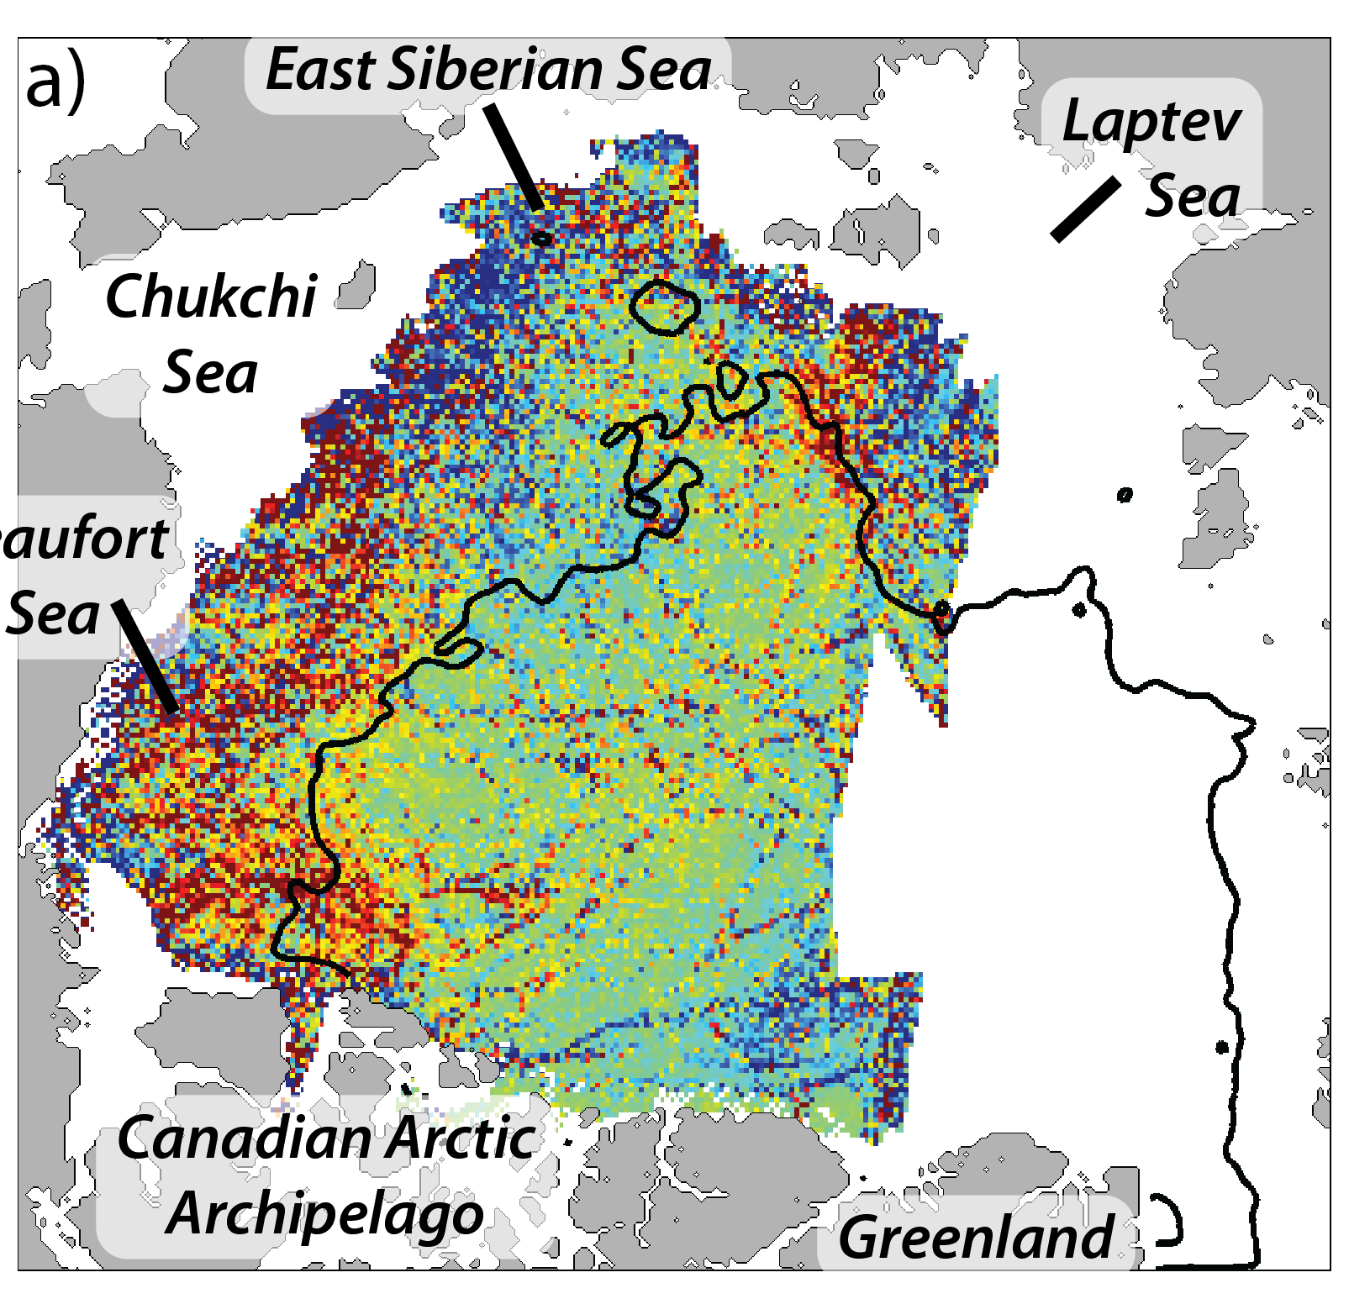
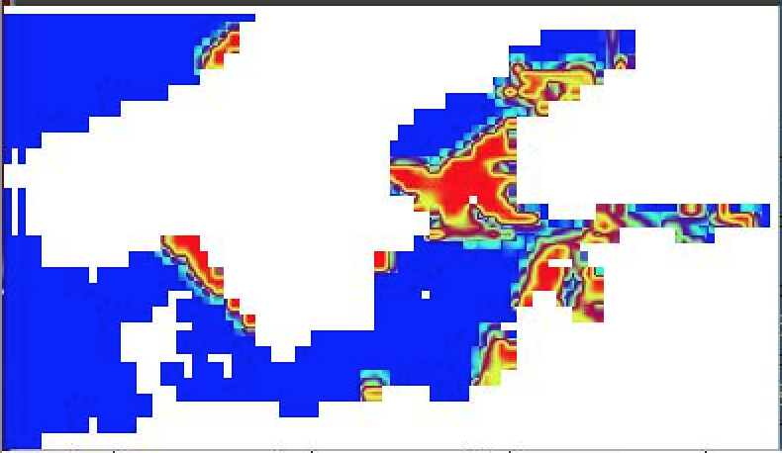
Sea ice modeling studies
Gunnar Spreen: Sea ice deformation in simulations and data
Martin Losch: Convergence and accuracy of sea ice dynamics solvers
Chris Hill: MIT/GFDL common code repository

Slide 5
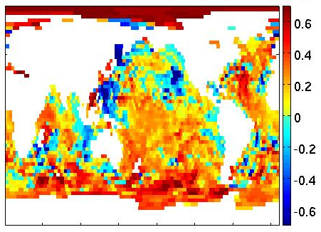
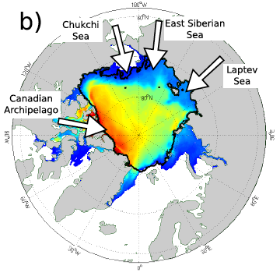
Eddying global-ocean and sea-ice adjoint-method optimizations
Hong Zhang: Assessment of CS510 adjoint optimization
David Halpern: Impact of data assimilation on ECCO2 Equatorial Undercurrent and North Equatorial Countercurrent in the Pacific Ocean
Carmen Boening: Assimilation of GRACE data in a global, eddying, ocean and sea ice model
Ian Fenty: ICESat-1 and CryoSat sea ice thickness constraints in ECCO models

Slide 6
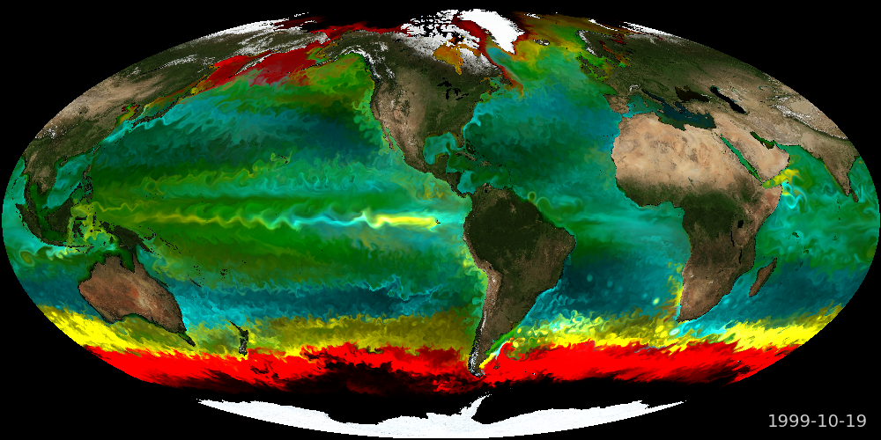
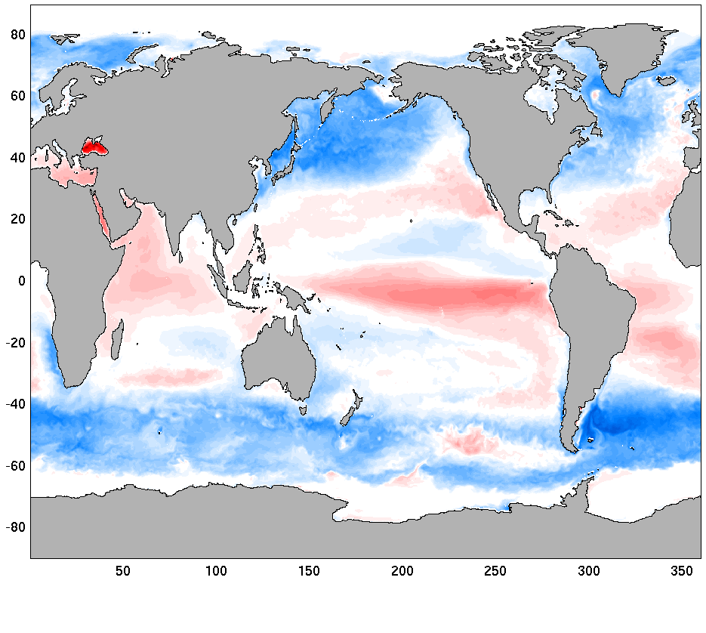
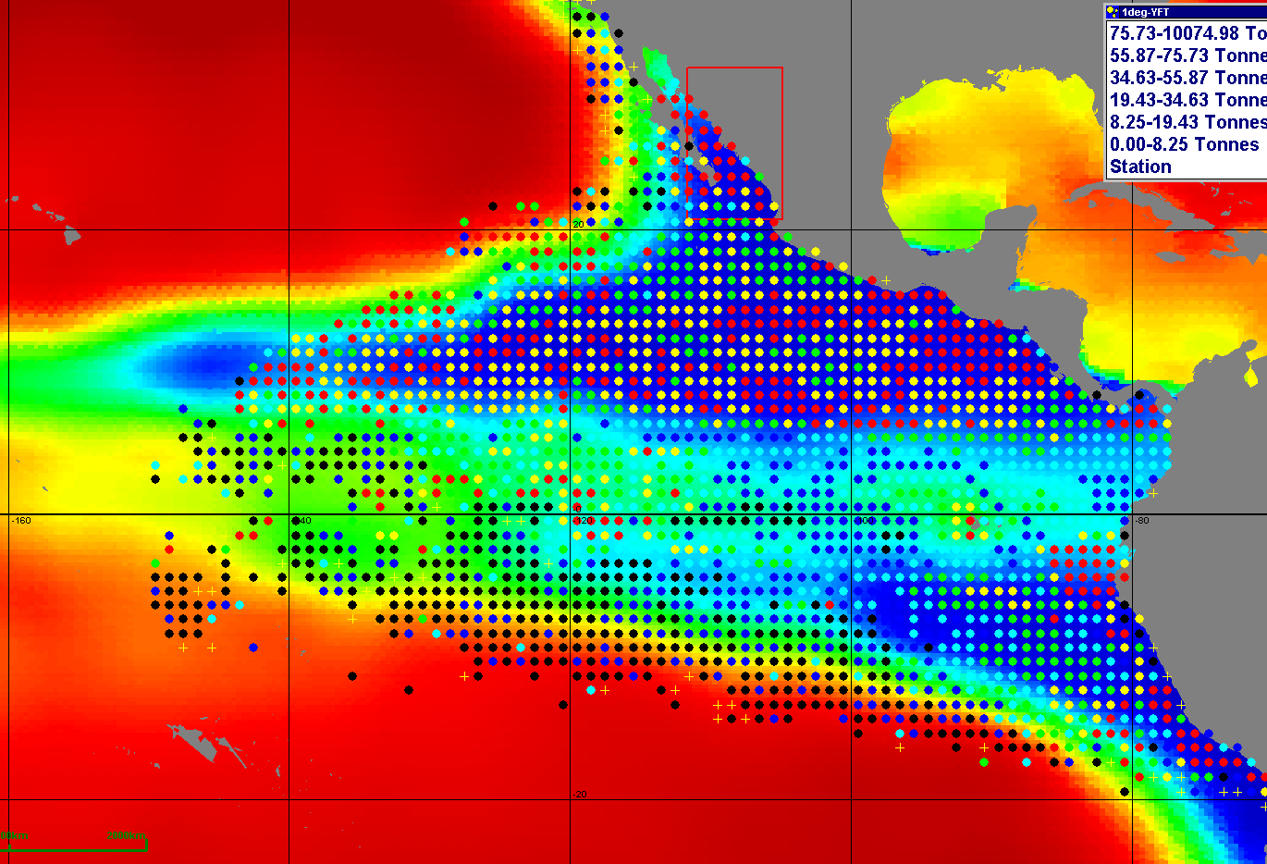
Ocean ecology and biogeochemistry applications of CS510 solutions
Mick Follows: Ecological applications of ECCO
Michelle Gierach: ECCO2-Darwin ocean biogeochemistry model
Dale Kiefer: ECCO monitoring and simulating the tuna fishery of the Eastern Tropical Pacific

Slide 7
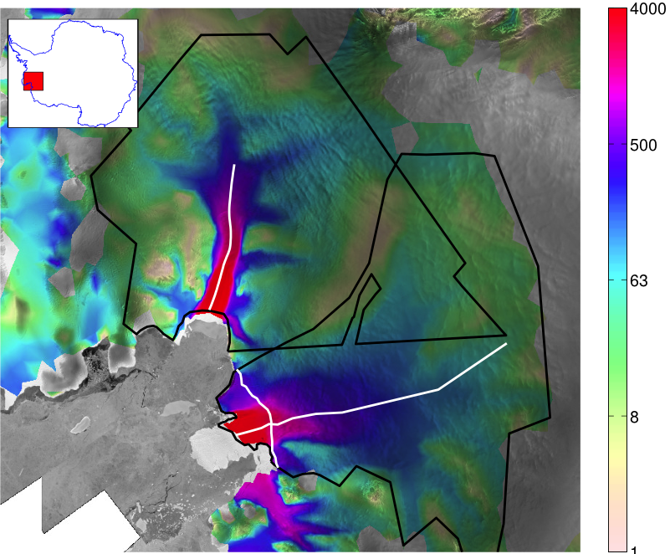
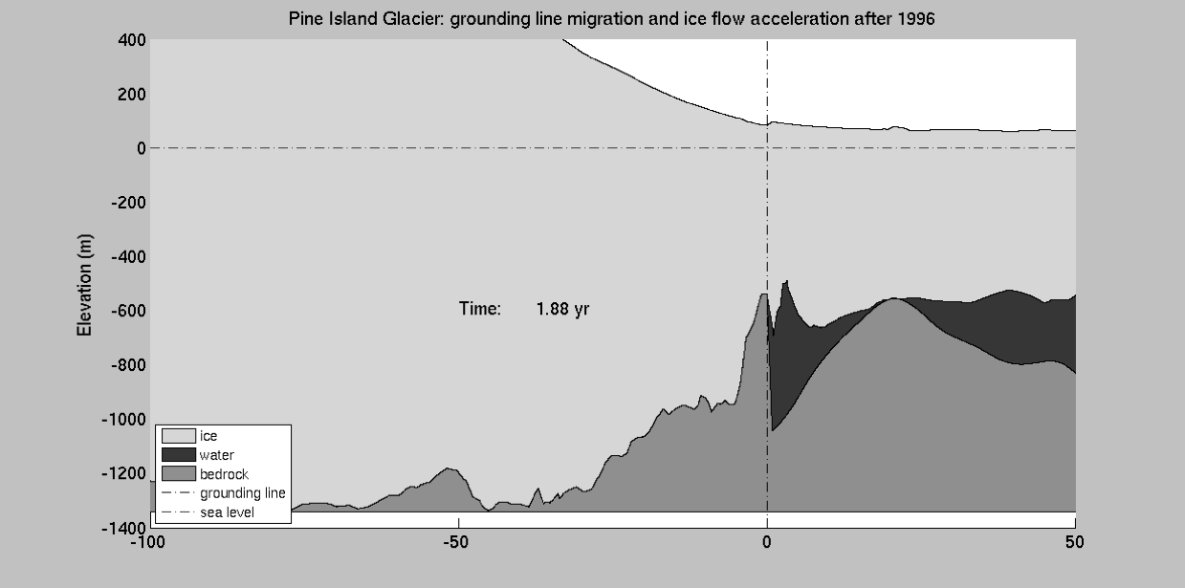
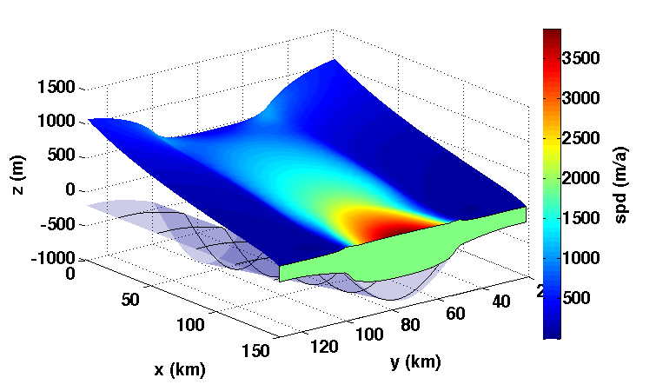
Ice sheet modeling and coupling
Helene Seroussi: Modeling of Pine Island and Thwaites Glaciers, West Antarctica
Eric Larour: Ice/ocean coupling using ISSM and MITgcm
Dan Goldberg: Parameter and state estimation with a time-dependent adjoint marine ice sheet model

Slide 8
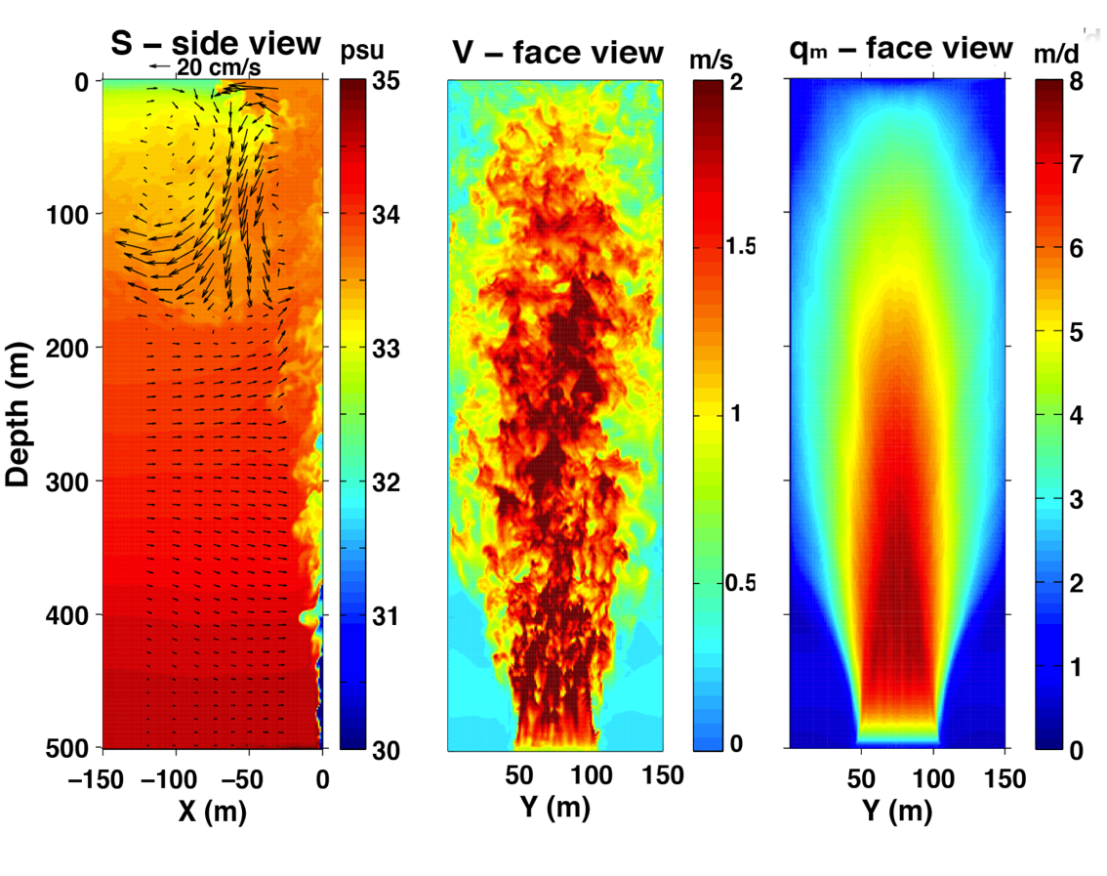
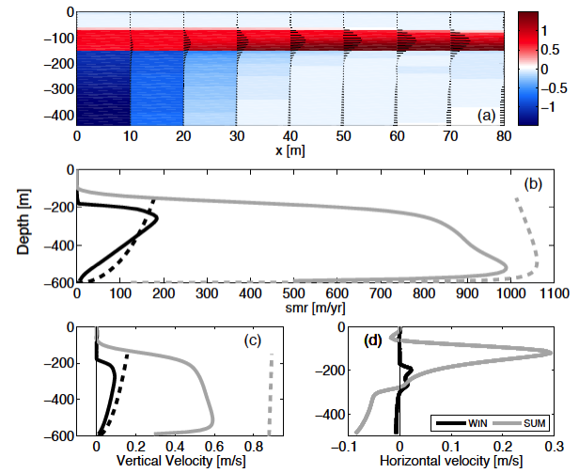
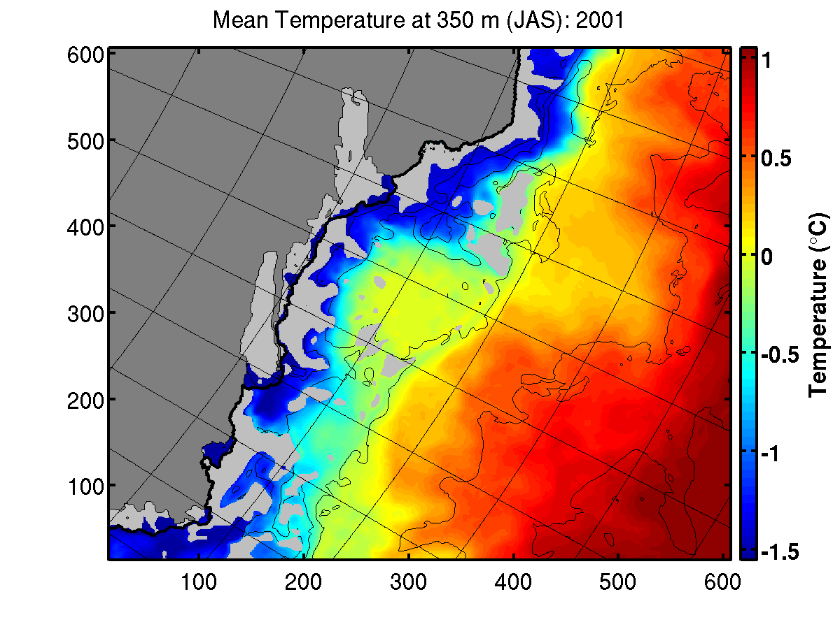
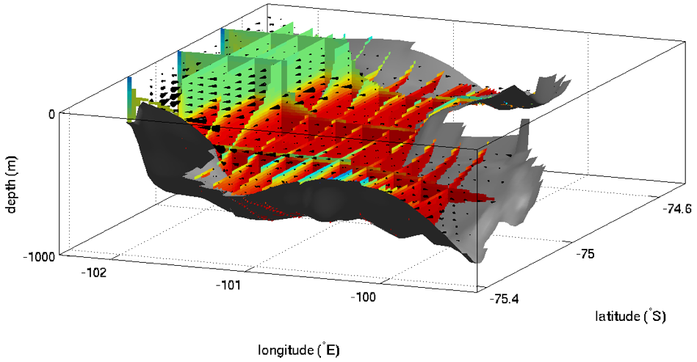
Ice sheet-ocean interactions
Yun Xu: Subaqueous melting of Store Glacier, West Greenland
Roberta Sciascia: Submarine melting of Helheim Glacier, Southeast Greenland
Michael Schodlok: Sensitivity of the ice shelf ocean system to sea ice formation along Sabrina Coast, East Antarctica
Patrick Heimbach: Sub-ice shelf melt rates under Pine Island, West Antarctica
Martin Losch: MITgcm adjoint sub-ice shelf cavity circulation under Pine Island, West Antarctica

Slide 9
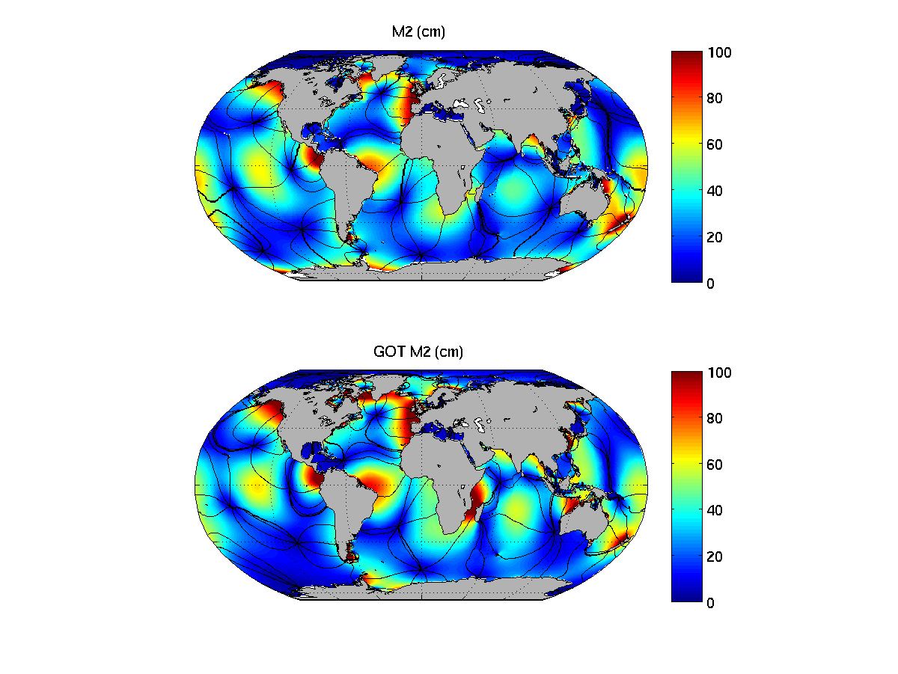
Impact of tides on large-scale ocean circulaton
Ayan Chaudhuri: Impact of tides on ECCO
Mar Flexas Sbert: Role of tides on the presence of the Antarctic Slope Front at the tip of the Antarctic Peninsula
Dimitris Menemenlis et al.: Global high-resolution ocean simulations with tides

Slide 10
Selected recent ECCO publications (a more complete list is here: http://ecco2.org/manuscripts/)
2014
R. Abernathey, D. Ferreira, and A. Klocker, 2014: Diagnostics of eddy mixing in a circumpolar channel. Ocean Modelling, submitted.
H. Brix, D. Menemenlis, C. Hill, S. Dutkiewicz, O. Jahn, D. Wang, K. Bowman, and H. Zhang, 2014: Using Green's Functions to initialize and adjust a global, eddying ocean biogeochemistry general circulation model. Ocean Modelling, submitted.
M. Buckley, R. Ponte, G. Forget, and P. Heimbach, 2014: Low-frequency SST and upper-ocean heat content variability in the North Atlantic. J. Clim., in press, doi:10.1175/JCLI-D-13-00316.1.
Chaudhuri, A. H., R. M. Ponte, and A. T. Nguyen, 2014: A comparison of atmospheric reanalysis products for the Arctic Ocean and implications for uncertainties in air-sea fluxes, Journal of Climate, in press.
Danabasoglu, G., et al., 2014: North Atlantic simulations in Coordinated Ocean-ice Reference Experiments, phase II (CORE-II): Part I: Mean states. Ocean Modelling, 73, 76-107, doi:10.1016/j.ocemod.2013.10.005.
Dansereau, V., P. Heimbach, and M. Losch, 2014: Simulation of sub-ice shelf melt rates in a general circulation model: velocity-dependent transfer and the role of friction. J. Geophys. Res., in press, doi:10.1002/2013JC008846.
B. Dushaw and D. Menemenlis, 2014: Antipodal acoustic thermometry: 1960, 2004. Deep-Sea Res. I, 86, 1-20.
A. Kalmikov and P. Heimbach, 2014: A Hessian-based method for Uncertainty Quantification in Global Ocean State Estimation. SIAM J. Scientific Computing (Special Section on Planet Earth and Big Data), in revision.
M. Losch, V. Strass, B. Cisewski, C. Klaas, and R. Bellerby, 2014: Ocean state estimation from hydrography and velocity observations during EIFEX with a regional biogeochemical ocean circulation model. J. Mar. Syst., 129, 437-45.
M. Morlighem, E. Rignot, J. Mouginot, X. Wu, H. Seroussi, E. Larour, and J. Paden, 2014: Bed topography of Russell Glacier, Greenland, inferred from mass conservation using Operation IceBridge data. J. Glaciol., submitted.
M. Morlighem, H. Seroussi, E. Larour and E. Rignot, 2014: Inversion of basal friction in Antarctica using exact and incomplete adjoints of a higher-order model, J. Geophys. Res., submitted.
Piecuch, C. G., and R. M. Ponte, 2014: Mechanisms of global mean steric sea level change. J. Clim., in press.
G. Spreen, R. Kwok, D. Menemenlis, and A. Nguyen, 2014: Sea ice deformation in a coupled ocean-sea ice model and in satellite remote sensing data. J. Geophys. Res., submitted.
C. Wortham and C. Wunsch, 2014: A multi-dimensional spectral description of ocean variability, J. Phys. Oceanogr., in press, doi:10.1175/JPO-D-13-0113.1.
Wunsch, C. and P. Heimbach, 2014: Bidecadal Thermal Changes in the Abyssal Ocean. J. Phys. Oceanogr., in press.
Zedler, S., C.S. Jackson, F. Yao, P. Heimbach, A. Koehl, R.B. Scott, and I. Hoteit, 2013: Tests of the K-Profile Parameterization of turbulent vertical mixing using seasonally averaged observations from the TOGA/TAO array from 2004 to 2007. Ocean Modelling., in revision.

Slide 11
Selected recent ECCO publications (a more complete list is here: http://ecco2.org/manuscripts/)
2013
M. Baringer, et al., 2013: Meridional Overturning Circulation and Heat Transport Observations in the Atlantic Ocean. Bull. Amer. Met. Soc., Special Supplement: State of the Climate in 2012, S65-S-68, in press.
A. Chaudhuri, R. Ponte, G. Forget, and P. Heimbach, 2013: A comparison of atmospheric reanalysis surface products over the ocean and implications for uncertainties in air-sea boundary forcing. J. Clim., 26, 153-170, doi:10.1175/JCLI-D-12-00090.1.
R. Chen, 2013: Energy pathways and structures of oceanic eddies from the ECCO2 state estimate and simplified models. Ph.D. Thesis, MIT-WHOI Joint Program, Cambridge, MA.
B. Dushaw, P. Worcester, M. Dzieciuch, and D. Menemenlis, 2013: On the time-mean state of ocean models and the properties of long-range acoustic propagation. J. Geophys. Res., 118, doi:10.1002/jgrc.20325
I. Fenty and P. Heimbach, 2013: Coupled sea ice-ocean state estimation in the Labrador Sea and Baffin Bay. J. Phys. Oceanogr., 43(6), 884-904, doi:10.1175/JPO-D-12-065.1.
I. Fenty and P. Heimbach, 2013: Hydrographic preconditioning for seasonal sea ice anomalies in the Labrador Sea. J. Phys. Oceanogr., 43(6), 863-883, doi:10.1175/JPO-D-12-064.1.
Goldberg, D.N. and P. Heimbach, 2013: Parameter and state estimation with a time-dependent adjoint marine ice sheet model. The Cryosphere, 7, 1659-1678, doi:10.5194/tc-7-1659-2013.
I. Hoteit, T. Hoar, G. Gopalakrishnan, N. Collins, J. Anderson, B. Cornuelle, A. Koehl, and P. Heimbach, 2013: A MITgcm/DART ensemble analysis and prediction system: Development and application to the Gulf of Mexico. Dynamics of Atmospheres and Oceans, in press.
A. Kalmikov, 2013: Uncertainty quantification in ocean state estimation. Ph.D. Thesis, MIT-WHOI Joint Program, Cambridge, MA.
A. Khazendar, M. Schodlok, I. Fenty, S. Ligtenberg, E. Rignot, and M. van den Broeke, 2013: Observed thinning of Totten Glacier is linked to coastal polynya variability. Nat. Commun., 4, 2857.
M. Manizza, M. Follows, S. Dutkiewicz, D. Menemenlis, C. Hill, R. Key, 2013: Changes in the Arctic Ocean CO2 sink (1996-2007): A regional model analysis. Global Biogeochem. Cycles, in press.
M. Mazloff, R. Ferrari, and T. Schneider, 2013: The force balance of the Southern Ocean meridional overturning circulation. J. Phys. Oceanogr., in press, doi:10.1175/JPO-D-12-069.1.
Piecuch, C. G., and R. M. Ponte, 2013. Buoyancy-driven interannual sea level changes in the tropical South Atlantic, Journal of Physical Oceanography, 43, 533-547.
R. Reynolds, D. Chelton, J. Roberts, M. Martin, D. Menemenlis, and C. Merchant, 2013: Objective determination of feature resolution in two sea surface temperature analyses. J. Clim., 26, 2514-2533.
Roquet, F., C. Wunsch, G. Forget, P. Heimbach, et al., 2014: Estimates of the Southern Ocean General Circulation Improved by Animal-Borne Instruments. Geophys. Res. Lett., 40, 6176-6180, doi:10.1002/2013GL058304.

Slide 12
Selected recent ECCO publications (a more complete list is here: http://ecco2.org/manuscripts/)
2013 (cont’d)
R. Sciascia, F. Straneo, C. Cenedese, and P. Heimbach, 2013: Seasonal variability of sub- marine melt rate and circulation in an east Greenland fjord. J. Geophys. Res., 118(5), 2492-2506, doi:10.1002/jgrc.20142.
K. Speer and G. Forget, 2013: Global distribution and formation of mode waters (accepted book chapter). In: G.Siedler, J.Church, J.Gould and S.Griffies, eds.: Ocean circulation and climate: observing and modelling the global ocean, 2nd Ed., Elsevier.
Straneo, F. and P. Heimbach, 2013: North Atlantic warming and the retreat of Greenland’s outlet glaciers. Nature, 504, 36-43, doi:10.1038/nature12854.
Straneo, F., P. Heimbach, O. Sergienko, and 14 others, 2013: Challenges to Understanding the Dynamic Response of Greenlands Marine Terminating Glaciers to Oceanic and Atmospheric Forcing. Bull. Amer. Met. Soc., 94(8), 1131-1144, doi:10.1175/BAMS-D-12-00100.
R. Tenzer, N. Dayoub, and A. Abdalla, 2013: Analysis of a relative offset between vertical datums at the North and South Islands of New Zealand. Applied Geomatics, doi:10.1007/s12518-013-0106-8.
Vinogradova, N. T., and R.M. Ponte, 2013. Clarifying the link between surface salinity and freshwater fluxes on monthly to inter-annual timescales, J. Geophys. Res., 118, 3190-3201, doi:10.1002/jgrc.20200.
D. Volkov, F. Landerer, and S. Kirillov, 2013: The genesis of sea level variability in the Barents Sea. Continental Shelf Reseach, 66, 92-104.
D. Volkov and F. Landerer, 2013: Non-seasonal fluctuations of the Arctic Ocean mass observed by the GRACE satellites. J. Geophys. Res., in press.
C. Wortham, 2013: A multi-dimensional spectral description of ocean variability with applications. Ph.D. Thesis, MIT-WHOI Joint Program, Cambridge, MA.
C. Wunsch, 2013: Covariances and linear predictability of the Atlantic Ocean. Deep-Sea Research Part II, 85, 228-243.
C. Wunsch, 2013: Baroclinic motions and energetics as measured by altimeters. J. Atmos. Ocean Tech., 20, 140-150, doi:10.1175/JTECH-D-12-00035.1.
C. Wunsch, R. Schmitt, and D. Baker, 2013: Climate change as an intergen- erational problem. Proceedings of the National Academy of Sciences, 110(12), 44354436. doi:10.1073/pnas.1302536110
Wunsch, C. and P. Heimbach, 2013: Two Decades of the Atlantic Meridional Overturning Circulation: Anatomy, Variations, Extremes, Prediction, and Overcoming Its Limitations. J. Clim., 26(18), 7167-7186, doi:10.1175/JCLI-D-12-00478.1.
Wunsch, C. and P. Heimbach, 2013: Dynamically and kinematically consistent global ocean circulation and ice state estimates. In: G.Siedler, J.Church, J.Gould and S.Griffieses, eds.: Ocean Circulation and Climate: A 21st Century Perspective. Chapter 21, pp. 553–579, Elsevier, doi:10.1016/B978-0-12-391851-2.00021-0.
Y. Xu, E. Rignot, I. Fenty, D. Menemenlis, and M. Flexas, 2013: Subaqueous melting of Store Glacier, West Greenland from three-dimensional, high-resolution numerical modeling and ocean observations. Geophys. Res. Lett., 40, doi:10.1002/grl.50825

