Slide 1
An Ensemble of Historical Ocean
Reanalyses with Sparse Input
Benjamin Giese / TAMU
With:
Chunxue Yang IPSL, Kelley Bradley TAMU
Jim Carton, Gennady Chepurin UMD
Gil Compo, Prashant Sardeshmukh, Jeff Whitaker NOAA/CIRES

Slide 2
A Brief History of SODA
Simple Ocean Data Assimilation
Early 1990s – Development by Carton et al.
Early 2000’s - “SODA” Upgrades (POP, changes to SODA, etc.)
SODA 1.4 series – First released series
SODA 2.0 and 2.1 Series (Forcing upgrades - Drop rate corrections)
SODA 2.2 Series – First Historical Runs (20CR atmosphere)
SODAsi Series – Sparse input

Slide 3
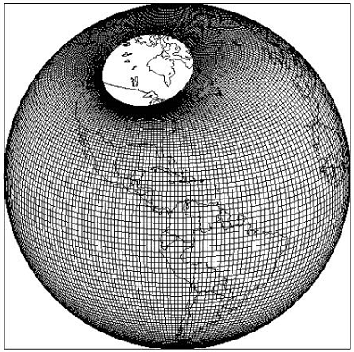
Simple Ocean Data Assimilation
(SODAsi.2)
Eighteen Ensemble Members
Numerics
  Parallel Ocean Program
Domain
  Global (including Arctic)
Resolution
  0.4x0.25 average (~25km x 25km midlat) horizontal
  40 levels: 10m near surface to 450m in deep ocean
Winds
  Eighteen ensemble members of 20CRv2* daily stress 1846 – 2011
Heat and Salt fluxes
  Bulk formulae using 20CRv2 daily variables
SODA Data Assimilation
  ICOADS 2.5 SST data (no hydrography)

Slide 4
In response to the need for longer time series of SST reconstructions were developed: eg. Kaplan, HadISST, ERSST
These reconstructions rely on patterns of ENSO in data rich periods to reconstruct SST in data poor periods.
Note: Our notion of ENSO structure is largely based on the 82/83 and 97/98 events….which were both strong and far to the east.
SST reconstructions imprint the structure of these events into periods of few observations.

Slide 5
HadISST
SODA
1877
1997

Slide 6
SODAsi vs. Earlier versions of SODA
Ensemble Mean Forcing vs. Ensemble Member
SODA 2.2.4 uses ensemble mean forcing
SODA si.2 uses Ensemble Member Forcing

Slide 7
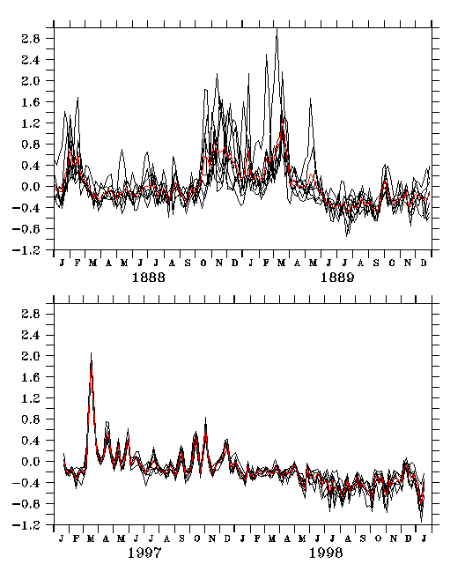
Niño 4 Zonal Wind Stress in Ensemble Reanalyses

Slide 8
Yang and Giese (2010) show that using ensemble forcing both weakens (in the west) and strengthens (in the east) ENSO.
Cooler SST in the west Pacific decreases the zonal SST gradient and thus weakens zonal advection giving rise to weaker ENSO.
Stronger WWB forcing generates strong Kelvin wave response and can strengthen ENSO in the eastern Pacific.

Slide 9
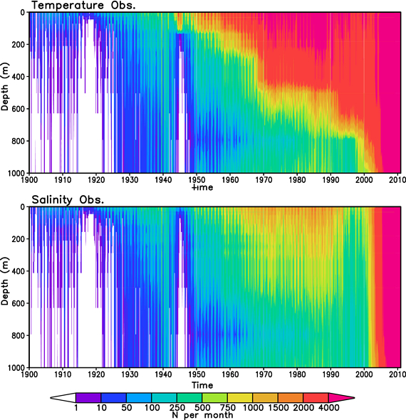
Detecting historical ocean climate variability
Journal of Geophysical Research: Oceans
Vol. 117 Issue C2, C02023, 11 FEB 2012 DOI: 10.1029/2011JC007401
Notes:
Subsurface (top) temperature and (bottom) salinity observations binned into 1° × 1° × 1 mo bins with time. Note the slight decrease in data coverage at 800 m depth prior to the 1990s, a result of the differing choices of standard levels among data providers and data centers.

Slide 10
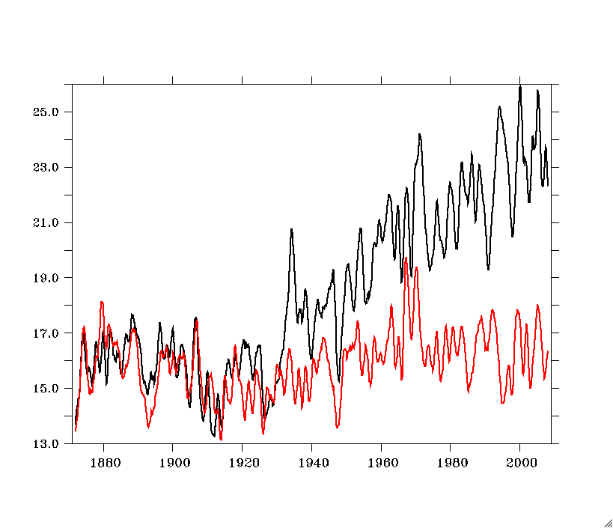
Streamfunction (sv) for SODA 2.2.4 and 2.2.0
SODA 2.2.4 - Full Assimilation
SODA 2.2.0 - No Assimilation

Slide 11
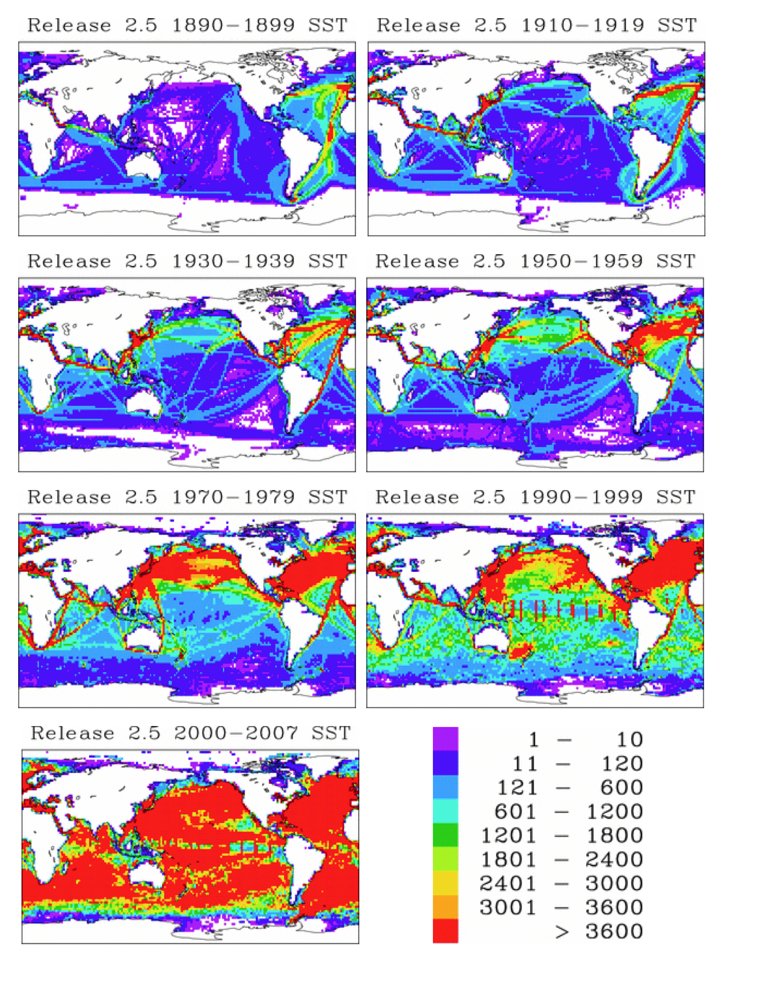
Number of Observations
In ICOADS Release 2.5
From: http://icoads.noaa.gov/r2.5sst.html

Slide 12
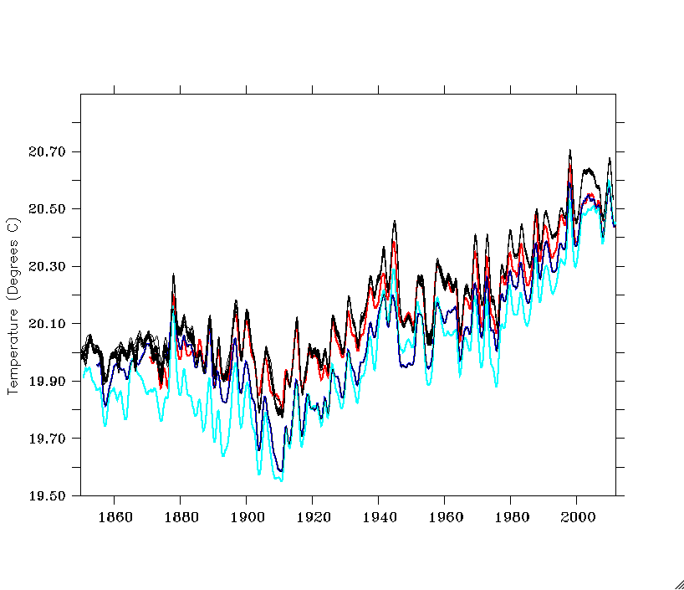
SST averaged 60S to 60N
Black – 18 SODAsi.2 ensemble members
Red – HadISST
Dark Blue – ERSSTv3b
Cyan – Cobe II

Slide 13
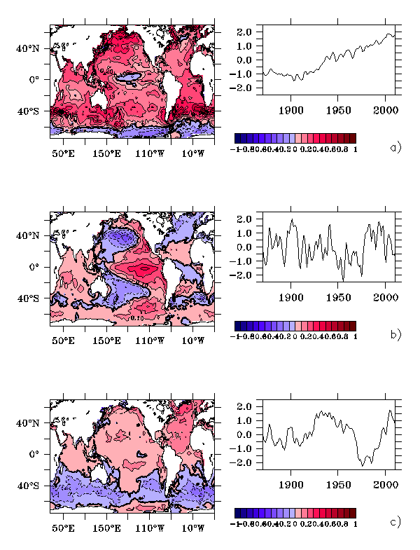
SST EOFs
43%
9%
6%

Slide 14
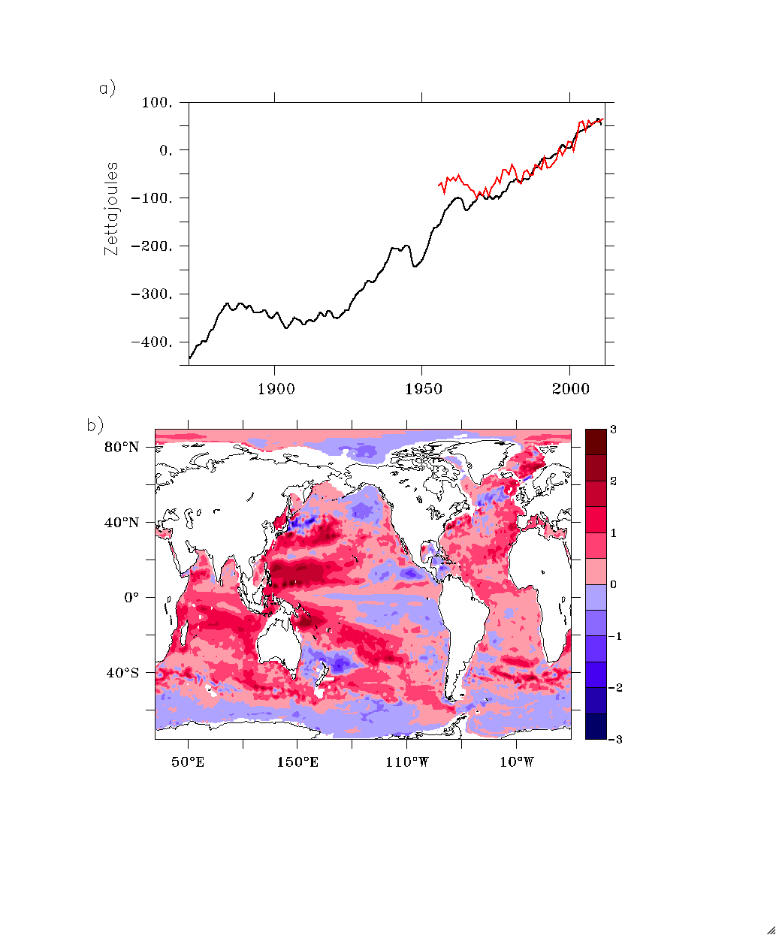
Global Average
Heat Content 700m
Levitus et al. (2008)
shown in red
Zettajoules – 10²¹ joules
HC700 Tendency
Averaged 1920-2011
Q = dT/dt *ρ*c_{p}
= 0.41 watts m⁻²

Slide 15
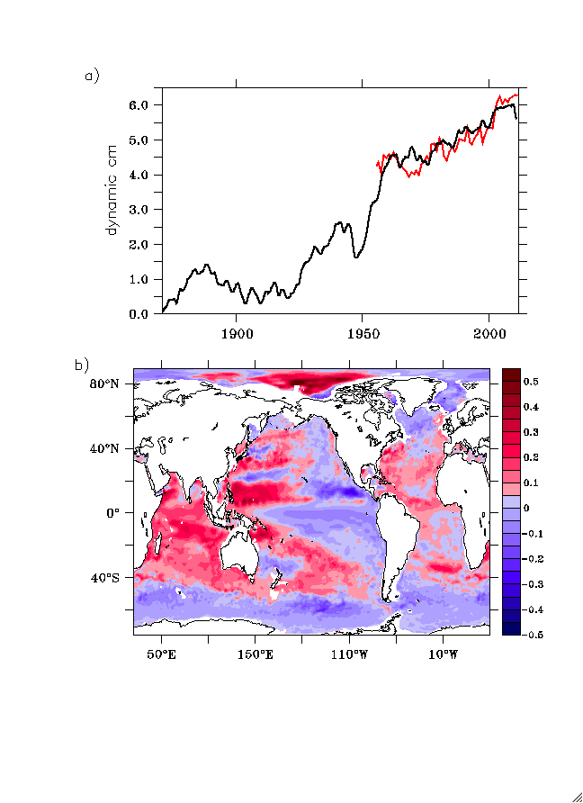
Dynamic Height 700 m
Red – Levitus (2012)
Thermosteric sea level to 700m
Change in Dynamic Height
Dyn-cm per year 1920-2011

Slide 16
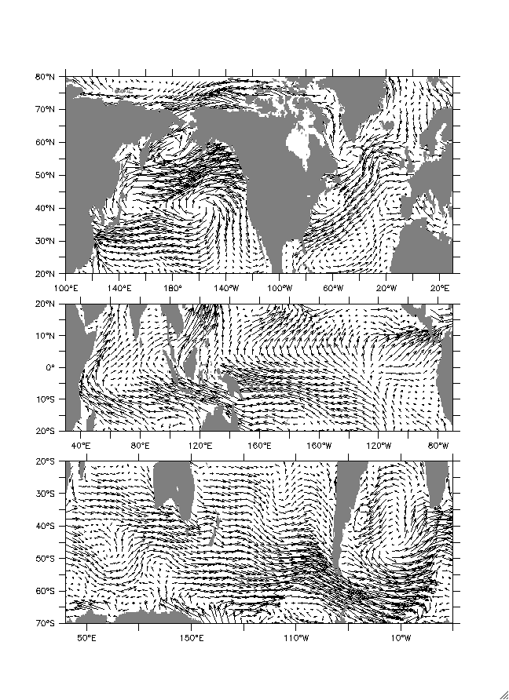
Wind Stress Tendency
Northward migration of Circulation
Strengthened Walker Circulation
Intensification of mid-latitude
westerlies

Slide 17
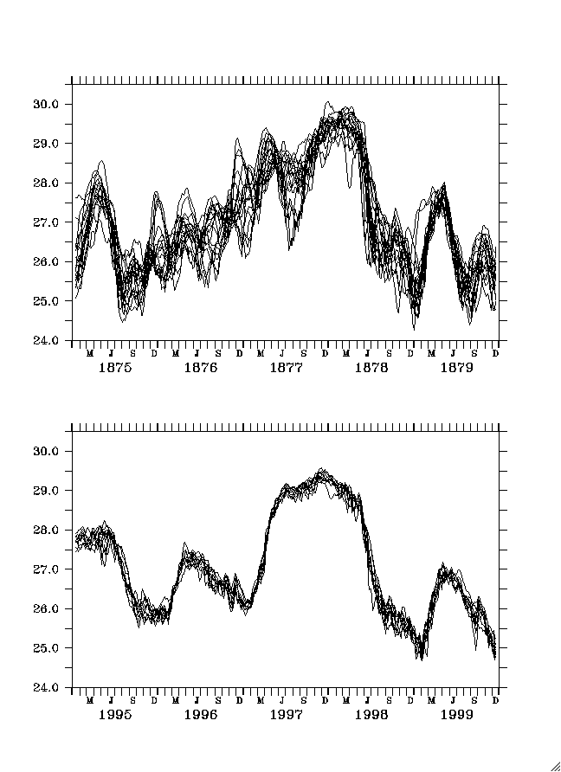
Niño3.4 SST for 18 ensemble
members of SODAsi.2
20CRv2 uses HadISST1.1
monthly means interpolated
daily values.
All ensemble members use
the same SST, with a constant
error estimate.

Slide 18
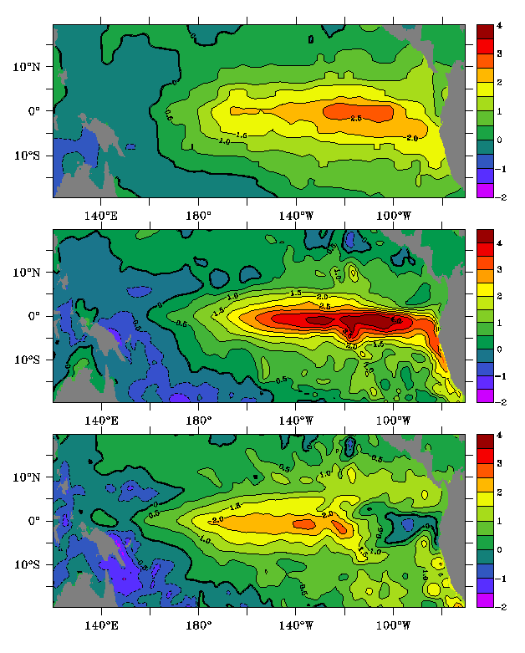
SON SST Anomaly 1877
HadISST1.1
Used to force 20CRv2
SODAsi.2
Ensemble Member 15
SODAsi.2
Ensemble Member 18

Slide 19
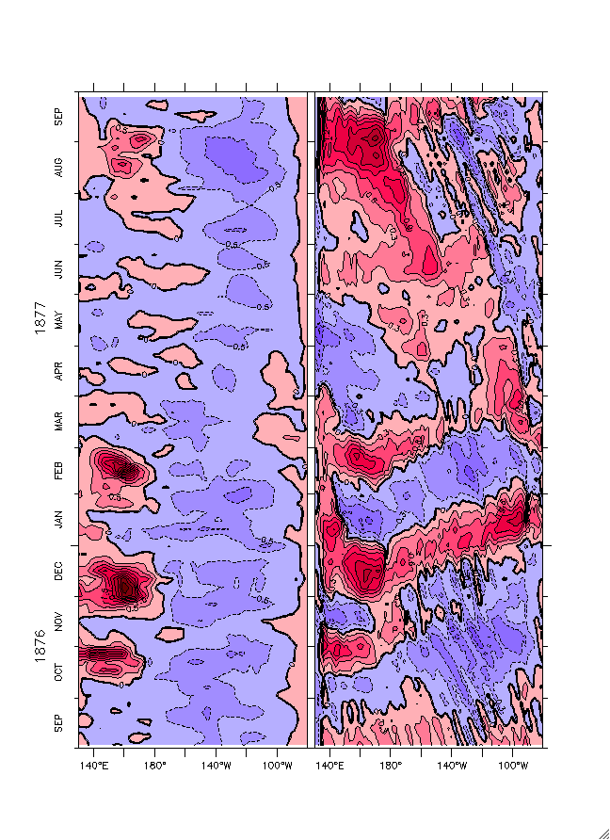
Weak/West Pacific ENSO Ensemble 18

Slide 20
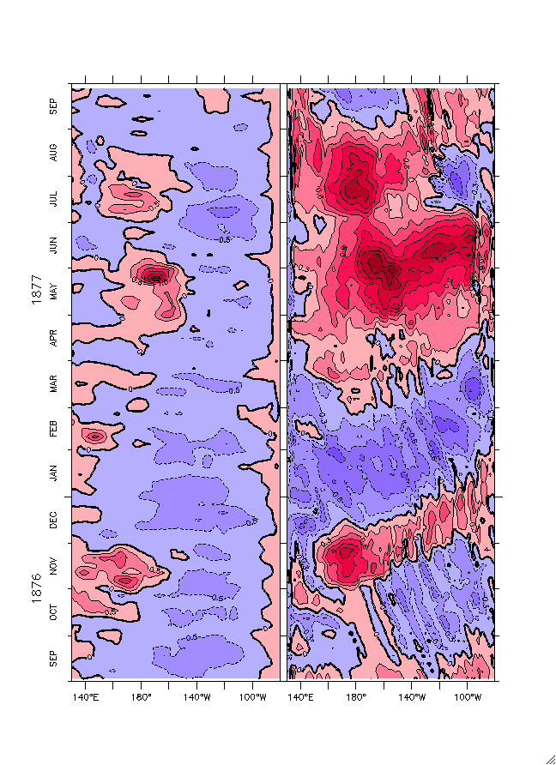
Strong/East Pacific ENSO Ensemble 15

Slide 21
New Directions
OARCA – Ocean Atmosphere Reanalysis for Climate Applications
  20CRv2 forced by HadISST
  SODAsi forced by 20CRv2 (1)
  20CR system forced by SODAsi (2)
  New ocean run forced by (3)

Slide 22
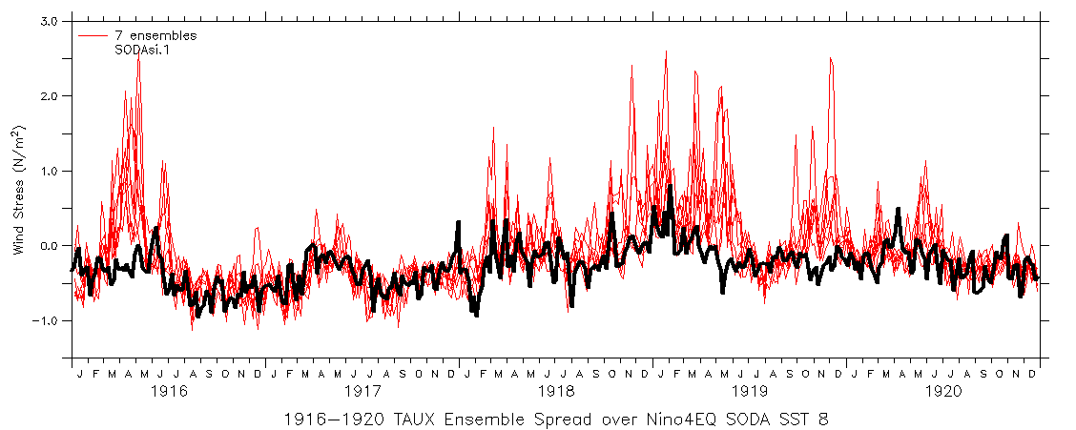
Niño 4 Zonal Wind Stress
- from 1 ensemble member in 20CRv2 (black line)
- from 7 ensembles members of 20CR driven by SODAsi

Slide 23
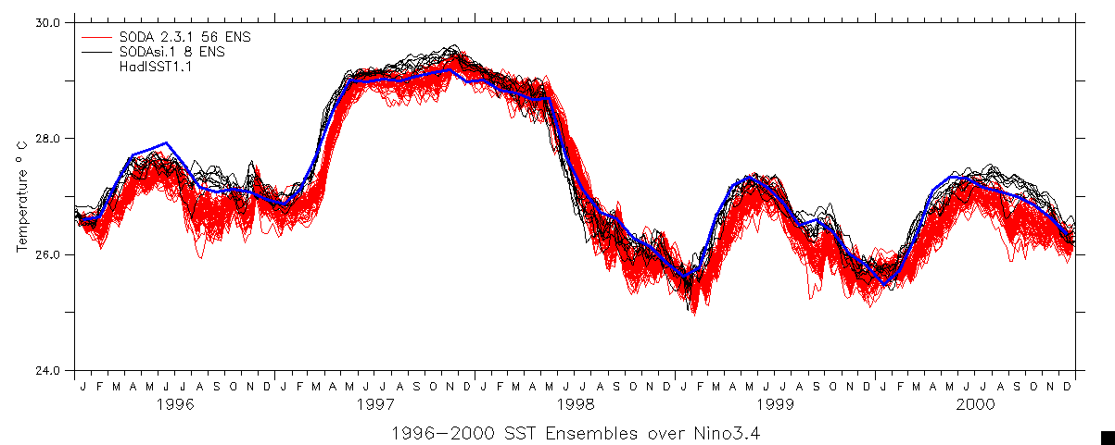
Niño 3.4 SST 1996-2000
Blue – HadIsst1.1
Black - SODAsi.1
Red - 20CR system forced by SODAsi.1

Slide 24
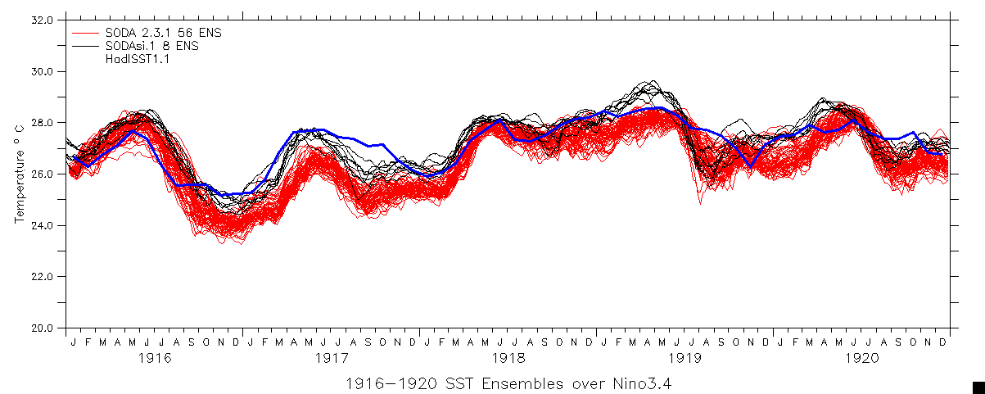
Niño 3.4 SST 1916-1920
Blue – HadIsst1.1
Black - SODAsi.1
Red - 20CR system forced by SODAsi.1

Slide 25
Summary and Conclusions
A new ensemble of historical ocean reanalyses has been completed
The reanalyses show trends and decadal variability….Heat content and dynamic height have quite linear trends from about 1920 to the present.
The historical reanalyses are used to explore ENSO variation over the period from 1871-2011. There is little long term trend in strength, location, or frequency of ENSO…but there is prominent multi-decadal variability.
There are some interesting preliminary results suggesting a coupled historical reanalysis may be feasible.

